Slide 1

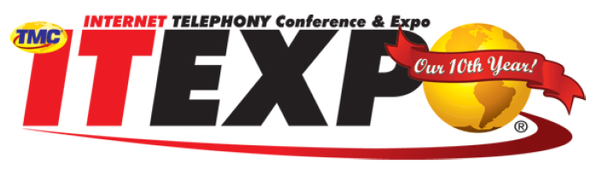
Presence and the Unified User Experience
Kathy Heilmann
Director, Voice and UC Solutions Marketing
Siemens Enterprise Communications
5 October 2010
Copyright © Siemens Enterprise Communications GmbH & Co. KG 2010. All rights reserved.
Siemens Enterprise Communications GmbH & Co. KG is a Trademark Licensee of Siemens AG
Notes:
1
Presentation Objective: Provide an overview of SEN Group's range of solutions and specific elements of our three solution area portfolios (Voice & Applications [including UC and Contact Centers], Network Infrastructure, and Services).
Also, to illustrate the value customers derive from our solutions and what makes us better and different as a provider of enterprise communications solutions and services.

Slide 2

What If You Were Able To ...
Strengthen your competitive position
Reduce costs because:
Be more competitive because:
Be more responsive because:
Your employees use your own in-house conferencing solution, reducing communications and travel costs.
While on a call, your employees can switch from their mobile device to another phone with a lower cost connection.
Your employees can avoid failed communication attempts, reducing cost of network traffic, and valuable time/effort.
Your organization can make decisions and respond to market faster
Your business processes are more streamlined, enabling business to move faster and more efficiently
Your customers can reach your employees in real-time, on the first try
Your employees can see who is available to collaborate on a time-critical customer issue
Your employees can be reached via one published number, regardless of their location or device
Your teams can initiate spontaneous conferencing/collaboration sessions, with a single click
Accelerate responses to your customers
Reduce communications costs and travel expenses
Notes:
Objective: To get your customer thinking of what it would be like to benefit from UC
<click> for animation build
Be more competitive because:
Your organization can make decisions and respond to market faster, through simple, seamless, intuitive communication.
Your business processes are more streamlined and tightly synchronized with your communications, enabling business to move faster and more efficiently
Your customers can reach your employees in real-time, on the first try, eliminating customer satisfaction issues, and increasing revenue opportunities
<click> for animation build
Be more responsive because:
Your employees can see which colleagues or experts are available to collaborate on a time-critical customer issue
Your employees can be reached via one published number, regardless of their location or which device they are using
Your teams can initiate spontaneous conferencing and collaboration sessions, on-the-fly, with one or a few clicks
<click> for animation build
Reduce costs because:
Your employees use your own in-house conferencing solution, reducing your cost-per-minute, and the need for business travel.
While on a call, your employees can switch from their mobile device to another phone with a lower cost connection.
Your employees can avoid failed communication attempts, which save the cost of network traffic, as well as valuable employee time and effort.

Slide 3
Customer Value Proposition:
The Business Case for UC Collaboration
“HARD” “SOFT”
Be More Competitive
Be More Responsive
Reduce Costs
Tactical
Strategic

Slide 4



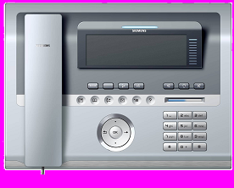
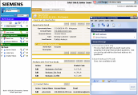
The Unified Communications Landscape
Clara Parker
Connectivity to Telephony & IT Infrastructure
Multi-Modal Client Access Choices
Multi-resource
Collaboration
Presence-based Communications
Unified
Communications
SDK/SOA
APIs, Web Services/Portlets
Business Application &
Workflow Integration
Modular Deployment & Feature Options
Open Application Architecture
Notes:
Objective: Provide a high level overview of the openness and flexibility of OpenScape UC and how this benefits the enterprise, workgroups and individual workers.
OpenScape is an application suite with an architecture that is extremely open and very flexible. This openness enables it to operates with multiple IT infrastructures
It was built on the Services Oriented Architecture (SOA) as its framework, which allows it to easily connect and integrate with just about any other part of your existing communications infrastructure.
It supports connectivity to any PBX and voice infrastructure.
It supports multiple devices and clients access modes. Note: The OpenScape Web Client interface will initially not be available with V3. It will be available with V3R1.
It is modular, addressing various needs and users within the enterprise, and it can be deployed as a Customer Premises Equipment (CPE) solution or as a hosted deployment for service providers. Note: In V3 a hosted solution is only available as a custom built solution using the SDK. The hosted offering will be available in OpenScape V4.
It has a very powerful Software Developer Toolkit (SDK) which we believe is one of our key differentiators. The SDK and a variety of Web Services interfaces allow applications designers to embed OpenScape feature-functions in commercial front-office and business process IT solutions. This is the basis for the contextual embedding of communication services into applications and business processes.
We believe our SDK is easier to use and enables customers to connect OpenScape to disparate technologies. What differentiates our SDK is that it exposes everything, and what we are exposing is of more value.
Note: The Developer edition (aka SDK) is only available to select partners. System Integrators should contact the local Siemens Professional Services organization to request SDK usage and support. In a future release of OpenScape UC V3, the SDK will be generally available to all SIs.
We will review each of these areas in more detail.

Slide 5






A Comprehensive Look at Presence
"Manage my communications..."
"I know who..."
Aggregated presence
  Device & media
  Location
"Tell-me-when"
User-based / device-independent
view of presence & location
Multimedia communications
(voice, video, IM, e-mail, SMS, Fax)
Click-to-call / Conference
Communication Journal
Contact list
Federation
Workflow integration &
automation
"Someone in organization…"
"I control my availability..."
Team presence
Team One-Number-
Service
Team "Tell-me-when"
Team Portal
Team Journal & Contacts
Call screening
Priority calls
Alerts
Rules
"When I'm not available..."
"Someone in universe…"
Unified Messaging
Delegation
Guest portal
Personal auto-attendant
Differentiated
presence
Contact Scout
Social Networking
  Expertise, Keywords
  Presence based
  real-time
  communication
Community Portal
Federation
"When I'm mobile..."
One-Number-Service
Any device access to PBX features
Mobile client
Seamless Device Handover
Toll-Bypass
Schedule assistant
Self-Service portal
Virtual speech assistant
"Collaborate and create…"
Team Portal
Persistent & ad-hoc conferencing/collaboration
Team presence, ONS, "tell-me-when“
Advanced collaboration tools
  Recording / playback
  Virtual speech assistant
  Floor control
Notes:
Objective: This is meant to be a high-level introduction to the kinds of benefits derived from a “complete” UC solution. Introduce the concept of “Reducing Human Latency”, a term introduced by Gartner. Use this slide as an example of what we mean by “open unified communications”, from a user perspective.
Note to presenter: Not all features listed are available with OpenScape UC V3, such as:
SMS, Fax unified messaging (avail in Xpressions)
Federation (candidate for V4)
Differentiated Presence
Toll-Bypass
Schedule assistant
Virtual speech assistant (candidate for V4)
Contact Scout
Social Networking
Expertise, Keywords
Presence based real-time communication
Community Portal
Advanced collaboration tools
Recording / playback
Virtual speech assistant
Team Portal
Team Journal & Contacts
Delegation (candidate for V4)
A complete UC experience allows you to:
Manage my communications – This means I have complete control over how I communicate and with whom, independent of device or location. I manage my presence and how my calls are routed, and I can use any multiple forms of media type. I decide who my most important contacts are and track those calls in my call journal.
<click> for animation build
I know who – Using presence and one number service, I don’t waste time contacting others and I increase my chance of “First contact communication”.
<click> for animation build
Someone in Org – Communicating with colleagues becomes easier and faster because I can see when a team or workgroup is available and I have a “single point of access to pooled knowledge” which accelerates knowledge access across the enterprise as a whole.
<click> for animation build
Someone in Universe – Real time communications can happen outside of the enterprise when the UC application is open and can be integrated with outside applications such as social networks and community portals.
<click> for animation build
Collaborate and create – Teams that collaborate seamlessly are more effective. Being able to quickly and easily setup of conference calls / collaboration sessions, plus know exactly who has joined the call and add those who aren’t with a simple click, gives enterprises an advantage. Decision making is accelerated, speeding up customer and market responsiveness.
<click> for animation build
I control my availability – I publish one number and all my contacts can reach me anywhere/anytime on any device. I can easily adjust my availability and preferred communications device and balance my activities between remaining focused on critical projects or meetings, while ensuring high priority callers such as customers or urgent requests still get through to me.
<click> for animation build
When I’m not available – All my communications can forward to a single unified mailbox or I can assign a delegate to take all my communications. I can also provide Self-Service Options to my callers, which gives them password accessible access to my MS Outlook calendar or stored documents.
<click> for animation build
When I’m mobile - I can stay connected and still be reached from my mobile device or PDA. From a voice portal interface, I can access all the UC features such as accessing and managing email and voice mail and using text-to-speech technology to have messages read over the phone. I can access my MS Outlook calendar, task lists, and contacts and even make changes to my presence status.
Note: The speech recognition component of the voice portal will be available with OpenScape UC V4)

Slide 6
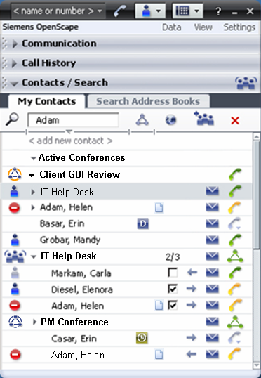

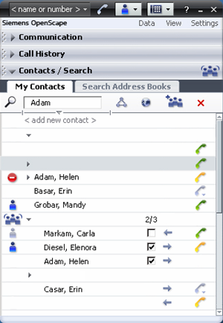
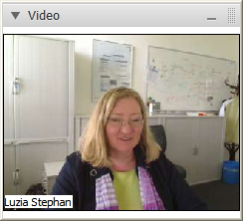
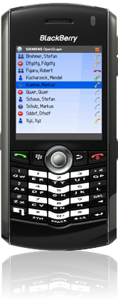
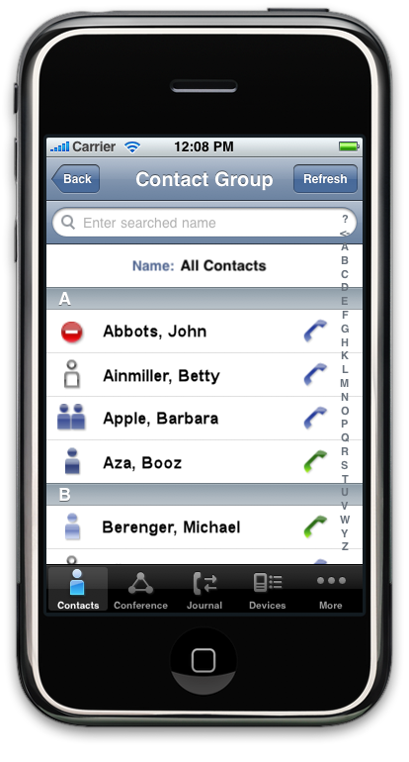


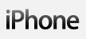

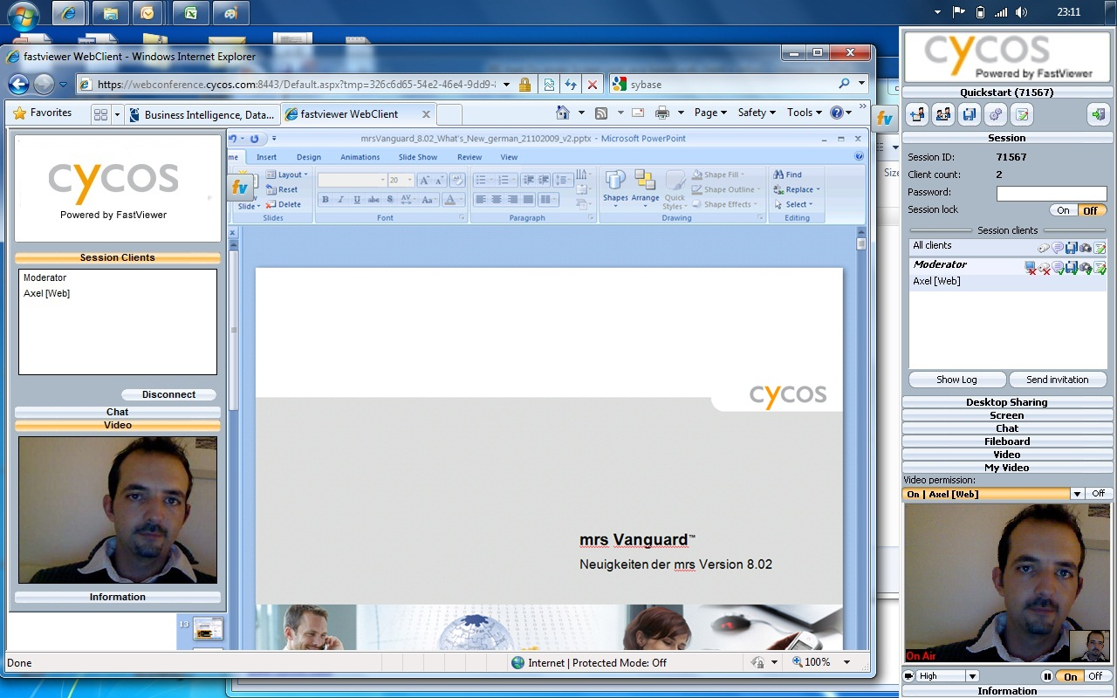

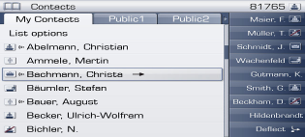
UC Clients Define the User Experience
Video Client
Mobile Clients
Desktop Client
Voice Portal Client
Client Access Choices
Multi-Media and Multi-Modal
Easy to use GUI & voice interface
Rich, intuitive user experience
Web Collaboration Client
Phone Client
Notes:
Objective: Describe the various client options with OpenScape UC and how this benefits the enterprise, workgroups and individual workers.
Here you see the different client options available for accessing OpenScape UC. There are two graphical user interfaces: the desktop client that uses minimal space on your screen, and the web client for accessing OpenScape UC from another desktop. You can also use your PDA to access the features of OpenScape UC while traveling, or alternatively you can use the Voice Portal when you don’t have access to your PC or PDA.
Note: The OpenStage client will be available with V4 in 2009.

Slide 7
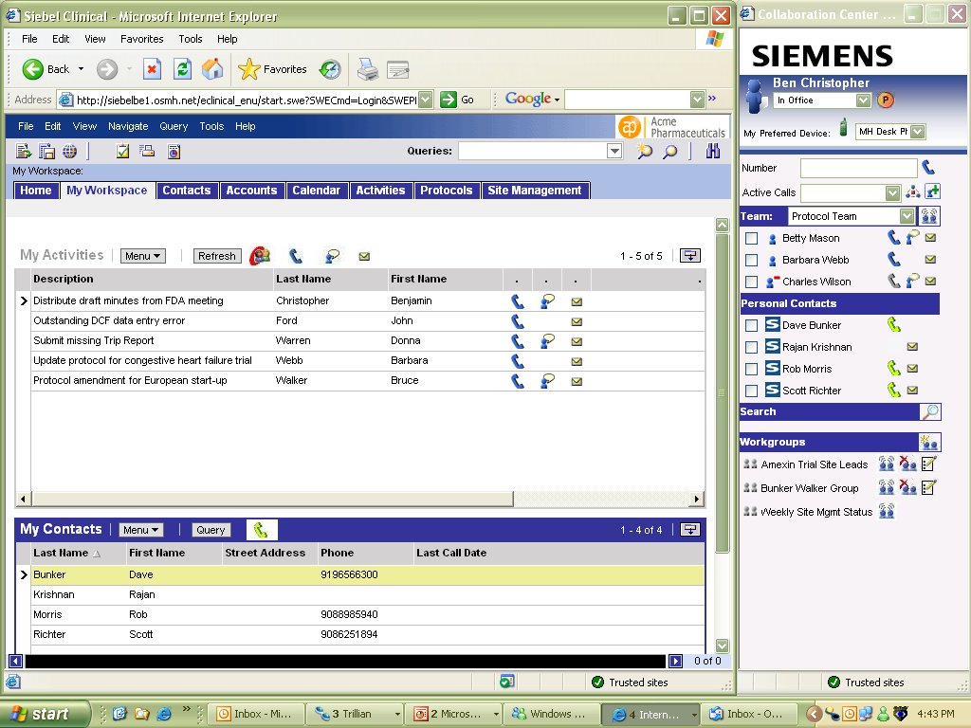
UC Integrated into Business Processes
Context-Sensitive
Presence-Awareness of Internal Parties
Click-to-Contact Key Internal and External People
Click-to-Conference Project Teams
Expedite Resolution of Time-Sensitive Issues
Notes:
Objective: Describe the great business value realized when business applications are integrated with OpenScape UC. Show the pre-packaged integration with Siebel Clinical (CTMS).
Scenario:
Here we see OpenScape functionality embedded into the Siebel (Oracle) Clinical application used for Clinical Trials Management.
<click> for animation build
In this example, OpenScape brings click-to-contact capabilities, including click-to-call, click-to-IM, click-to-email, and click-to-conference, directly into the application used by Clinical Research Associates, Clinical Study Managers, Project Clinicians, Site Coordinators, Clinical Data Managers, Clinical Trial Administrators and others.
By embedding real-time communications capabilities into the CTMS application used by all the key participants we are able to accelerate responsiveness and collaboration throughout the trials process. Information is shared faster, clarifications take place earlier, and essentially unnecessary wait time is eliminated at every step.
With OpenScape’s full-spectrum presence embedded into the CTMS application, clinical trials teams stay better informed and better connected.

Slide 8
Why You Need Unified Communications
Reduce costs
Be more responsive
Be more competitive
Reduce annual travel and mobile communication costs by $2,600 per person
Save over $1,000 monthly per employee, due to fragmented communications
Increase team and process productivity by eliminating at least 5 hours of cumulative latency per person per week
Source: Insignia Research sponsored study, download from www.siemens-enterprise.com
Notes:
Objective: This is the wrap-up slide. Summarize the advantages of OpenScape UC.
The bottom line is that enterprises deploy UC because they want to be more competitive, more responsive and reduce costs. As evidenced by the few customer examples I showed you, OpenScape UC is a proven solution to help you do just that.

