Slide 1
Marketing Automation Will NEVER Replace Sales
Jeff Dworkin
jeff.dworkin@marketingautomaton.partners
calendly.com/jeffdworkin/
@mktgpartner

Slide 2
“There will always, one can assume, be the need for some selling. But the aim of marketing is to make selling superfluous. The aim of marketing is to know and understand the customer so well that the product or service fits him and sells itself.”
Peter Drucker
The Essential Drucker

Slide 4
Our job as marketers is NOT to make sales superfluous, it is to make them Closing Machines by carrying as much of the burden for them as we can.
If closing was easy, we’d all be salespeople.
Jeff Dworkin
IT Expo 2017

Slide 5
Every day in the life of a sales person

Slide 6
We buy on emotion and justify with logic
James Chartrand
Men With Pens

Slide 7
The Irreplaceable Skills of a Salesperson
Assertiveness
&
Empathy

Slide 8
The Customer Journey
Notes:
The relationship between getting a prospect’s attention, engaging them with meaningful content, and moving them along their journey to becoming a Marketing Qualified Lead.

Slide 9
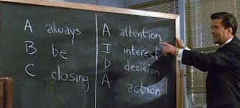

Slide 10
A
Attention
I
Interest
D
Decision
A
Action
Notes:
Awareness – Consideration – Decision
Attract-Convert-Close-Delight
Possible Solution-Interest-Research-Evaluation-Narrowing the Field- Social Vetting-Negotiation-Decision
Awareness – Evaluation – Consideration
Person or Committee
Sales Model
What marketing has [CLICK]

Slide 12
The Customer Journey
Attention
Interest
Decision
Action
Notes:
Many ways to slice up and look at the customer journey. Is it all just symantics. Sales focused view of the Customer Journey

Slide 13
The Customer Journey
Acquisition
Engagement
Qualification
Customer
Notes:
More customer centric view of the customer journey

Slide 14
The Customer Journey
Suspect
Prospect
Engagement
Marketing Qualified Lead
Sales Qualified Lead
Opportunity
Customer
Notes:
Better granulized view of the journey allows us to better target our efforts and measure the results.

Slide 15
The Customer Journey
Suspect
Prospect
Engagement
Marketing Qualified Lead
Sales Qualified Lead
Opportunity
Customer
Notes:
This is the very top of the funnel. In the past this was what marketing was all about. Get their attention, branding, get some contact information and pass them to sales.

Slide 16
The Customer Journey
Suspect
Prospect
Engagement
Marketing Qualified Lead
Sales Qualified Lead
Opportunity
Customer
Notes:
The very first efforts at segmenting and qualifying someone before we send them off to sales. Can we at least tell sales in what products or services they are interested. Do they have a budget. Think about a trade show. Marketing tires to keep the chatchky collectors and tire-kickers away from the sales team.

Slide 17
The Customer Journey
Suspect
Prospect
Engagement
Marketing Qualified Lead
Sales Qualified Lead
Opportunity
Customer
Notes:
Now it is up to marketing to start engaging with prospects. Combination of both inbound and outbound techniques. Nurture campaigns, targeted content, build trust.

Slide 18
The Customer Journey
Suspect
Prospect
Engagement
Marketing Qualified Lead
Sales Qualified Lead
Opportunity
Customer
Notes:
This is now our goal. Marketing Qualified leads are what sales tells us they are.

Slide 19
What is Different Now
Marketing Owns the prospect deeper into their journey
Showing the impact of marketing on Sales
Data Collection
Not just leads. Marketing Qualified Leads.

Slide 20
What Makes a Marketing Qualified Lead

Slide 21
It Depends
It could be a single “trigger event” that your sales team dictates.
Someone submits a “Contact Me” form
Someone downloads a particularly important piece of content
Behavior indicates that they have extreme interest
Accumulated behavior (Lead Score) indicates they should be contacted by sales

Slide 22
An MQL is what Sales Says It Is!

Slide 23
Handing off to sales and closing the feedback loop
Notes:
CRM Integration. Notify Sales/Sales Managers. Close the Loop back.

Slide 24
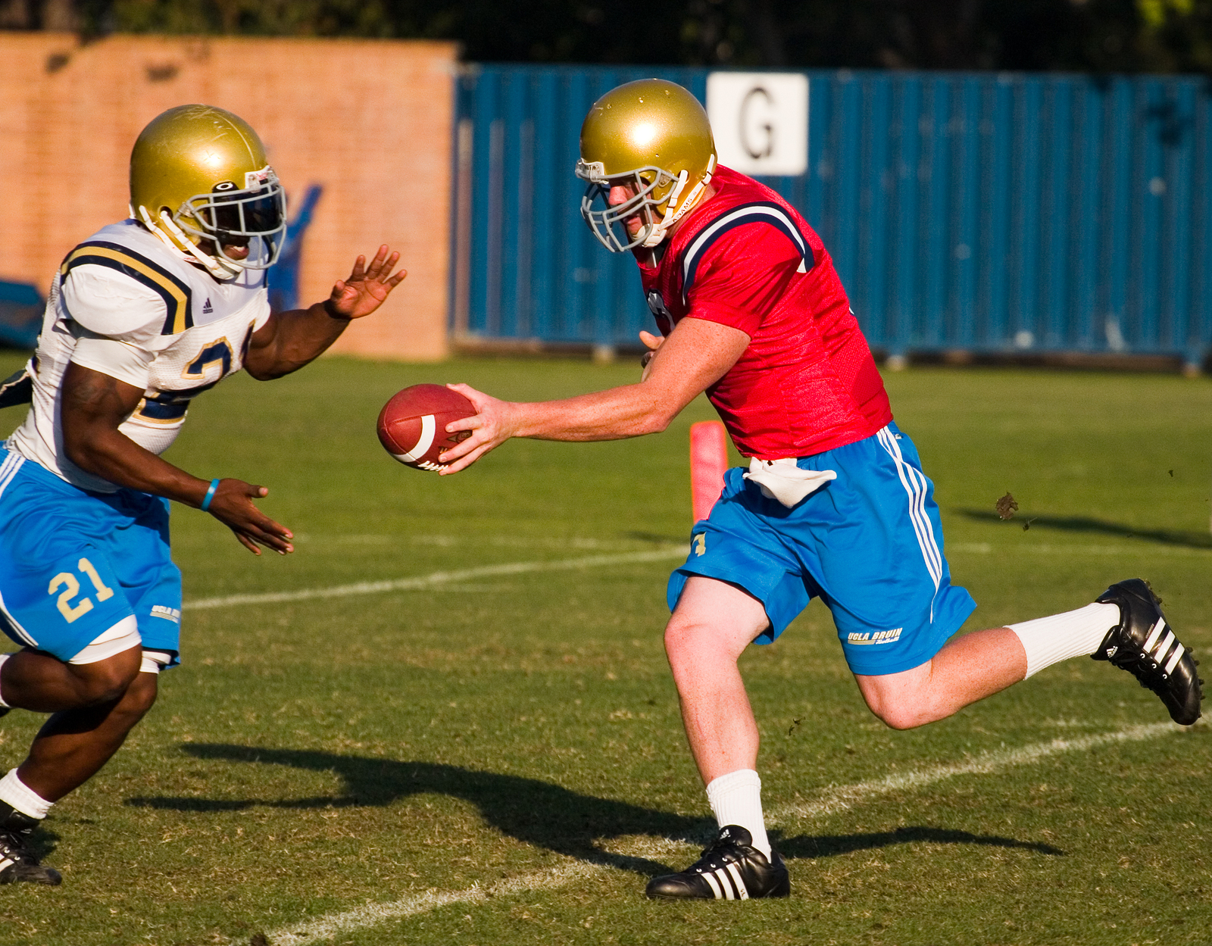
Handing Off
This is not an overly complex issue but it can be hard to implement if it requires Sales to do anything beyond their Normal process
Blind Send or Forcing an Ack
What if sales rejects the MQL?

Slide 25
CRM Support
Feature
Best Practice Tip
Not Necessarily CRM Integration
Record some basic CRM Information
Value of Lead
% To Close
Not having native integration with the CRM system that the company uses can kill the success of a MAP Initiative
Notes:
This is what happens when you don’t have CRM integration and full support of executives and sales teams.

Slide 26
Closing the Loop
What Did Close
What Did NOT Close and WHY
With out this, you are doing marketing in a silo

Slide 27
Fail Here and You Fail….Period

Slide 28
Horizontally Integrated Marketing
Notes:
Conversion used to be that moment when we got email address (or other contact information). That is when it changes from inbound to outbound. Remarketing makes that point of demarcation at bit fuzzy.

Slide 29
Move an MQL to Sales

Slide 30
Wrap Up
Marketing is here to support sales, not replace them
Marketing owns the lead deeper into the funnel, but it still takes a salesperson to close
Your sales team defines an MQL
Make sure the hand off is clean
Close the loop
Own the Data – Prove your ROI

Slide 31
Marketing Automation Will NEVER Replace Sales
Jeff Dworkin
jeff.dworkin@marketingautomaton.partners
calendly.com/jeffdworkin/
@mktgpartner

