Slide 2
Dual Mode Connectivity for M2M
Bill Molesworth
Vice President, Terrestrial Wireless Services
ORBCOMM Inc.

Slide 3
Intelligent Assets Are Everywhere
Transportation • Heavy Equipment • Maritime
Industrial/Remote Assets • Government

Slide 4
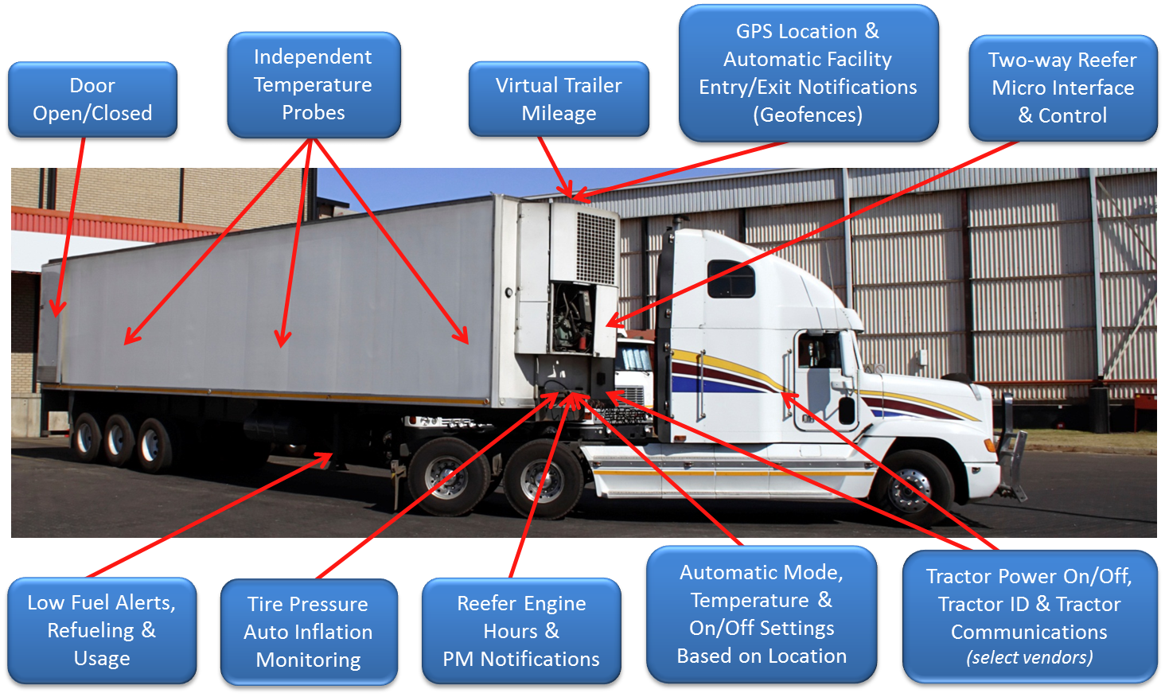
Example: Intelligent Reefer Management

Slide 5
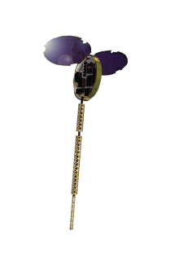
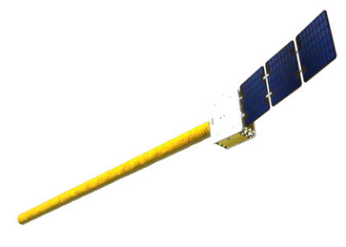
How Do You Connect Them?
Low-Earth Orbit (LEO) Satellites: 27 OG1 LEO satellites and 15 ground stations providing global two-way data service
Coming Soon: 18 next generation OG2 satellites launching from mid-2013 to 2014
“Terrestrial” Wireless Networks
“Dual Mode” Networks that combine LEO Satellite and Terrestrial Wireless Networks

Slide 6
What Is "Dual Mode” Connectivity?
Blends satellite coverage with cellular bandwidth for optimal connectivity & value
Enables high bandwidth messaging when needed
Brings higher data throughputs and voice capabilities
Fills in gaps in terrestrial coverage
Multiple redundant connections
Global network service footprint
Least cost routing

Slide 7
Key Considerations
Requires a secure, scalable Web-based platform to tie satellite and terrestrial networks together
“One view” of a dual-mode subscriber is not easy
Management of provisioning and messaging needs
Billing and usage analysis
Message tracing, quality of service and reports for over-usage and alarming
APIs for automated capabilities & subscription management

Slide 8
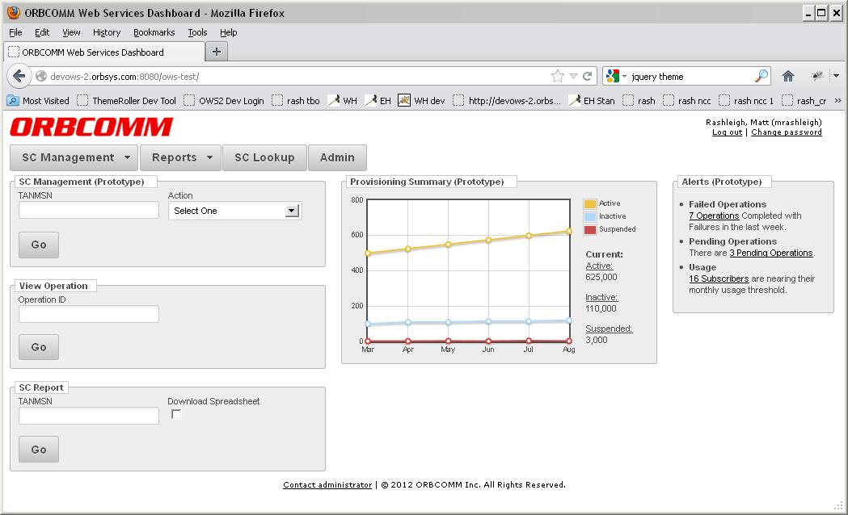
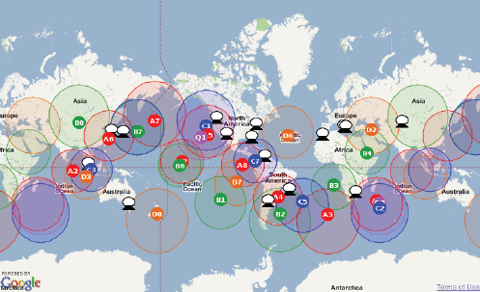
Service Management
Control, Control, Control
Visibility over networks is key
Management of airtime-related expenses
Tools for self-care troubleshooting, analysis and issue resolution
Enhance device reliability and longevity

Slide 9
Thank You!
ORBCOMM Inc.
703-433-6300 • 1-800-ORBCOMM
sales @orbcomm.com
www.orbcomm.com

