Slide 1


Slide 2



Using Cryptographic ICs For Security and Product Management
Misconceptions about security
Network and system security
Key Management
The Business of Security
Product Management
Christopher Gorog, PMP
chris.gorog@atmel.com
February 2, 2011

Slide 3
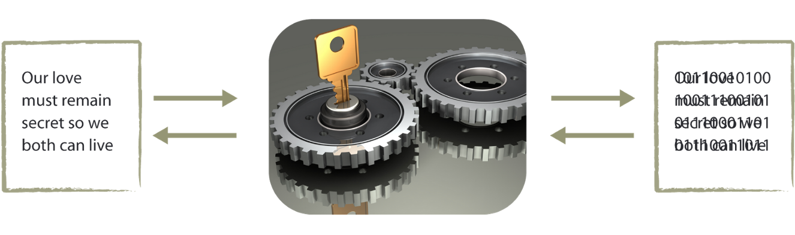
Misconceptions about Security
Encryption
Encryption Key
Encrypt
Commonly used for data confidentiality
Information
Encrypted
Information
Decrypt
I have encryption, isn’t that all I need
Encryption is a property of data
  Data is scrambled using mathematical equations
  Data can be encrypted in transit, or at rest (memory)
  Encrypted data is unusable without the proper key
Process of using encrypted data poses the security risk
  Keys to encrypt and/or decrypt have to be available
  Challenge is to control who or what has access to these values

Slide 4
Transmission Networks
Composed of many different types of systems
Vast difference in resources (processing, memory, bandwidth, etc)
Making the network operate together requires a unified security model that is the same in each system
What needs to be considered for each system to get them all seamlessly working together

Slide 5
Components of System Security
Initial Root of Trust (secure boot)
Validation of operating software
Identifying who is on either end of communications (Authentication)
Confidentiality of data (Encryption)
Verify communications are unaltered in transit (Integrity)
Management and Storage of Identity (Keys and Certificates)
Single system security model

Slide 6
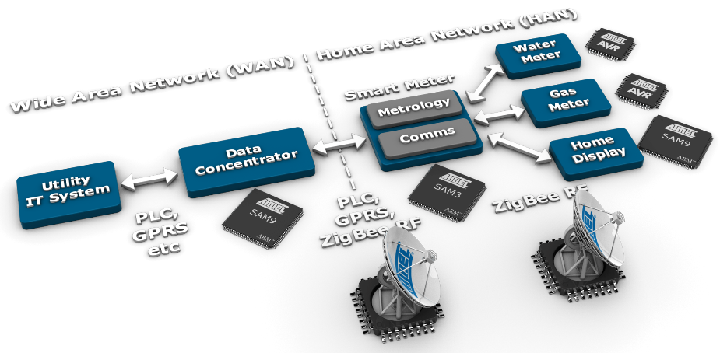
Smart Grid Networks
Typical Advanced Metering Infrastructure (AMI)
Network of microsystems interconnected
Each component of system security implements cryptography
Standard key management for each node
Notes:
Atmel portfolio includes nearly all the basic blocks required to build a smart metering infrastructure. From a stand alone electronic meter or gaz meter you can build using an 8-bit AVR micro with outstanding low power and analog performances to a full AMI or Smart grid architecture that will use both 8-bit and 32-bit MCUs as well as RF chip and software stacks and touch solutions.

Slide 7
Cryptographic IC for Network Management
System of unmanned devices
Security model spans the confines single device
Management of network as a system
Augmenting, updating the network
Rotating and refreshing
Recover from event or incident

Slide 8
Cryptographic IC for Product Management
Ability to uniquely identify each and every product
Where it has been, who has used it, where was it produced, etc..
Valuable data that allows 100% product verification anywhere
Product chain security

Slide 9
The Business of Security
Justifying the ROI on addition of a security IC
Obvious result – network security and identity protection
The best selling point for security is as a business enhancement
  Management of deployed products
  Organization of supply chain
  Positive enforcement of usage
  Verification of quality products

Slide 10
Product Management Solutions
Enforcing a licensing model
  How to ensure that only licensed partners can use your design
  How to control numbers of licensed products on the market
What happens to companies products after they are released to production?
  Many companies do not know the answer to this question
  Many that have tried to find out do not like what they discover
Need a positive control of all aspects of supply chain
Customer Quote “We have more products sold under our name that are not produced by us than what we produce”

Slide 11


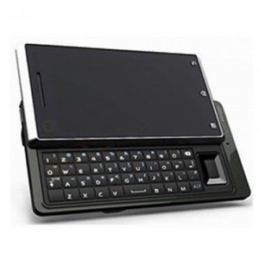


Supply Chain Management
Collect market trend and sales data
  Ensure revenue streams
  Track subcontractors success levels
  Market saturation control
  Limit warrantee and technical support cost
  Pricing control
  Control model compatibilities
  Track end user information
  Supply Chain auditing

Slide 12
Optional Material

Slide 13
Additional Product Uses
Firmware and software protection
  Firmware root of trust
  Firmware download protections
Confidential file protection
  Media download
  Facilitating key exchange
Encrypting memory contents
User authentication
  Tokens, dongles and two factor logon
Call center support
Battery authentication
Networked device security
  Peer-to-peer systems
  Key Management (but used in many apps)
  Protecting communication
    Signatures and Certificates
    Verifying and encrypting
    Wireless network systems security
Removable component authentication
  Consumable, peripheral, daughter card, etc…
Mutual authentication

Slide 14
Key Management
Key Management
  Entire network becomes one system
  System attributes
    Load keys securely
    Provide uniqueness
    Enable Authenticate (non - repudiation)
    Operate uniformity (synchronize with network)
    Refresh implementation (key rolling)
    Prevent tamper (software / key extraction)
    Etc.
Modularity
  Core security uniformity
  Address all required attributes
  PKI, certificates, CA

Slide 15
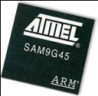
Network Key Management
Encrypted PII
PII
AES
Verify
Key
Key
Key
Key
Key
Key
Key
Key
MAC
Every node produces unique and one-time use session keys
Session keys can encrypt Personally Identifying Information (PII)
Any node can be authenticated uniquely on network
Each node can produce the same key anywhere on the network
  Create cryptographic communication keys on the fly
  Verify communication transmission

Slide 16
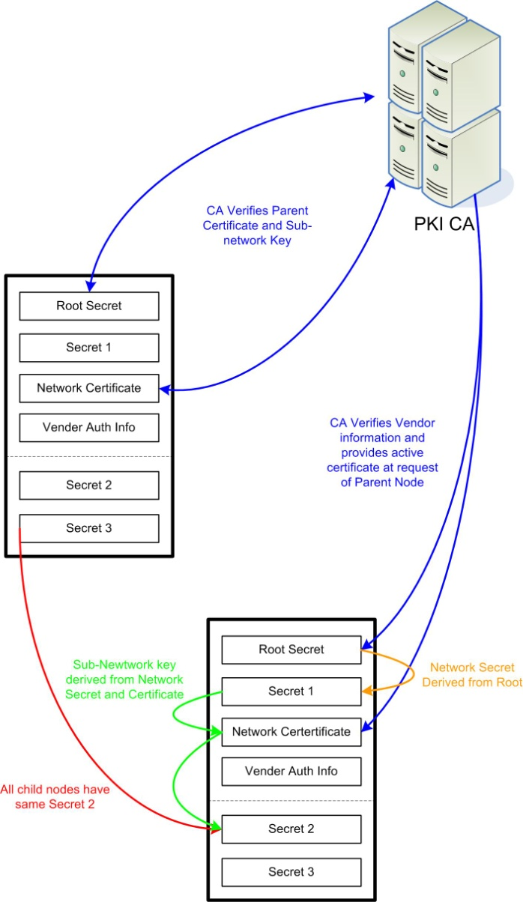
Authentication and Key Management

Slide 17
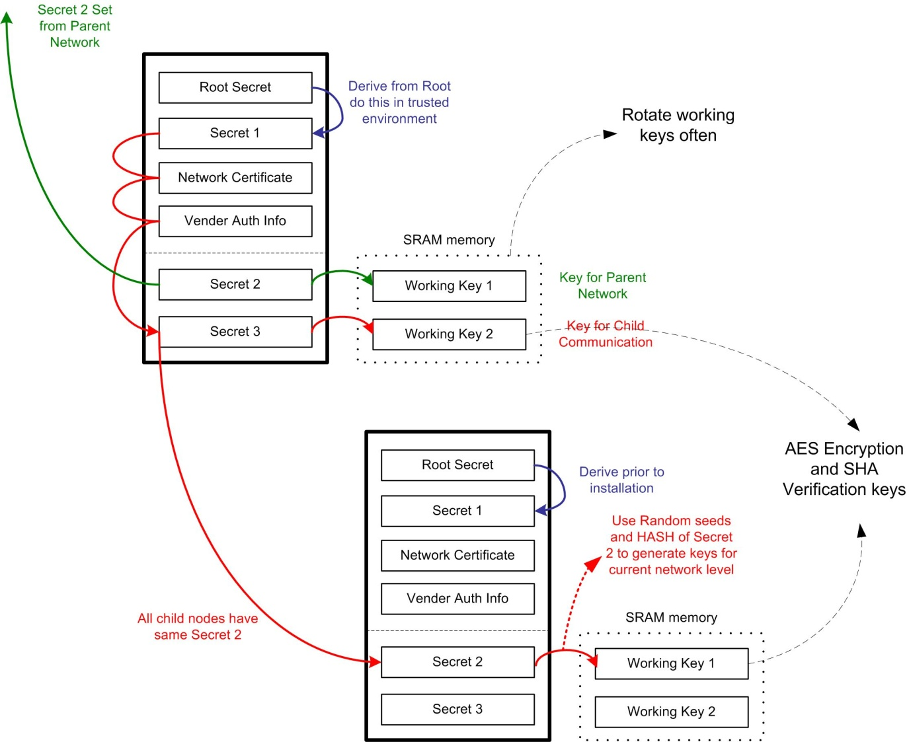
Key Management

Slide 18
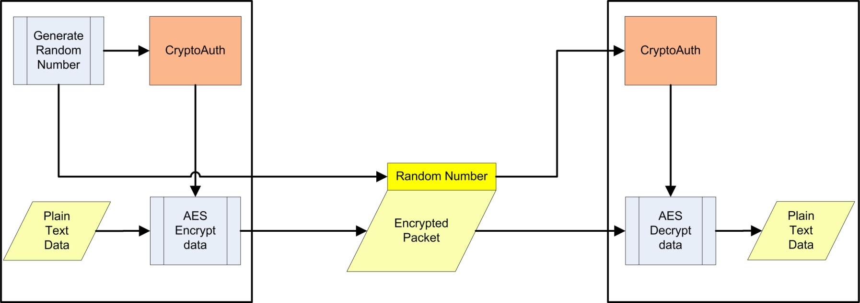
Working Key Generation
Hash &
Secret
Hash &
Secret

Slide 19
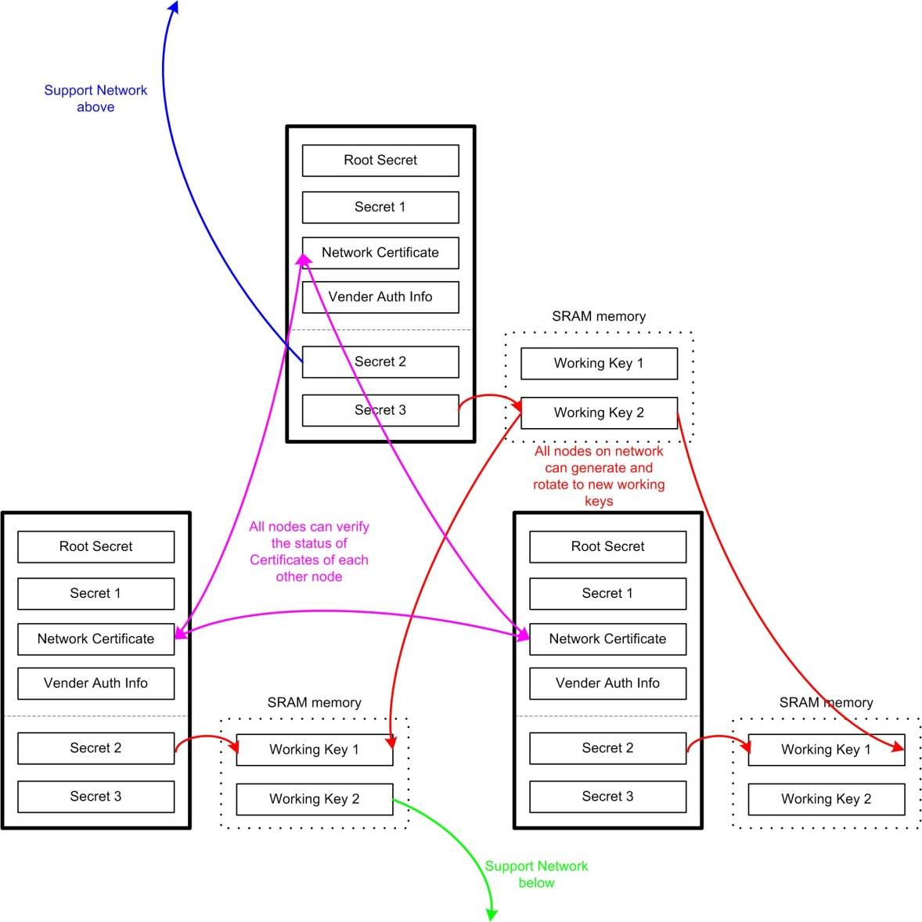
Key Utilization

Slide 20

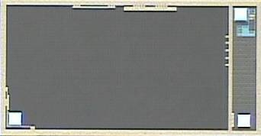
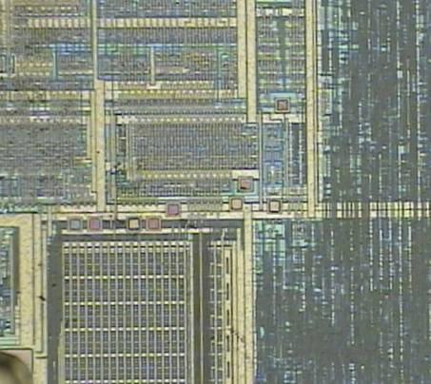
Why Hardware Security is Better
Key Detection on Hard Drive Disk
ICs architected from ground up for security
  No exposed regular structures, no exposed test capability
  Internal clock generation, power regulation, environmental tamper detection
Keys stored in memories have additional layers of protection
Security procedures and protocols are hard coded, not subject to attack
Only well protected information crosses the security perimeter
Tamper-resistant shielding
Standard chip design

