Slide 2
mHealth
Olivier Amiot
Director, Enterprise Marketing
Sierra Wireless

Slide 3
mHealth Market & Growth
Healthcare is a critical issue globally – demand is increasing, costs are rising, population is aging
Significant gains (cost, quality of care) to be had using wireless technology through remote monitoring of chronic disease conditions
73% of consumers in US are ready to use remote care monitoring services (PWC)
Wireless Healthcare Revenue forecast (2010-2013 US) US$596 Million to US$4.4 Billion (2009 Parks Associates)

Slide 4
mHealth Issues and Opportunities
Wireless broadband implementation and applications are complex to develop and deploy
Insurance and health reimbursement system for Telehealth services remains a key enabler of the business model
Enormous long term benefits and market potential, may enable new ways to manage health, disease and life-style
Regulatory agencies can be stringent, differ from country to country, and make it extremely complex to structure an open mHealth platform
Notes:
Bullet 1: as medical companies core businesses and skills set are totally different. Substantial cross sector under
standing and customer support is required.
Bullet 3: Insurance and health reimbursement system for Telehealth services remains a key enabler of business model
Bullet 4Human benefit and market potential is huge, and would enable new ways to manage health, disease and life-style

Slide 5
mHealth Platforms
Early FDA 510k cleared Telemedicine based on vital sign measurement and Store/Forward data transfer
Performing well based on intended task
Closed system and not programmable
Limited to single device, not covering multiple use cases
Costly
Ecosystem offers a wide variety of user interfaces, applications, services and devices
Main challenge for Heath provider is to integrate the technology and still be FDA 510k cleared

Slide 6
Open platform model
Configurable and programmable to support new services or applications
Able to integrate multiple devices from different manufacturers, patient interfaces, medical apps and content in common HIPPA, FDA cleared database and dashboard
“Open yet controlled” is the challenge to meet FDA 510K cleared criteria

Slide 7
Open & Controlled
Controlled environment means platform provider is able to FDA clear the application tool structure by which the application is built
Very little or no FDA required for new apps
New devices are FDA cleared by device manufacturer
Control the release of apps on app store to ensure interoperability between 3rd party apps and devices

Slide 8
The Open Platform
Connect ANY device or patient to ANY Caregiver System
Customer Health Platform
The Server Platform
Measurement & HID Devices:
Bluetooth, USB, Serial, Zigbee, Zwave,
Any secure Internet Connected Device
or Provider EMR
FDA 510(k) Cleared

Slide 9
Summary
Enormous market growth & potential
Pre certified wireless modules are key to unlock emerging device and platform potential
Programmable wireless modules support encryption of identifiable health data to meet HIPPA requirement for FDA cleared database; are suited for portable devices
Apps and services will be generated from devices and an open and controlled platform
Notes:
and dashboards reducing Healthcare challenge as well as time to market.

Slide 10
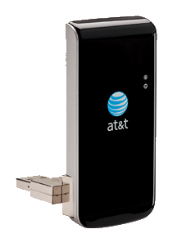
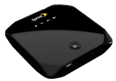
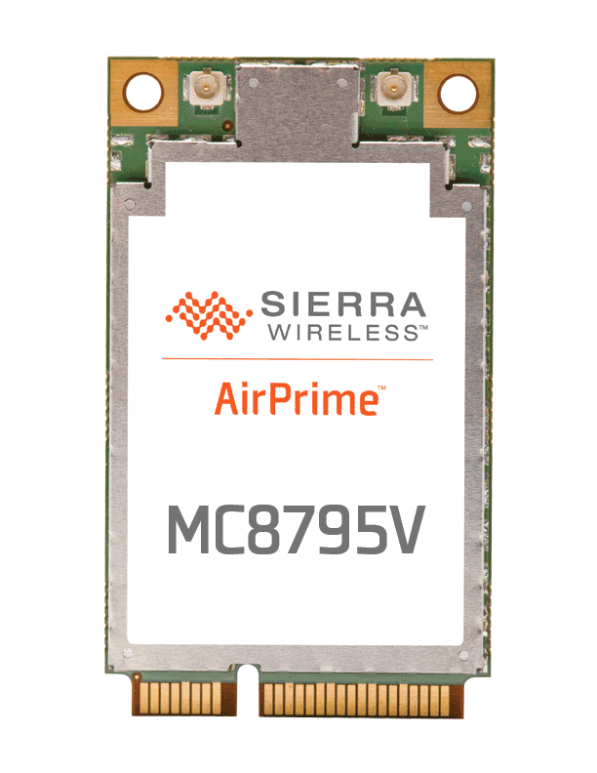
Sierra Wireless Overview
Global Leader in Mobile Broadband & M2M
Most innovative Mobile Broadband Device vendor ^{(ABI )}
Leader in embedded modules, gateways and routers ^{(Revenue)}
Fast to market with comprehensive Service Delivery Platform
Worldwide sales and support
R&D facilities in Canada, US, France and China
Leading operators and manufacturers around the world count on Sierra Wireless

Slide 11
Thank You !

