Slide 1
4G Operator experiences: Methods to maintain a good reputation
4GWE Miami, Feb 2010
Friday - 2/4/10. 10:15-10:50am

Slide 2
VSS Corporate Profile
VSS Monitoring, Inc. is the leading innovator of Distributed Traffic Capture Systems™ and Network Taps
Founded 2003
Headquarters San Mateo, California
90+ employees worldwide
Channel focused (40+ International Resellers)
Technology alliances with major system integrators and analyzer OEMs
Japanese office opened Q3 2007
China office opened Q4 2008
UK office opened Q2 2009
Offices in New York and Washington, D.C.
Notes:
Core Competence: Network Device Engineering. While VSS maintains a large portfolio of standard taps, our core competency is in the area of R&D, specifically in Distributed Traffic Collection. Since company inception, we have been innovation leaders.
First to Introduce:
● Aggregation
● Selective I/O mapping
● On-board web-servers (to enable distributed monitoring)
● Inline / Span Configurability
Our Distributed products feature remote management, high-port density aggregation, inline/span options, data-injection, I/O mapping, filtering, port-bonding, extensive management options and diagnostics, secure access, and easy-to-use GUI.
We have global coverage, and international sales offices. All R&D and manufacturing done in the silicon valley, where we are able to maintain control over quality!

Slide 3
Customers & Partners
 | Telecom | Enterprise | Government
Customers
Partners

Slide 4
Agenda
Session premise
Surmounting the 3G carryovers, incorrectly dimensioned backhauls, loss of critical debugging packets, issues with SPAN ports, the expense of 10G tools, aggregation of traffic between 1G/10G networks, detecting microbursts – just some of the operational experiences coming to light from the recent rash of 4G deployments across the country. In this talk, Andy Huckridge will take you through many of the initial deployment issues and shed light as well as methods to maintain a good carrier reputation in a confusing 4G world.
Discussion
Q&A
Notes:
The Agenda for this presentation will flow as so: Basic company background, intro to VSS Distributed Traffic Capture Systems, a look into our product portfolio, and a summary with time for questions.

Slide 5
What are the challenges along the road ahead?
Network Complexity
Flattening of network = New network entities / protocols
Evolving Standards
Multiple-4G architectures proposed for IMT-Advanced
Economics
3rd party overlay IP services beyond operators’ control
End User Experience
Circuit Telephony migration to Packet LTE network
CAPEX / OPEX constraints
New monitoring requirements to ensure QoE / QoD
Real time access to user plane & control plane
3.5G, LTE, WiMAX, LTE-Advanced, IMS, Femto…
Revenue / Traffic growth not aligned
Rapid troubleshooting / report / repair
Security & Compliance
Corporate compliance (e.g. SOX)
Lawful interception
Revenue opportunities through sophisticated SLAs
Increasing number of proprietary monitoring systems
Notes:
(VSS recognize these LTE specific monitoring challenges)
VSS views specific challenges in 4G Monitoring to be summarized into 5 major categories.
Network complexity as a result of network flattening due to IP, combination of new standards and legacy systems force operators to adhere to their tight budget.
Monitoring in 4G is not only about network level performance but ensuring end user experience as new 3rd party IP services are overlay onto the network, while ensure the network is in compliance and secure from data breach or cyber attacks.

Slide 6
Learning the lessons from the past. Real life 3G deployments
Case Studies

Slide 7
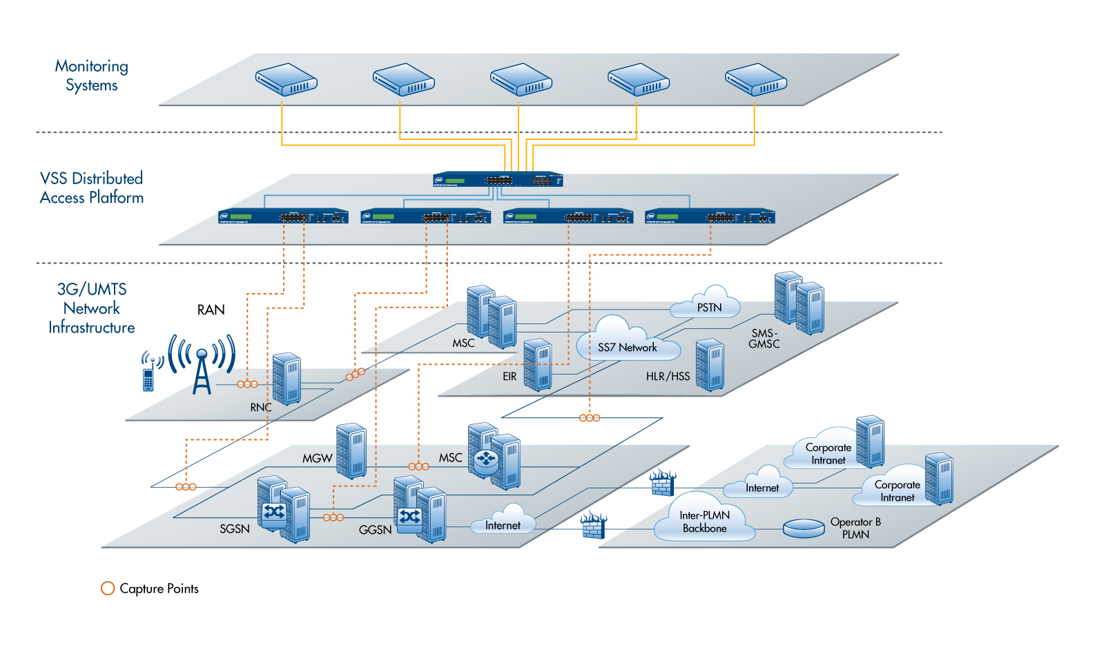
Case Study: 3G/UMTS Network
Challenges:
IMS/Triple/Quad Play.
Capture traffic from multiple locations for proactive QoE monitoring and signaling analysis
VSS Solution:
Centralized Monitoring via selective aggregation and session-aware load balancing.
Custom filtering for each monitoring system to receive only the traffic of interest
Results:
Reduced total monitoring CAPEX / OPEX by 70%
Reduced number of analyzer from 100 to 14
Improved visibility to voice quality and error
Simplified architecture
Protocol Analyzer
Gn/Gi
SMS/MMS Probes
Forensics / Recorder
VoIP (media)
VoIP (Signaling)

Slide 8
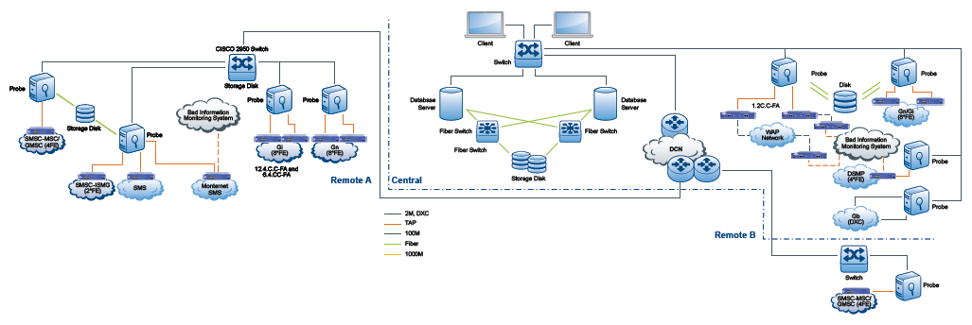
Case Study: Chinese Mobile Operator / GPRS
Challenges:
Solution to monitor SS7, WAP, MMS, SMS and other IP data
Previously installed competitors low end low density taps, unable to scale as services expand
Customer behavior analysis
Monitoring cost out of control
Capacity planning of SS7 and data links
VSS Solution:
High density intelligent 10/100 taps
Aggregation taps from multiple locations to consolidate and centralize signaling analysis
Custom filtering to MMS, SMS and Sigtran/SS7 monitoring
Results:
Reduced capture cards ratio by 600%
Reduced MMS failure rate down to 1%
Provided additional port capacity to scale future tools and across provinces
Eliminated use of SPAN ports

Slide 9
The Visibility Problem
Network Monitoring 2.0

Slide 10
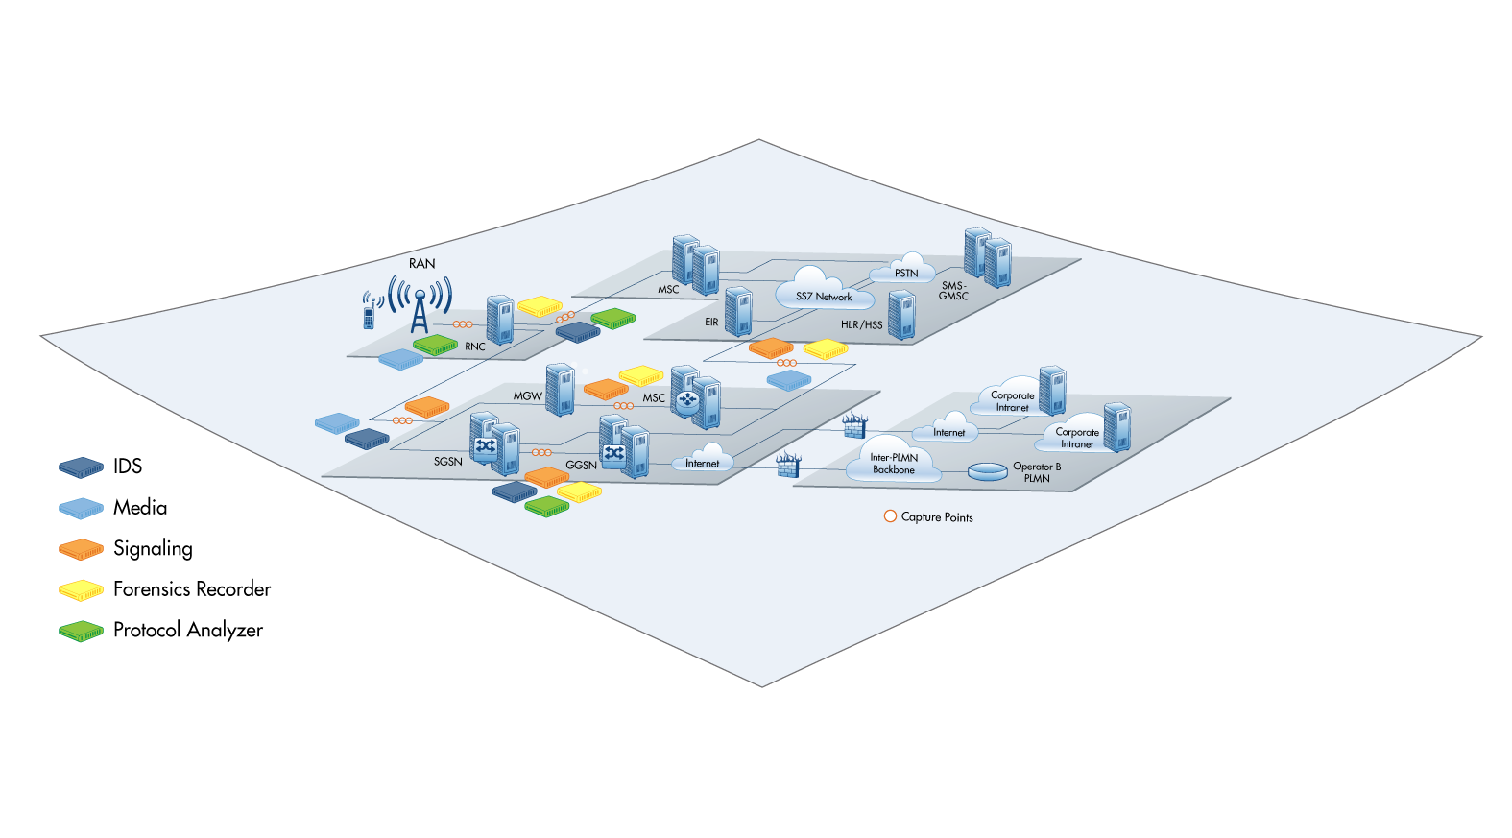
Network not fully visible: Network Monitoring 1.0
Situation
Tools and probes are deployed across many interfaces
Access by SPAN or basic network taps
Different tools for different IP services (VoIP, IPTV, user/control plane, protocol analyzer, SLA mgmt, IPS/IDS, DPI, etc.)
Challenges
Physical access / blind spots
Network complexity
High management overhead
CAPEX / OPEX – management overhead
Tools scalability / performance (1G / 10G)
Fragmented monitoring creates further performance and complexity problems.

Slide 11
What is the visibility problem?
Services create revenue only if they are deployed… Monitoring is essential to make sure the services stay deployed...
Deployed solutions are increasingly complex.
Traffic on hockey-stick growth curve.
Slow to troubleshoot, manage and monitor change.
Proliferation of monitoring tools create physical access contention to SPAN ports.
Traffic volume at high speed (e.g. 10G) exceeds tools capacity.
Management cost out of control even as IT budget shrinks.
IP Services
(VoIP, IPTV, VPN, P2P, IM, etc.)
IT Infrastructure
(IDS/IPS, Storage, App Servers, Database, WAN, Sniffer, etc.)
Network Infrastructure
(Ethernet, ATM, Wireless, SONET, etc.)
Network monitoring must be pervasive across different physical networks and all network layers.

Slide 12
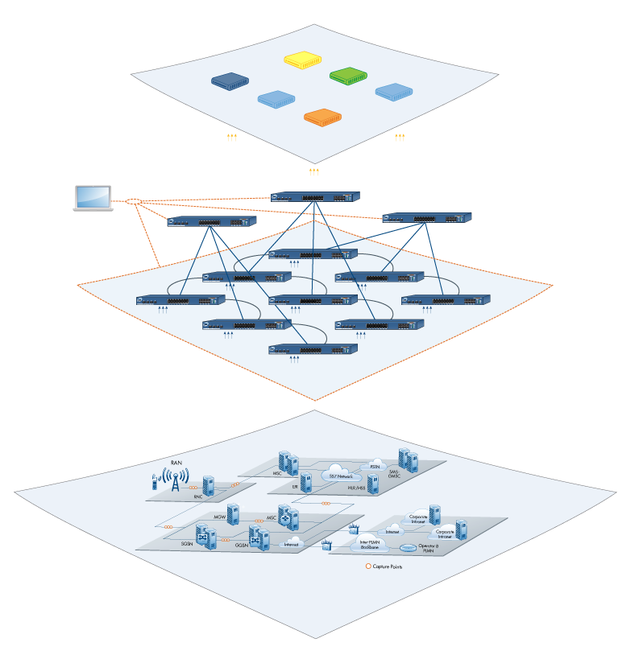
The new paradigm: Network Monitoring 2.0
Decouple analyzer tools from communication infrastructure
Centralized “tool farm”
Dramatic tools reduction
Views not stovepiped: Ends 1:1 relation between network link and monitor tool
A traffic capture layer provides universal network access for all tools
Single intelligent layer for all traffic capture needs. Distributed intelligence & redundancy
Front end traffic grooming / pre-processing for tools increases tool utilization
Reduce or eliminate contention for SPAN ports
Simplified & centralized management
Monitoring Systems
Distributed Traffic Capture Layer
Network Infrastructure
Notes:
Strategic Approach

Slide 13
Solving many of the 4G deployment issues
Getting to the details

Slide 14
What are the 4G issues we see today?
Issues tapping gigabit copper
Brand damage
Surmounting 3G carryovers
Incorrectly dimensioned backhauls
Loss of critical debugging packets
Issues with SPAN ports
The expense of 10G tools
Aggregation of traffic between 1G/10G networks
Detecting microbursts
Net Neutrality
Hockey stick increases in data growth on mobile networks
CAPEX / OPEX constraints.
User Equipment issues (most notably with the iPhone)
Network issues, most notably with the Backhaul, support of multiple networks and access to debugging information
Monitored traffic not being evenly distributed between analytic / analysis tools of the same time type
SLA adherence

Slide 15
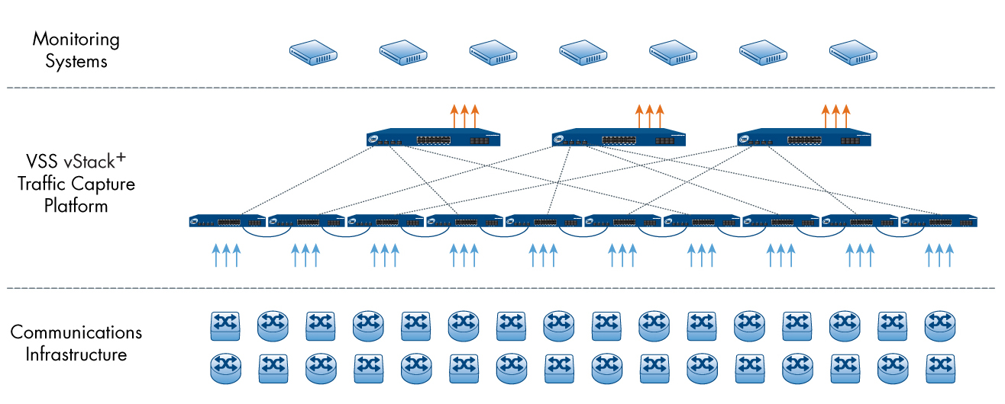
vStack+™ Intelligent Stacking
Intelligent Data Routing: Redundancy, Scalability and Assurance
Intelligent routing and self-discovery
Redundant mesh architecture
Self-acting failover
Routing for highest-speed low latency (multi and optimal)
Scalable system. Self-healing mesh. Unmatched capability
High-bandwidth
Central network vantage
Highly scalable

Slide 16
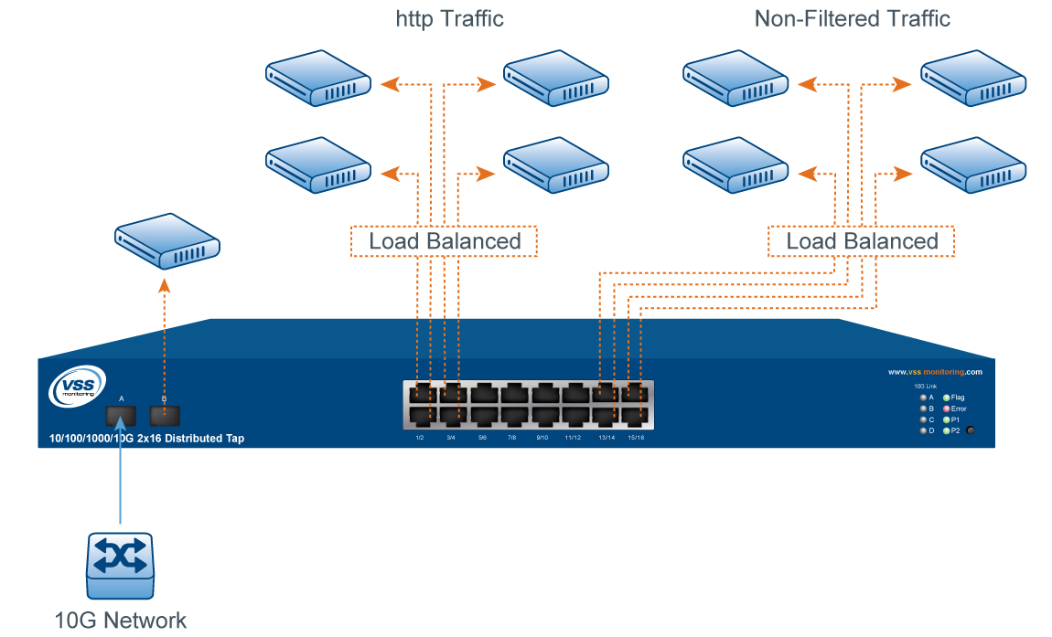
Session-Aware Load Balancing
Distribute Traffic Across Multiple Tools Per IP Session
Even distribution of traffic across multiple links
Highly granular balancing (10 criteria)
Maintain session consistency
Fault-tolerant
Monitor 10G networks with existing tools
Fully leverage Gigabit tools
Prevent oversubscription on monitor ports

Slide 17
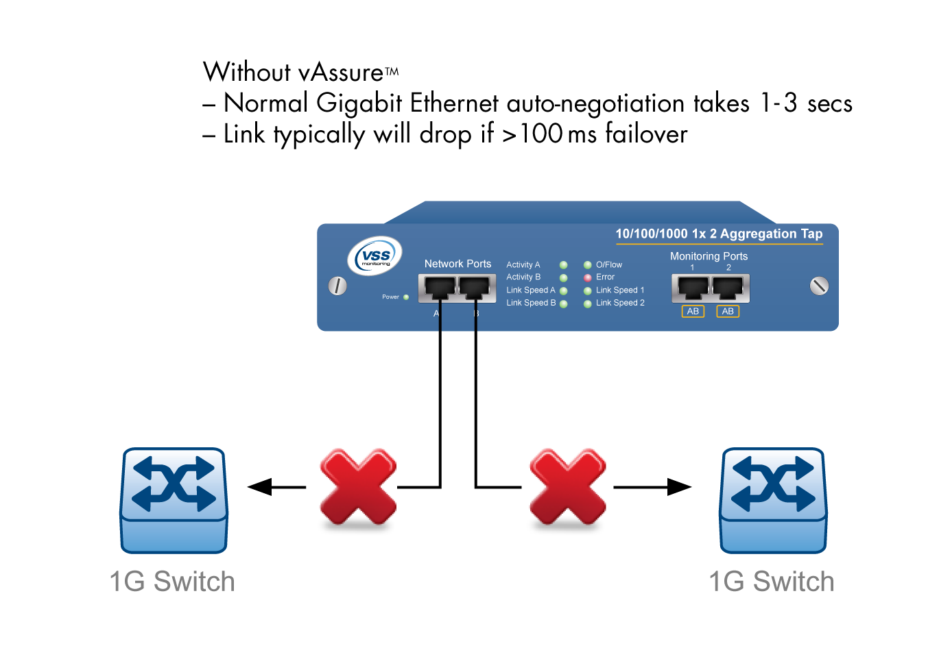
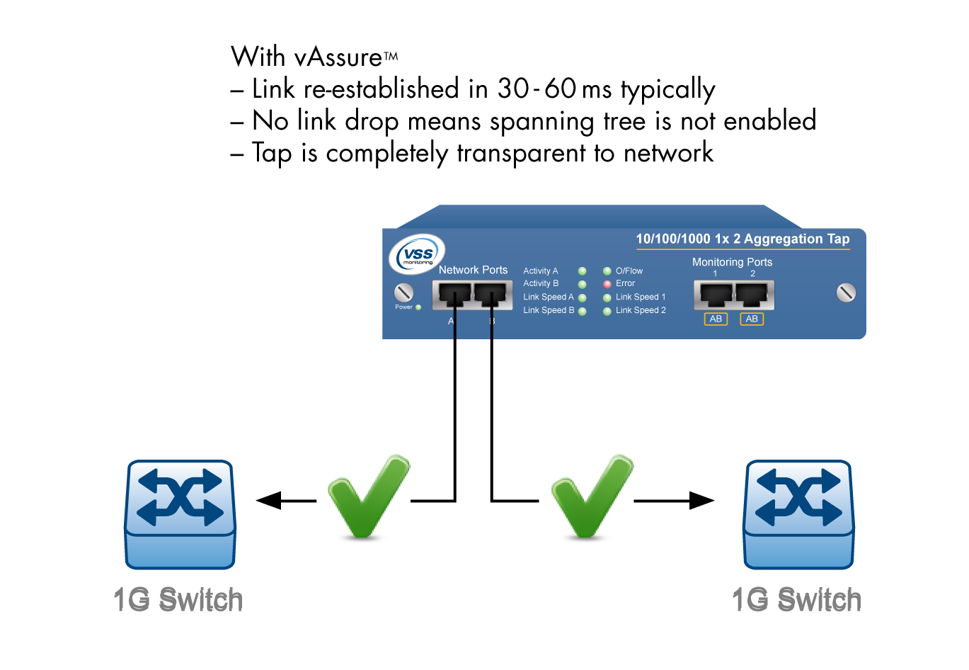
vAssure™
Copper Gigabit Failover
Hyper-fast switchover
30-60ms typical
Registers as noise
Won’t trigger spanning tree
No configuration required
Built-in to all VSS copper Gigabit taps
Solves failsafe monitoring & inline dilemmas
Fail-safe
Prevents network downtime
Time sensitive apps uninterrupted

Slide 18
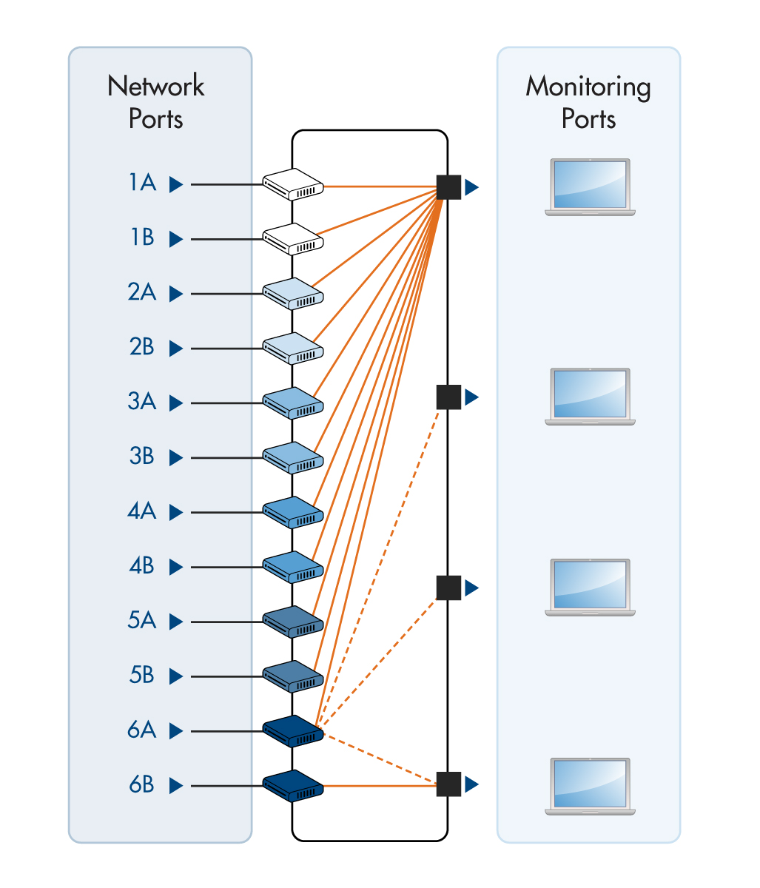
Aggregation / Selective Aggregation
Monitoring Tools Work Best With The Correct Traffic
Input traffic to monitor output control
One-to-multiple network ports to one-to-multiple monitor ports
1-to-1
1-to-Many
Many-to-1
Many-to-Many
Reduce costs
Improve efficiency of tools
Reduce number of monitor interfaces required

Slide 19
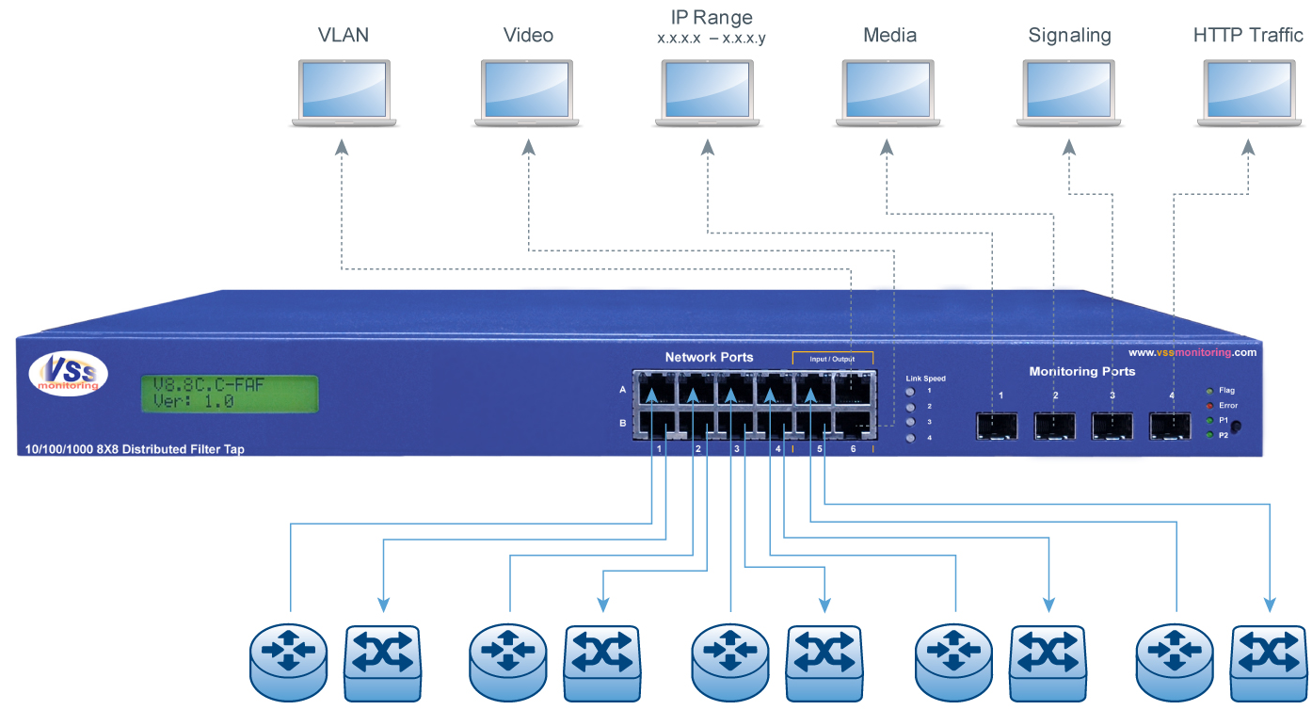
Hardware-Based Filtering
Selectively Forward Only Traffic Of Interest To Tools
User-defined traffic of interest
User-customizable
Custom offset filters
Tunneling applications
Layer 2-7 filtering
VLAN, QoS, IP Service Type
UDP/TCP/ICMP
port, range
MAC and IP
source, destination
Reduce Costs
Ultra-Low Latency
Line-Rate Monitoring

Slide 20
Time and Port Stamping
Support Accurate Ingress Information At Packet Level
Ingress time stamp and ingress port stamp
NTP, GPS and moment-of-ingress time stamp support
9 bytes added at the end of payload for time and port information
Time Stamp: 8 bytes after payload
Port Stamp: 1 byte after payload
CRC recalculated
Only visible to monitor ports
Scalable packet arrival information
Link-level forensics data
Track latency propagation

Slide 21
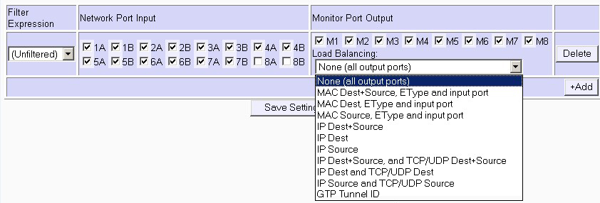
GTP Balancing
GPRS Tunneling Protocol
Balance GTP traffic
Send traffic to multiple user-selected monitor ports
Based on GTP Tunnel ID (TEID)
Balance GTP traffic across multiple analysis tools
Keep GTP session / tunnel packets together for same tool

Slide 22
GTP De-Encapsulation
Remove GTP Encapsulation
Strip GTP headers before passing packet to monitor port
Per port GTP De-Encapsulation
Enable Load Balancing & easier Filtering on GTP payload content
Allows tools without support for GTP, to analyze GTP traffic
More easily filter GTP traffic based on payload content
Balance GTP traffic based on other criteria

Slide 23
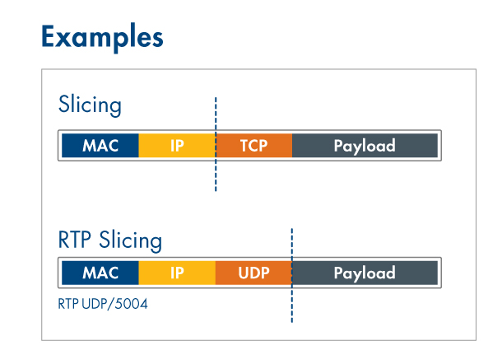
vSlice™ - Conditional Packet Slicing
Monitor Tool Over-Utilization And Data Privacy Regulations
Truncate packets
User-customizable offset and protocols
Multiple ports
Reduce traffic load to monitor tools
Remove user information before reaching monitor tools
Increase monitoring efficiency / reduce costs

Slide 24
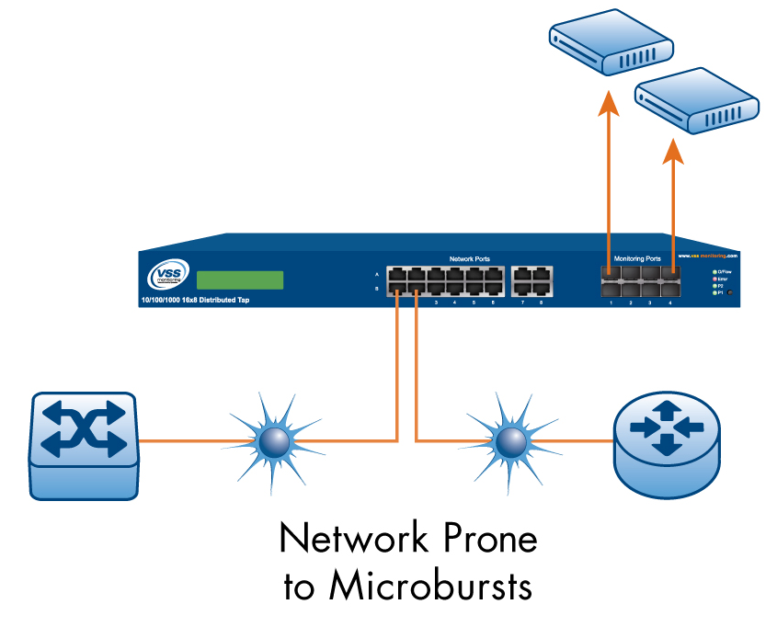
vCapacity™ – Capacity Planning
Network Blind Spots - Microbursts
Identifies and provides bit-level metadata
Sub-millisecond network utilization statistics
Identify network microbursts / peak utilization
Minute by minute FTP reporting capability
Accurate view of network bandwidth issues / requirements
Identify location of problems in real-time

Slide 25
VSS Value Proposition
Economics
Performance
Visibility
Revenue stream stability
Shorter MTTR
Reduced churns
Reduced complexity
Faster ROI
Greater application / network performance
Ultra low latency
Enhanced QoS/QoE
Achieve SLA goals
Tools optimization
Centralized monitoring
Network forensics and security
Lawful intercepts
Deep packet inspection
Find problems fast
Distributed Traffic Capture Systems:
Network Monitoring 2.0 is a Paradigm Shift – Monitoring no longer an afterthought
Strategically addresses the company’s bottom line
Best price-performance in the market
Flexibility and scalability across all IP networks
Grow solution as your need grows
Notes:
VSS Monitoring is the leading innovator of Distributed Traffic Capture Systems enabling carriers, enterprise and government to centralize monitoring infrastructure in a single location thereby achieving greater visibility, response times and cost savings across all security and monitoring appliances in the infrastructure.

Slide 26
Summary
Vision
Innovation
Partnership
VSS is committed to addressing the 4G / LTE challenges.
Network Monitoring 2.0 delivers a sustainable and strategic network management strategy to LTE.
Best price-performance solution in the market.
Technology leader in distributed traffic capture.
180+ product portfolio
Flexible, scalable and reliable solution, with no single point of failure
VSS brings a breadth of experience and capabilities to help Service Providers, Enterprises and Government agencies with their mission- critical network data

Slide 27
Thank-you
Closing thoughts…
From years of experience in this area, the industry’s best known & respected NEMs / Operators continue to put the most in to testing of products / services and in to operational capability & maintenance. There is a direct correlation between positive brand awareness, sales and bottom line revenue growth when this strategy is employed.
andy.huckridge@vssmonitoring.com

