Slide 1
Wall Street on 4G Investment
Jim Baker, Managing Partner
Xenventure

Slide 2
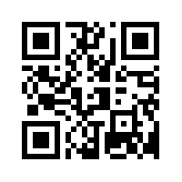
Jim Baker
Managing Partner
jim@xenventure.com
Unbiased, vendor-independent wireless consulting
Market analysis, technical design, and systems implementation
Strategic seed capital financing for small, fast-growth companies
Currently project managing Wi-Fi/4G pilot on Silicon Valley light rail

Slide 3
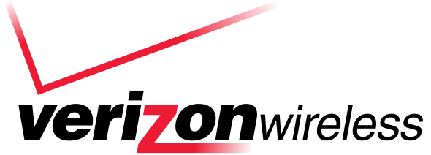
Fact #1 – 2011 will be the breakout year for 4G
Verizon launched 4G LTE in 38+ markets in December

Slide 4
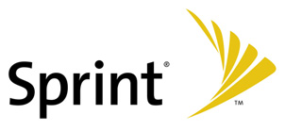
Fact #1 – 2011 will be the breakout year for 4G
Verizon launched 4G LTE in 38+ markets in December
Sprint/Clearwire expands 4G WiMAX in LA, San Francisco, NYC

Slide 5
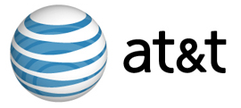
Fact #1 – 2011 will be the breakout year for 4G
Verizon launched 4G LTE in 38+ markets in December
Sprint/Clearwire expands 4G WiMAX in LA, San Francisco, NYC
AT&T and T-Mobile pressured into ‘creative’ HSPA marketing campaigns

Slide 6
Fact #1 – 2011 will be the breakout year for 4G
Verizon launched 4G LTE in 38+ markets in December
Sprint/Clearwire expands 4G WiMAX in LA, San Francisco, NYC
AT&T and T-Mobile pressured into ‘creative’ HSPA marketing campaigns
LightSquared plans hybrid LTE/satellite network by year end

Slide 7
Fact #1 – 2011 will be the breakout year for 4G
San Jose, California – 7.5Mbps down, 900Kbps up
Clear 4G WiMAX, consumer subscription

Slide 8
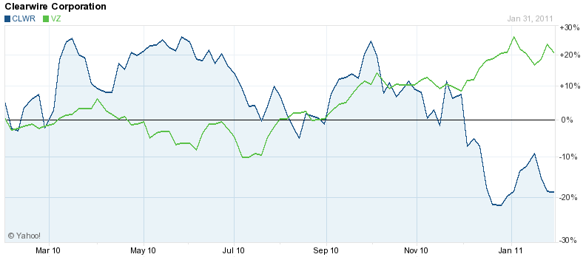
A Tale of Two Carriers

Slide 9
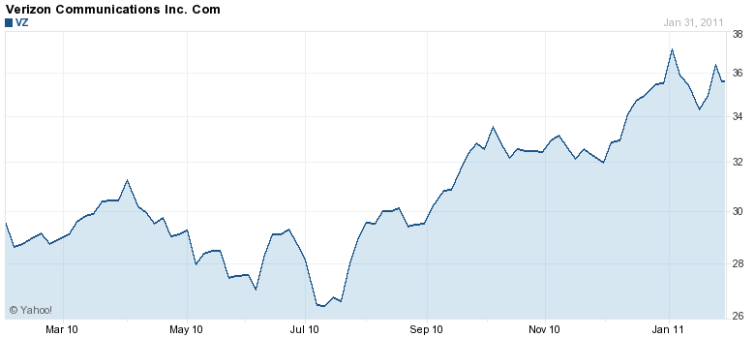
Wall Street Outlook – Verizon (NYSE:VZ)
31%
Last 12 months
Verizon had to upgrade its network to 4G as 3G EV-DO was so dated
Success (or not) of CDMA iPhone will be of greatest concern to investors
CEO Seidenberg says 4G may replace DSL

Slide 10
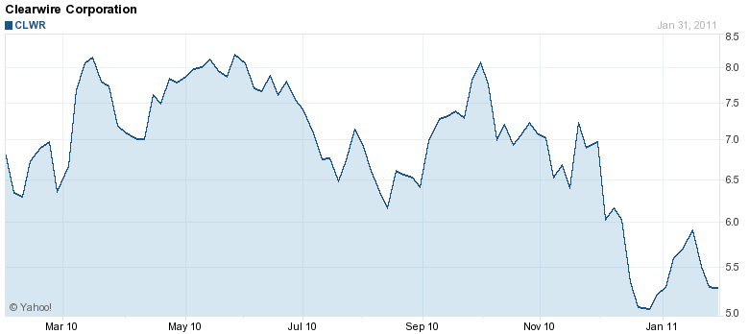
Wall Street Outlook – Clearwire (NASDAQ:CLWR)
62%
Last 12 months
Clearwire’s outlook is looking extremely poor, hobbled by a bad 4G retail strategy
“The hope that 4G wireless networks would help the industry is fading” [Barron’s]
Questions remain over Clearwire’s ability to raise finance for network build

Slide 11
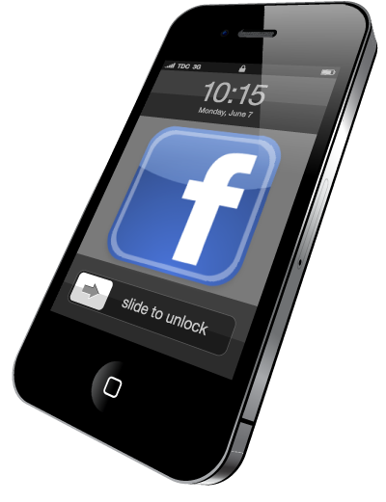
Fact #2 – Apps will drive 4G subscriber uptake
Devices get smarter – GPS, video & still cameras
Media-heavy apps need faster networks
Consumer desire for media will drive 4G adoption
4G delivers bandwidth, QoS, improved architecture

Slide 12
Fact #2 – Apps will drive 4G subscriber uptake
4G bandwidth demand over next five years

Slide 13
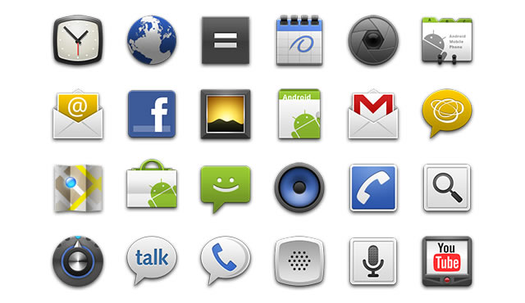
Fact #2 – Apps will drive 4G subscriber uptake
“Google's strategic initiatives in 2011[are] all about mobile.
First, we must focus on developing the underlying fast networks
(generally called LTE)…which will usher in new and creative applications,
mostly entertainment and social, for these phone platforms.”
Eric Schmidt
Chairman & CEO, Google
Harvard Business Review

Slide 14
Fact #3 – Investment is a crapshoot
Carriers having 4G does not mean they’re a good investment
New 4G entrants are private, and relying on non-Wall Street funds
App sector is dominated by small, agile, private companies
Funding comes from small groups of super-angels and Silicon Valley VCs
Very hard to get in on early rounds in hot start-ups
Many are acquired way before a public offering and Wall Street
“Does ‘4G’ mean it’s four times gooder ?” My seven year old son
Notes:
Facebook 7x increase in 12 months
Up 40% in two months

Slide 15
Take Away
Valued at $3.7 billion
Valued at $87 billion
Valued at $15 billion
Notes:
Facebook 7x increase in 12 months
Up 40% in two months

Slide 16
Take Away
Valued at $3.7 billion
Valued at $87 billion
Valued at $15 billion
Valued at the price of a house
Notes:
Facebook 7x increase in 12 months
Up 40% in two months

