Slide 1
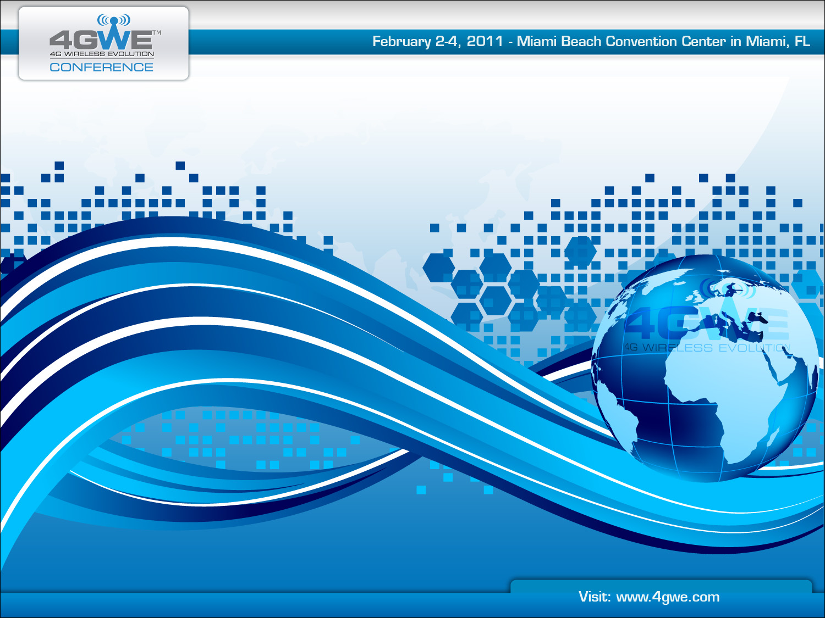
The Key to Successful Backhaul
Greg Friesen, VP, PLM
DragonWave Inc.

Slide 2
Legal Disclaimer
The information contained in this presentation (“Presentation”) has been prepared by DragonWave Inc. (the “Company”) for informational purposes only as a business update for existing investors in the Company. The Presentation has not been independently verified and the information contained in it is subject to updating, completion, revision, verification and further amendment. While the information contained in it has been prepared in good faith, neither the Company nor its shareholders, directors, officers, agents, employees, or advisors give, has given or has authority to give, any representations or warranties (express or implied) as to, or in relation to, the accuracy, reliability or completeness of the information in this Presentation, or any revision thereof, or of any other written or oral information made or to be made available to any interested party or its advisers (all such information being referred to as “information”) and liability therefore is expressly disclaimed. Accordingly, neither the Company nor any of its shareholders, directors, officers, agents, employees or advisers take any responsibility for, or will accept any liability whether direct, express or implied, contractual, tortious, statutory or otherwise, in respect of the accuracy or completeness of the information or for any of the opinions contained in, or for any errors, omissions or misstatements or for any loss, howsoever arising from the use of this Presentation.
In furnishing this Presentation, the Company does not undertake or agree to any obligation to provide the recipient with access to any additional information or to update this Presentation or to correct any inaccuracies in, or omissions from, this Presentation which may become apparent. Interested parties are encouraged to obtain separate and independent verification of information and opinions contained in this Presentation as part of their own due diligence. Information contained in this Presentation is the property of the Company. It is made available strictly for the purposes referred to above. This Presentation must not be disclosed, copied, published, reproduced, distributed, used or disclosed in whole or in part at any time without the prior written consent of the Company and by accepting the delivery or making to it of this Presentation, the recipient agrees not to do so and to return any written copy of this Presentation to the Company at the request of the Company. This Presentation should not be considered as the giving of investment advice by the Company or any of its shareholders, directors, officers, agents, employees or advisors. Each party to whom this Presentation is delivered or made must make its own independent assessment of the Company after making such investigations and taking such advice as may be deemed necessary. In particular, any estimates or projections or opinions contained in this Presentation necessarily involve significant elements of subjective judgement, analysis and assumption and each recipient should satisfy itself in relation to such matters. In no circumstances will the Company be responsible for any costs, losses or expenses incurred in connection with any appraisal or investigation of the Company.
This release contains certain forward-looking statements. Forward-looking statements are not promises or guarantees of future performance and readers are cautioned not to place undue reliance upon any such forward-looking statements. Forward-looking statements are based on the Company’s current expectations and assumptions that are subject to a variety of risks and uncertainties that are difficult to predict and that may be beyond the Company’s control. Actual results could differ materially from those expressed in any forward-looking statements due to factors including the following:
  The Company’s growth is dependent on the development and growth of the market for broadband wireless access.
  The Company faces intense competition from several competitors and if it does not compete effectively with these competitors, its revenues may not grow and could decline. The Company also faces competition from indirect competitors.
  The Company’s success depends on its ability to develop new products and enhance existing products.
  The Company has a history of losses and cannot provide assurance that it will attain profitability.
  If the Company is required to change its pricing models to compete successfully, its margins and operating results may be adversely affected.
  The Company relies on a small number of customers for a large percentage of its revenue.
  The Company’s ability to sell products and services is dependent upon it establishing and maintaining relationships with channel partners.
  The Company’s quarterly revenue and operating results can be difficult to predict and can fluctuate substantially.
  The Company has a lengthy and variable sales cycle.
  Additional risks which can also impact upon forward looking statements are identified in DragonWave’s Annual Information Form which is available online at www.sedar.com. DragonWave assumes no obligation to update these forward-looking statements as a result of new information or future events.
This Presentation does not constitute, or form part of, any offer or invitation to sell or issue, or any solicitation of any offer to subscribe for or purchase any securities in the Company, nor shall it, or the fact of its delivery, making or distribution, form the basis of, or be relied upon in connection with, or act as any inducement to enter into any contract or commitment whatsoever with respect to such securities. Any failure to comply with these restrictions may constitute a violation of applicable securities laws. By accepting this Presentation, the recipient represents and warrants that it is a person to whom this Presentation may be delivered or distributed without a violation of the laws of any relevant jurisdiction.

Slide 3
Demand Driven Hyper-Growth
Rapidly increasing smartphone penetration:
  270 million smartphones sold in 2010
  2.3 billion smartphone sales from 2010–2015
  Only 5% of mobile phones sold in Asia in 2009 were “smart”
  iPhone user generates 50X more traffic than average mobile user
Rise of the Internet appliances:
  3G/4G chipsets in various electronics, vehicles, notebooks, and household devices
  28 million iPads to be sold in 2011
  Multi-device data plans
  Potential for billions of new connected devices
Within 5 years:
  1.5 billion mobile broadband subscribers
  50–100X increase in mobile data usage
  30X more data than voice
Mobile Network Traffic Growth
TB/Month
Source: Cisco Global Mobile Data Traffic Forecast, 2010

Slide 4

Charting a Course in Unclear Waters
Many opinions on future bandwidth requirements and traffic mix
If the last few years are any indication, industry prognosticators often get it wrong
Need to develop a “future-proof” backhaul strategy

Slide 5
Backhaul Innovation is Vital
On Average, backhaul accounts for 30% of OPEX
Short term backhaul requirements are well understood
  100 Mbps per cell site next year
  Multi-gigabit aggregation rings
Based on current mode of operation, these costs will rise significantly in 4G networks:
  Avg. monthly cost per cell site will rise to $23,000 by 2012, compared to the 2009 average of $2,100. (Source: Yankee Group)
Difficult to predict long-term bandwidth requirement and traffic mix but maintaining the status quo is not a viable option
Backhaul Costs in 4G Networks Threaten to Overwhelm the Operator Business Case

Slide 6
Migration to Ethernet Backhaul
First step in achieving greater backhaul leverage is a shift to Ethernet
75% of backhaul will be Ethernet-based by 2014
Ethernet-Based Backhaul
Source: Infonetics research, 2010
The cost and efficiency benefits of packet based backhaul solutions are driving a significant shift towards Ethernet.

Slide 7



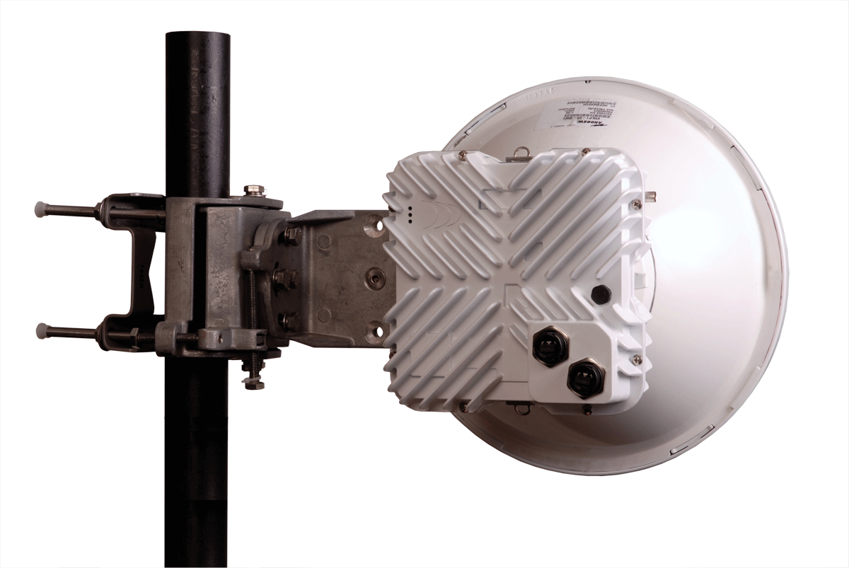
Ethernet Backhaul Options
 | Pros | Cons
Laying Fiber | Nearly unlimited Capacity (>1Tbps) | High upfront capital Long time to service Complicated to build
Service Lease | Low initial cost Simple deployment | High monthly costs Expensive in long term Limited scale Complicated SLA (often not dedicated BW) Limited coverage High Total Cost of Ownership
Microwave Deployment | Medium initial cost Rapid deployment Lowest TCO Control of service levels Maximize coverage | Limit of ~5 Gbps Some upfront capital

Slide 8
Microwave v. New Fiber Build – Distance Sensitive
10 Year Cost Comparison
Distance (KM)

Slide 9

Meeting Short Deployment Timelines
New service rollouts require that operators set ambitious timelines for project completion
Packet microwave solutions can be deployed in a matter of weeks, including:
  License coordination service
  Site planning
  Network planning
  Installation and commissioning
In comparison, fiber builds can take up to 18 months

Slide 10

Packet Based Architecture
The only way to deliver the level of performance required by future applications and services is to move to IP
    Traditional SONET/SDH backhaul systems introduce protocol conversion inefficiencies and latency
Packet-based microwave systems transport IP natively:
    Eliminates conversion overhead
    Deliver IP-based services much more efficiently and at lower cost
    Full support for critical Ethernet data transport features
    TDM interfaces for full support and convergence of legacy traffic
    Simplicity of a single traffic plane and one element management system (EMS)
Notes:
10

Slide 11
Ring and Mesh Capability
Requirements:
  Native Packet
  Capacity
  Scalability
  Fast Switchover
  Adaptive Modulation
  Ethernet QOS
  Nodal intelligence
Improves:
  Coverage
  Network Availability
  Resource Usage
  Spectrum
  Tower Space
  Fiber POPs
  Capacity Utilization

Slide 12

Capacity and Scalability
High capacity microwave is suitable for access and aggregation networks:
  Current packet microwave systems are capable of multi-Gbps speeds per link
  Bandwidth acceleration, XPIC and higher order modulations are driving higher capacity and spectral efficiency
Remote scalability to increase capacity on demand:
  No Hardware changes required
  Pay-as-you-grow
  Automatic upgrades options for added simplicity

Slide 13

Low Latency
Native IP packet microwave systems enable ultra-low latency of under 0.1 ms over the link
This 4G-optimized capability allows business critical applications such as voice-over-IP, video-over-IP and all future time-sensitive applications to perform at high levels
Keeping this priority traffic on the native Ethernet transport layer greatly reduces the risk of incurring delays associated with segmentation and re-assembly, or frame adaptation.

Slide 14
All Outdoor Deployment Option
All Outdoor deployments provide many significant cost and operations benefits including:
  Lower site leasing costs
  Reduced cabling requirements
  Minimized installation and configuration costs
  Reduced power consumption
The Result?
  Up to a 40% savings relative to split mount deployments
  Up to 70% savings relative to all-indoor deployments

Slide 15
Spectral Efficiency
All packet
XPIC
Advanced compression technology
  Bulk compression
  Header optimization
  Compression per individual queues
Horizon 4th Gen Microwave Solutions
3rd Gen Microwave with XPIC
2nd Gen Microwave
1st Gen Microwave
Up to 10-fold improvement in spectral efficiency with Horizon microwave systems.

Slide 16
Network Evolution Strategy
Hybrid microwave solutions support TDM and IP natively but require more boxes, increasing complexity and cost
Converged packet microwave solutions simplify the transition to all-IP without compromising future performance

Slide 17
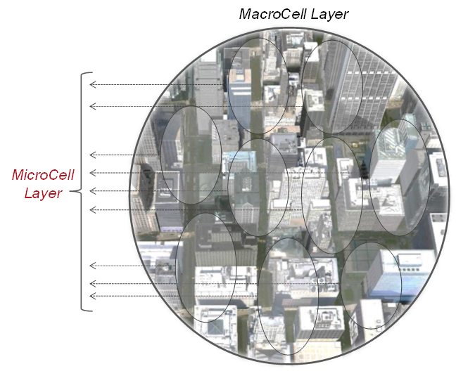
Microcellular Network Backhaul
Shift to microcellular architectures, driven by:
  Higher access spectral efficiency and re-use
  Higher network capacity
  Improved indoor coverage
Deployment on non-traditional structures; fiber rarely present
Unique backhaul requirements:
  Hardened, all outdoor microwave systems
  Simple install, management, scalability
  Ability to blend into the urban environment
  Aggregation of traffic in microcellular layer to hand off to macro layer and/or metro fiber

Slide 18
Microcell Unit Design Considerations
Single box solutions (Backhaul, Access Point & Switch integrated)
  Planning regulation “friendliness” is crucial
  Compact & modular with multiple mounting options
  Reduced cost of installation
    Simple, lightweight, low parts count
    Easy alignment, auto-self test
  Need to be able to weave back-and-forth up the streets
  Typically 5-8m above ground level
  Mains powered
Sites do not typically need “omni” visibility, need to see up and down [gridded] streets
Compatibility with municipal zoning requirements

Slide 19

Summary
Goal should be to chart the safest course, which will meet a wide range of future requirements
  Capacity Requirement are unclear
  Price is eroding, making backhaul costs vital
The current backhaul model is unsustainable
High capacity packet microwave is a key part of the solution
Microcellular architectures will play an important role in high-density regions

