Slide 2
Connecting Distributed Enterprise Via Video
Anatoli Levine, RADVISION

Slide 3
About Anatoli Levine
Sr. Director, Product Management – Americas, Technology Business Unit, RADVISION
President, IMTC (International Multimedia Telecommunications Consortium)

Slide 4
About RADVISION
RADVISION is the pioneer in the area of Visual Communications since 1992 and leading provider of core technologies, products and solutions that enable unified multimedia communications over IP, 3G and emerging next generation IMS networks.

Slide 5
Video in Today’s Enterprise…

Slide 6
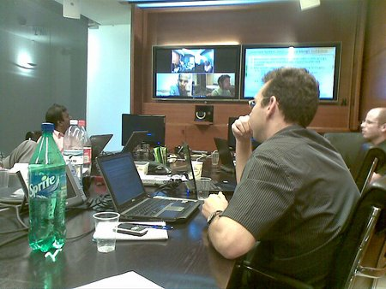
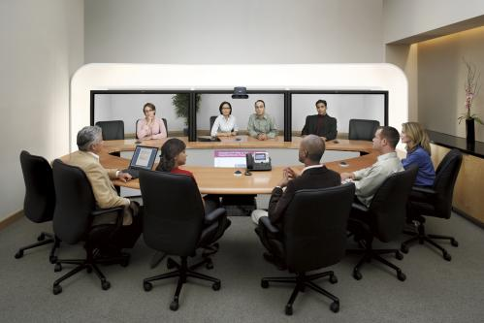
Video In Today’s Enterprise…

Slide 7
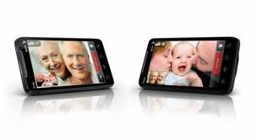
Enterprise… on Mobile
Notes:
Tsahi

Slide 8
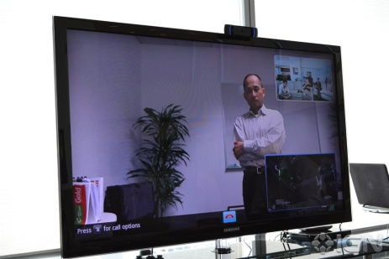
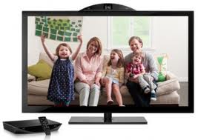
Enterprise… on TV

Slide 9
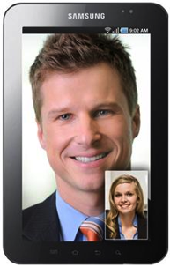
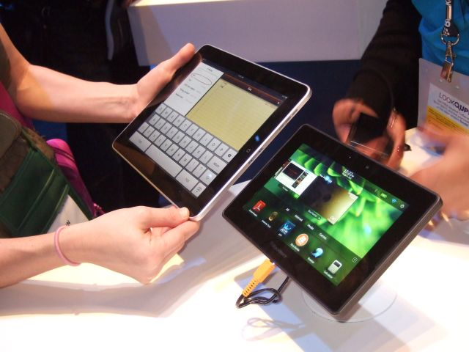
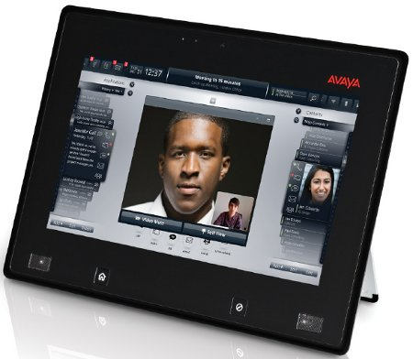
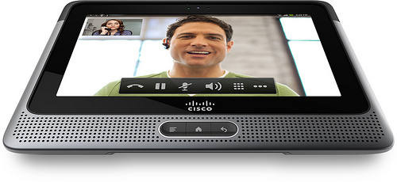
Enterprise… on Tablets

Slide 10
Enterprise Video Communication Challenges
Connecting Clusters
Interoperability (SIP, H.323, XMPP, Jingle, FaceTime…)
Dialing
Delivering QoE
Firewalls

Slide 11
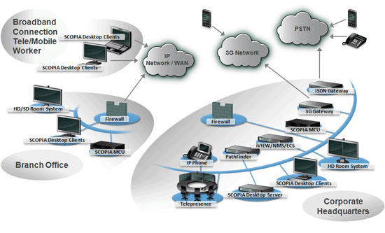
RADVISION Solutions: End-to-end

Slide 12
RADVISON Solutions: QoE
VFU
UEP
SVC
FEC
NetSense

Slide 13
RADVISION Solutions: QoE over the Internet
H.264/SVC
H.264

Slide 14
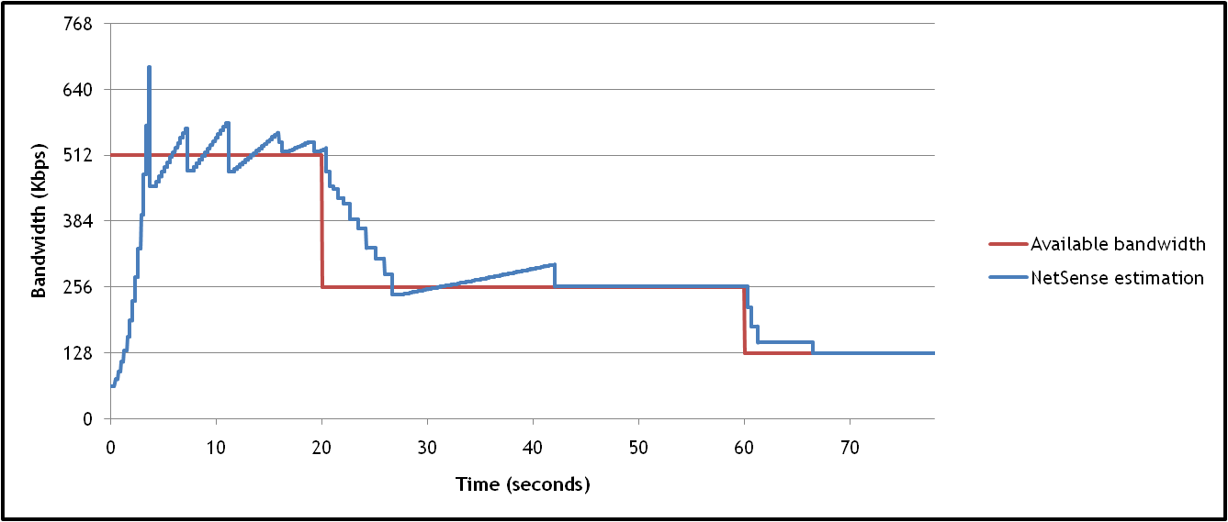
RADVISION Solutions: QoE Regardless of Access

Slide 15
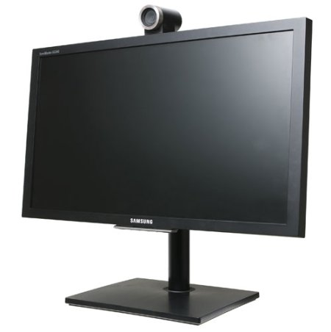
RADVISION Solutions: On any platform

Slide 16
Thank You!
Questions?
Anatoli Levine, RADVISION
alevine@radvision.com

