Slide 1
The “2” In M2M
John Horn
T-Mobile USA

Slide 2
Sum Of The Parts
Network Platform
Certification
SIM Design
Activation Platform
Subscriber Management Platform
Billing Design and Support

Slide 3
Network Platform
Why is the past important?
What is happening today?
Will the future protect our investment?

Slide 4
Certification
What is the purpose of certification?
Is M2M unique or are you lost in the demands of the larger business?
Time is money. How long is this going to take?

Slide 5
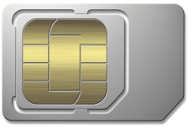
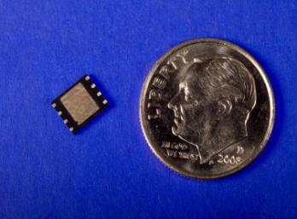
SIM Design
Why is this important?
Environmental endurance.
Form and functionality.

Slide 6
Activation Platform
Is it unique to M2M?
Is it flexible?
Is it scalable?

Slide 7
Subscriber Management Platform
What changes can you make?
What changes are you authorized to make?

Slide 8
Billing Design and Support
Is it electronic?
Does it support multiple rate plan models?
Does it have session rounding?

