Slide 1
How to Leverage Social Media for a Successful Marketing Campaign

Slide 2
Isaac Hazard Director of Strategic Consulting Mzinga
Suzanne Bowen VP Marketing & Business Development Super Technologies, Inc. & DIDX
Peter Radizeski
RAD-INFO, Inc.,
blogger and consultant

Slide 3
Social Media for Marketing
What is the goal?
How will it be executed?
What are the results/metrics/ROI?
What platform would be best?

Slide 4
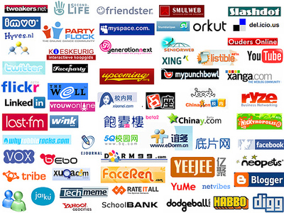

Slide 5
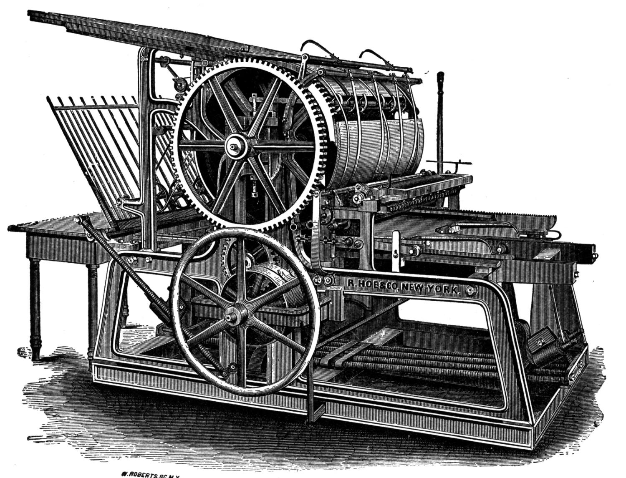
Social Media for Marketing
Start with:
How to Think about Social Media
It’s a printing press.
It’s a communications medium.

Slide 6
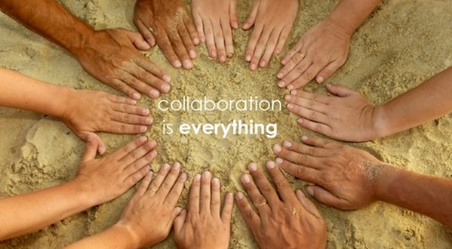
Leveraging Social Media
for Successful Marketing Campaign
How to get noticed
Lambaste with commercials?
Analyze every datum?
Cut the competitors?
Make it all about us?
What worked and doesn't?
Natural interaction emphasizing THEM, not US
Speaker: Suzanne Bowen, Co-founder and Vice President of Marketing, Super Technologies, Techistan, and DIDX
Borrowed from http://audiencedevelopment.wordpress.com/

Slide 7
Ciena Communities
Online Communities
Target Audience:
Ciena partners, website visitors & employees
Purpose: Enable better collaboration and online engagement with partners, employees and prospects
Social Technologies & Services:
Blogs
Message Boards
Profiles
IdeaShare
File Repository
Polls
Results & Business Benefits:
600+ members
5k+ member visits & views
Increase partner satisfaction
Improved partner education
Increased competitive advantage
By Mzinga
7
Notes:
7

Slide 8
How to Leverage Social Media:
Case Study: What Not to Do
By PR-Vantage.com

Slide 9
Social Media Case Study: What Not to Do
Company X sells IT products to the SMB market
In 2008, it launched a successful PR program that significantly raised its visibility
It abandoned all of its marketing in October 2008 anticipating significantly reduced sales as a result of the financial crisis
In January 2009, when sales did not crater, they decided that they would allocate all of their marketing to a social media campaign
Social media was attractive to Company X due to low cost and the buzz around it
The company executives had never used Facebook or Twitter, and only used LinkedIn for sales outreach

Slide 10
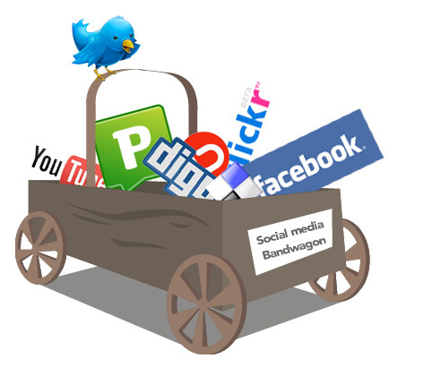
Seemed Like a Good Idea at the Time
Company X engaged a social media consultant with no experience in IT or B-to-B to establish its presence in social media (i.e. Facebook, Twitter and LinkedIn)
Not understanding the forum or how to communicate appropriately, the company used social media as a way to strictly promote the business and its product without engaging in discussions
Examples:
Consistently plugged products in tweets
and postings
Left profiles undeveloped
Blasted followers and friends with company announcements

Slide 11
Failure is an Option
Posts and tweets were made by the social media agency and not the Company
The Company was only interested in lead generation
No participation from Company X executives
Friends/Followers not relevant to Company X
Not perceived as a credible source
Tweets and posting were perceived as spam and over-linked to its homepage

Slide 12
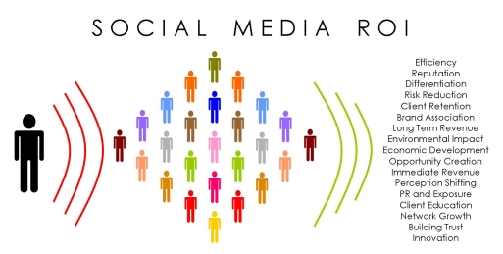
Change is Good
Company X realized that they weren't seeing results from social media efforts
They turned to Vantage Communications with the expectation of dropping social media and switching all of their marketing efforts to PR
Vantage engaged in discussion for Company X and recommended a program that integrated social media with public relations
We changed the social media focus:
Focus on engagement
Identified and built relationships
among key industry leaders
Provided relevant insight on
industry trends
Tracked and compared competitive
brands
Monitored other stories of interest to its audience
Followed and disseminated breaking news

Slide 13
Lessons Learned
Initial results…
Company now taking more active voice in social media
Started with LinkedIn since executives had more familiarity and LinkedIn used by ecosystem
Focus on participation in relevant LinkedIn Groups
Focus on thought leadership for news and insight
Engages its audience to develop brand loyalty
Actively communicates with key industry
influencers

Slide 14
Gary Vee says its all about the eyeballs and content.

Slide 15
Blogging, LinkedIn, forums, wikis, Facebook, Twitter, Google Wave, YouTube, podcast, etc. Each is a tool for your communication.
Each is different and reaches a varied audience.
The key is to have the proper message tuned in to the appropriate listeners. Notice, I said Listener. It isn’t about the most followers or any other number, it’s about the select who actually listen to your message.
It is social, so there are mores.
Listen first; then Interact / Engage.
Be Authentic. Transparency on the Internet is a must.

Slide 16
RAD-INFO, Inc.
Helping Service Providers with their marketing.
813-963-5884
http://rad-info.net

