Slide 1
Open Source Holds its Own Against Conventional Telephony
…and then some
Asterisk is a registered trademark of Digium, Inc.

Slide 2
Evolution of Open Source Telephony

Slide 3
Traditional PBX Market
Highly proprietary – vendor control
Fat profit margins
Well-constructed channels
High reliability
Clear professional standards
Centralized model – R&D, marketing, support
Notes:
3

Slide 4
Characteristics of Open Source
Critical mass required
Rapid development
Ecosystem
Customer control vs. vendor control
Low R&D cost per vendor/port
Easy integration, tweaking and customization
Bad documentation
No professional and service standards
Notes:
4

Slide 5

Asterisk
Most popular open-source OS for
telephony (85% share)
Worldwide body of developers
Robust and accepted platform
  Jan ‘09 report: 18% of N.A. installs (http://www.easternmanagement.com/pbx.htm)
OS: 30% growth in market size H1 2009 vs H1 2008

Slide 6
Maturing of the Asterisk Market
Notes:
6

Slide 7
2004 – Very Early Adopters
Great potential
Little commercial value
Very basic hardware support
Low market recognition
Notes:
7

Slide 8

2005 – OS PBX Makes Noise
Steadily increasing awareness
Market grows from bottom up
Early adopters and techies
Increased effort in hardware R&D
Beginning of the hype:
Mark Spencer makes the
cover of VON
Notes:
8

Slide 9
2006 – The Hype
Unrealistic optimism
Myth of OS = free IP PBX
“Everything is possible”
Many players join the game
  unclear business models
Notes:
9

Slide 10
2007 - Awakening
Players with unclear business model naturally decline in numbers
OS appliances
VC investments
FUD
Enterprise early adopters
Notes:
10

Slide 11
2008-2009 Commercialization
Leap in market penetration
Technology is stable, feature reach and supported by quality hardware
OS PBX climbs up the enterprise ladder
Traditional vendors face difficulties
Economic downturn -> accelerator
Asterisk becomes a brand
Major corporations choose Asterisk
Notes:
11

Slide 12
2010 – Head to Head with Giants
OS PBX has reached maturity
Unmatched flexibility
End users aware of the alternative
Channels and standards gap shrinks
Significant increase in market share
Study reports that 50% of enterprises
choosing open source consider avg
of 2.24 proprietary systems first
Notes:
12

Slide 13
Making the case for open source
Thoughts and Tools

Slide 14
Drivers of Open Source Telephony
40% cheaper than proprietary
  Avg endpoint for OS: $400-$600
  Avg endpoint for proprietary: $700-$1000
Application integration ease
Vendor-independent

Slide 15
Obstacles for Open Source
Fear of the unknown
Rhetoric of the proprietary vendors
  Unstable
  Unreliable
  Fringe (non-mainstream)

Slide 16
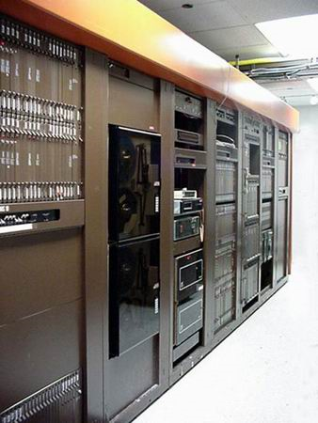
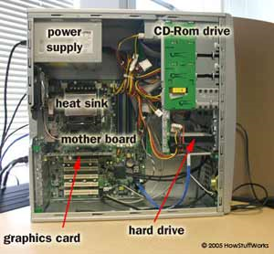
…And What About Reliability?!
vs.
Legacy switches
Asterisk® on PC
Notes:
Compared to Legacy:
Communication costs plummet, especially in multi-branch operations
Virtually unlimited number of international dial-tone providers (via SIP trunking) – no additional hardware required
Terrific flexibility for adding features, integrating with applications
Integration of dual-mode mobile phones for increased accessibility, decreased expenses
Reliability: can’t match the “five nines”
Problems with Asterisk-based system reliability:
PC reliability doesn’t match that of legacy PBX
All electronics are less stable: difference between dedicated “legacy” and multi-purpose “PC” systems
Even “industrial-strength” computers do not match the reliability of legacy, due to the nature of the software release cycle (could be years with legacy, as compared to months with IP-PBX, and the amount of code – much more in IP-PBX, to support all the additional features provided)
Different approach to QA – as opposed to legacy approach, where a single company takes responsibility, in Asterisk the community provides a large part of the testing

Slide 17
Leverage the Advantages of OS
Open software
  Low cost
  Worldwide network of developers
  No vendor lock
Hybrid systems offer transitional upgrade path
Provide redundancy via firmware/hardware combinations

Slide 18
Building In Reliability
Approach the “five nines” with your iPBX by employing utilities providing the “five R’s”:
  Redundancy
  RAID1
  Replicate & Restore
  Rescue
  Rapid Tunneling

Slide 19
R₁ = Redundancy
Notes:
Award-winning high availability solution
Identical PBX units back up each other
In case of system failure:
All telephony ports switchover
All IP phones switchover
All IP trunks switchover

Slide 20
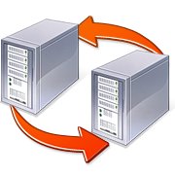
Hot Failover for Complete PBX
Provides full redundancy for a complete PBX system, including telephony interfaces
Auto detection of server failure & switch
to backup server
Firmware-based switching mechanism
is not network-dependent
Solution components:
  two Xorcom IP PBX units with identical configurations
  Xorcom Astribank channel bank(s) with dual USB ports

Slide 21
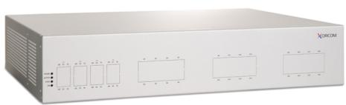

Initial Setup: Identical Servers
Two Xorcom servers + dual-USB Astribank
Xorcom server
(primary)
Xorcom server
(backup)
USB
USB
LAN/WAN
PSTN
Astribank (front panel)
USB-connected channel bank providing analog/digital telephony interfaces
IP Phones
Analog Phones

Slide 22


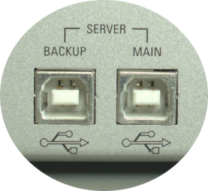
Standard Operation: Primary Active
Dual USB ports; Firmware monitoring/switching
Xorcom server
(primary)
Xorcom server
(backup)
USB
USB
LAN/WAN
PSTN
Astribank (rear panel)
USB-connected channel bank providing analog/digital telephony interfaces
IP Phones
Analog Phones

Slide 23
If the Primary Server Fails…
Server Failure
Xorcom server
(primary)
Xorcom server
(backup)
USB
USB
LAN/WAN
PSTN
Astribank (rear panel)
USB-connected channel bank providing analog/digital telephony interfaces
IP Phones
Analog Phones

Slide 24
…the Backup Server is Activated
Backup Server assumes Primary Server IP Address
Switch Changes to Backup Server
Xorcom server
(primary)
Xorcom server
(backup)
USB
USB
LAN/WAN
PSTN
Astribank (rear panel)
USB-connected channel bank providing analog/digital telephony interfaces
IP Phones
Analog Phones

Slide 25
Redundancy for Telephony Modules
Dedicated units for redundant power supply
Constant monitoring
Automated alert in case of failure
Load balancing of remaining power supplies

Slide 26
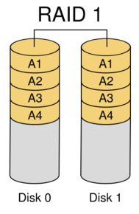
R₂ = RAID1 Support
Notes:
RAID — which stands for Redundant Array of Inexpensive Disks or Redundant Array of Independent Disks — is a technology that employs the simultaneous use of two or more hard disk drives to achieve greater levels of reliability, among other benefits.

Slide 27
RAID1 Support
Geometrically increases
IP-PBX hard-drive reliability
Two hard disks are supplied;
all blocks replicated/mirrored
If the active hard disk fails:
  the second hard-disk automatically takes over
  an alarm e-mail is sent to the system admin
  PBX continues working seamlessly

Slide 28
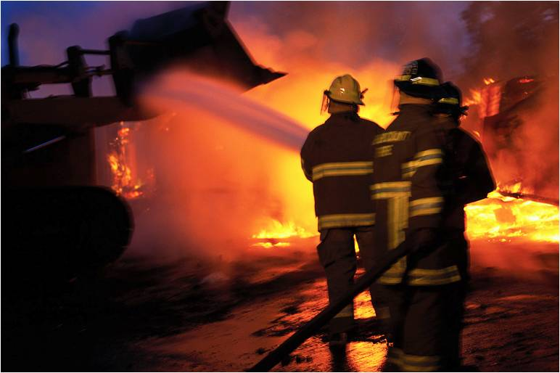
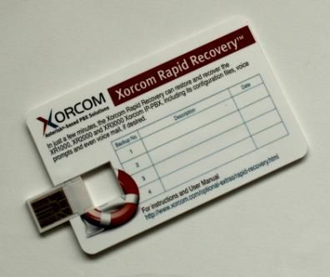
R₃ = Replicate & Restore
✗
✓
Backups are Complex and Time-Consuming
Backups Become Simple!
Notes:
[get input from Tzafrir / Leonid on how it’s done without Rapid Recovery]
Utility & storage on 2GB USB Disk-on-Key
Backs up entire PBX including
user-defined options:
configuration files
voice prompts
voice mail
Descriptive name for each backup
Single Disk on Key (DOK) for multiple system backups

Slide 29

Backup & Restore
Use a portable software utility to back up and restore entire PBX
  distribution
  configuration files
  voice prompts

Slide 30
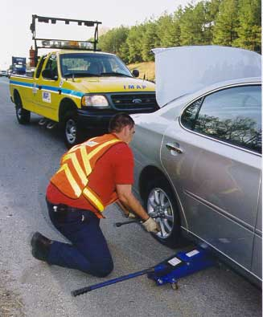


R₄ = Rescue: Temporary Recovery
Notes:
Bootable Disk-on-Key (DOK)
Runs PBX directly from USB port
Simple, safe and speedy disaster recovery from:
human error
disk crash
other disaster
Temporary solution until maintenance can be scheduled

Slide 31
Temporary Recovery
Bootable Disk-on-Key (DOK)
Simple, safe and speedy disaster recovery:
  human error
  disk crash
  other disaster
Temporary solution until
maintenance can be scheduled

Slide 32
R₅ = Rapid Tunneling Utility
Notes:
Secure remote access to IP-PBX
Targeted, real-time support
End user determines when to connect/disconnect
No tech knowledge required of end user
In real time, technical support team can:
troubleshoot
perform diagnostics
correct configuration issues

Slide 33
Rapid Tunneling Utility
Secure remote access to IP-PBX
Targeted, real-time support
End user determines when to connect/disconnect
No technical knowledge required of end user
In real time, support specialist can:
  troubleshoot
  perform diagnostics
  correct configuration issues
Notes:
Rapid Tunneling, a standard feature in all Xorcom IP-PBX models, is a software utility that allows secure remote access to the customer's IP-PBX by a certified Xorcom support specialist, with no technical knowledge required on the part of the end user. In response to a customer request for technical support, the Rapid Tunneling utility is used to generate a secure connection between the support server and the customer’s Xorcom IP-PBX. The customer needs no prior knowledge of Asterisk; he follows a simple GUI-directed process to establish the connection and the support professional takes it from there. The decision to disconnect the session at any time is in the hands of the (non-technical) end user, by simply clicking on a button on the GUI screen.
How Does it Work?
The Customer experiences a technical difficulty or requires a configuration change and contacts the certified Xorcom Support Specialist.
The Xorcom Support Specialist generates a unique file with a security-key and support server address and sends the file to the Customer by e-mail.
The Rapid Tunneling customer interface makes it easy for non-technical customers to activate the utility.
The Customer saves the file locally and then accesses a GUI page in the PBX user interface to activate the file.
This opens a secure (SSH) connection between the Customer's PBX and the support server.
Now the Xorcom Support Specialist can work directly on the Customer's PBX, change the configuration if necessary, and check any issue.
The Customer may disconnect the session at any time by pressing the Disconnect button.

Slide 34
Building in High Availability
Approach the “five nines” with the “five R’s”:
  Redundancy
  RAID1
  Replicate & Restore
  Rescue
  Rapid Tunneling

Slide 35

Case study
Hialeah Race Track

Slide 36

Basic Requirement
Old CAT-3 cabling
Planned to move 400 analog extensions
40 SIP phones
Proved very $$$!
Frequent power failures due to weather conditions
Solution: hot failover

Slide 37
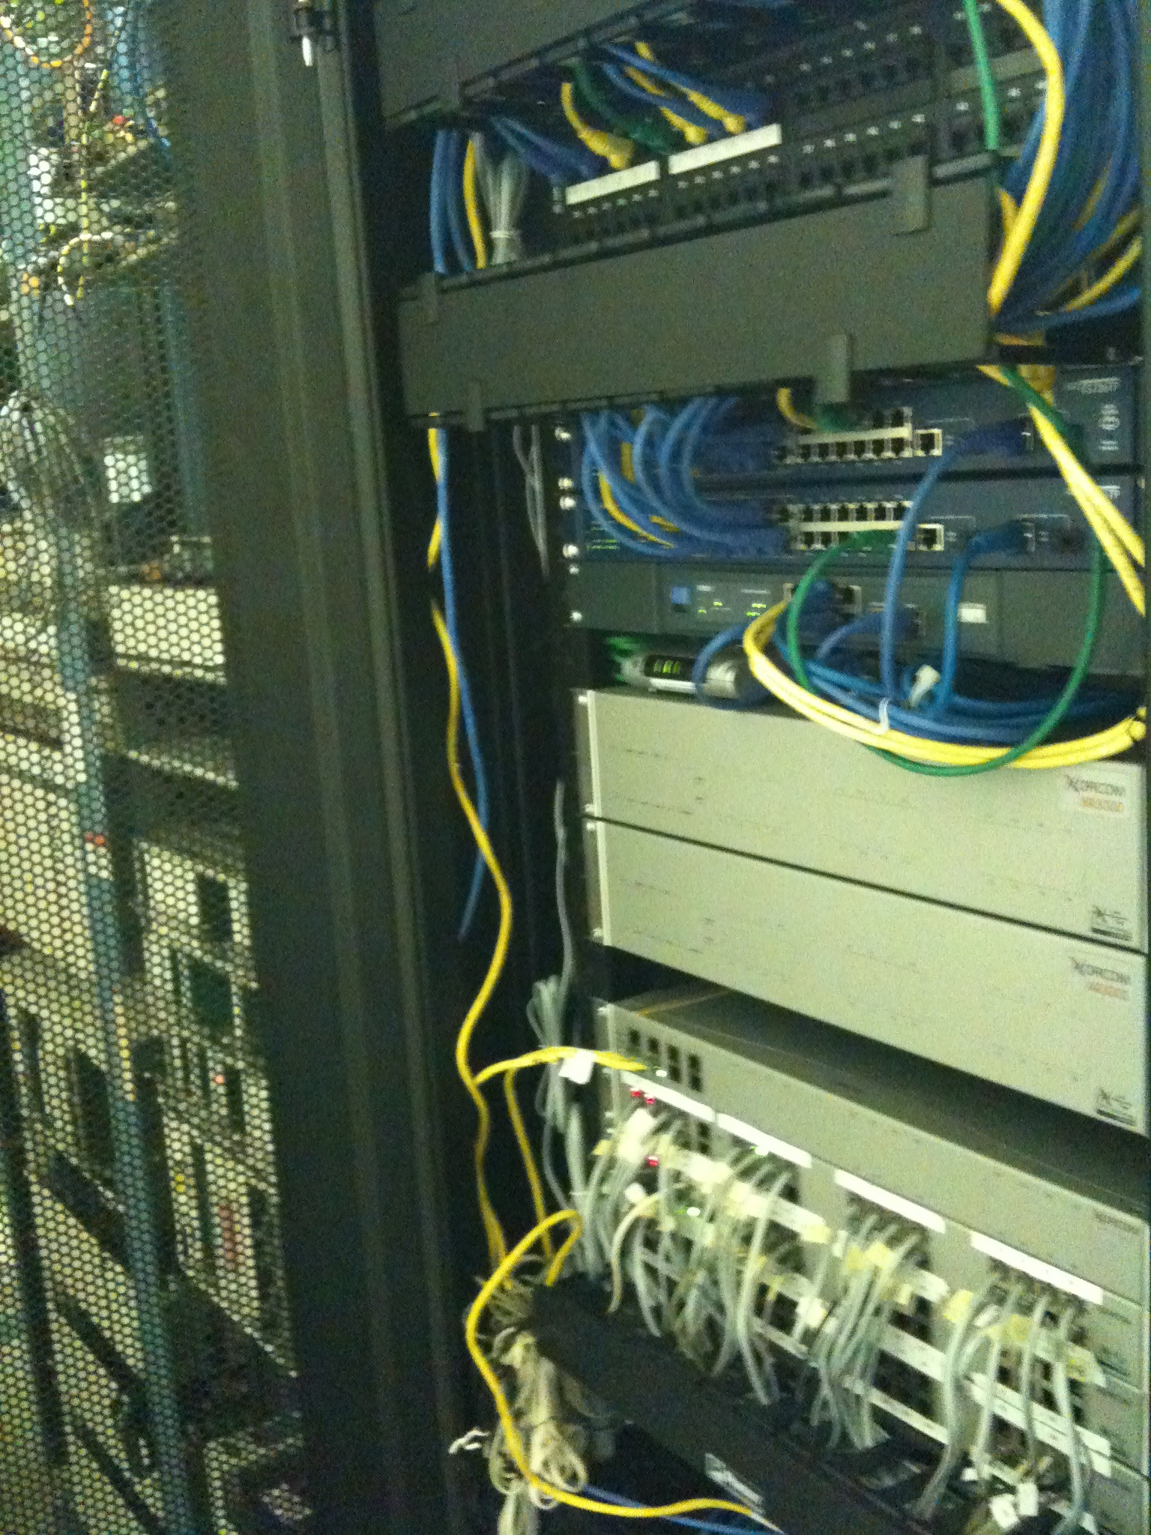
Primary PBX Server
Backup PBX Server
USB 2.0-connected telephony modules with built-in redundancy firmware

Slide 38
“The TwinStar Hot Failover solution from Xorcom really does minimize the possibility that we will ever be down for any length of time and as you can imagine, not having telephones work properly in our business is not an option.”
Pete Aiello, VP of Marketing and Simulcasting for Hialeah Park

Slide 39
Thank You
www.xorcom.com

