Slide 1
“Delivering Superior Voice with HD Codecs” (D-01)
1/21/2010, 8:30-9:15am
Andrew Nicholson,
Product Manager, Aculab

Slide 2
A brief overview of Aculab
Leading developer and provider of enabling communications technology since 1990
Products include:
Digital network access
Media processing resources
Gateways and protocol conversion
Products and platforms that enable developers/providers to deliver powerful solutions
DSP-based media processing
Software-based host media processing (HMP)
Vast array of protocol and standards support
Engineering support to put the technology to work

Slide 3
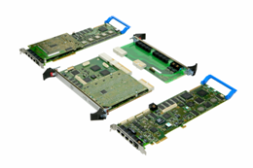
Prosody media processing platforms
Prosody X
PCIe / PCI / cPCI
High density media processing with IP connectivity and optional
E1/T1 trunks
Prosody S
High density host media processing with
IP connectivity

Slide 4
Wideband Codecs

Slide 5
Aculab and wideband voice
Wideband codecs we currently have:
G.722
G.722.1 (licensed from Polycom®)
G.722.2 (a.k.a AMR-WB), the codec used for 3G mobile networks
iSAC (from GIPS)

Slide 6
Thank you
andrew.nicholson@aculab.com

