Slide 1
Utilizing White Spaces for broadband access: Where do we go from here?
Agenda:
Spectrum Bridge Overview
The Spectrum Shortage…
TV White Spaces Background & Advantages
Telco Applications
White Spaces Case Study
Beyond TV White Spaces: Secondary Markets
The Future: Universal Spectrum Access
Rick Rotondo
CMO & Co-Founder
Spectrum Bridge Inc
1/21/2010

Slide 2
Spectrum Bridge:
Spectrum Bridge was formed to address growing spectrum scarcity by:
Making access to spectrum faster ,easier and more cost-effective
Helping network operators intelligently allocate existing spectrum
Increasing the efficient use of spectrum so that it can deliver more bandwidth to users
Created SpecEx.com – the worlds largest secondary market exchange for spectrum
Developed SmartWaves – the industries first business analytics tool for spectrum assets
Deployed the world’s first TV white spaces network in Claudville VA (10/09)

Slide 3
FCC Chairman on Spectrum Scarcity

Slide 4
TV White Spaces Overview
TV White Spaces:
The TV broadcast channels leftover from the Digital TV transition in June 2009
Spans from 54 – 698 MHz
6MHz wide channels = Broadband
FCC unlicensed use = Free!
Highly desirable frequencies
Great non-line-of-sight coverage
Bends around obstacles
Excellent building, wall and foliage penetration
Considered “Beach Front”

Slide 5
Bandwidth Allocation by Radio Service
White Space Channel Allocation = 282 MHz (47 x 6 MHz channels)
Channel Availability, Nationwide Average: 204 MHz (34 channels)
High Power Channel Availability, Nationwide Average: 108 MHz (18 channels)

Slide 6
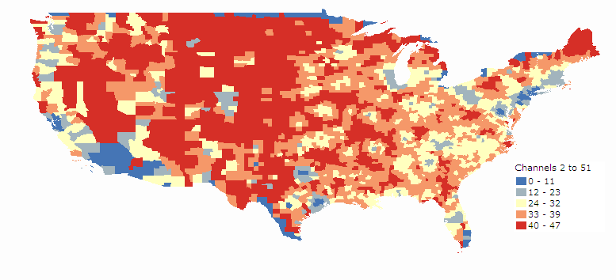
Taking Advantage of TV White Spaces
Rules Enable Use for Utility Apps and Smart Grid
White spaces radios must get channel authorization list from internet database

Slide 7
White Spaces: Database Driven Dynamic Spectrum Access
Makes it easy to efficiently use bits and pieces of spectrum

Slide 8
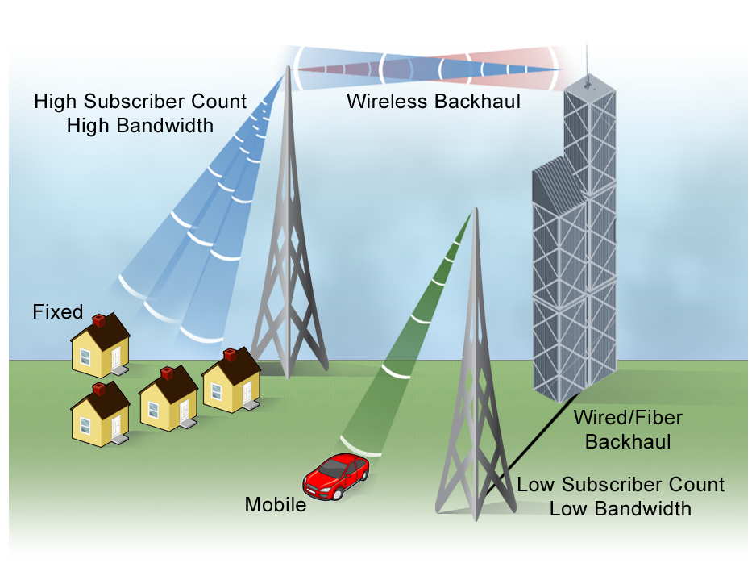
Ideal for a Wide Range of Fixed and Mobile Applications
Fixed Broadband Access
Rural Broadband
Middle Mile
link WiFi Hotspots
Wireless Backhaul
Mobile Broadband
Smart City Networks
M2M Communications
Link Backup (P2MP And Point2point)
Broadband Telemetry
Remote Security, Video And Control
Disaster Recovery
Campus-area Networks
In Home/Office Networks
We are actively looking for White
Spaces trials and radio partners!

Slide 9
Claudville VA: World’s First TV White Spaces Network
Previous: Dial-up and Sat-based internet only
Deployed a 5 node TV WS system:
Main radio transmitter at edge of town
Radios at school, business district, 2 residences
WiFi hotspots at school and business district
Results:
Over 1.8 miles NLOS
100% uptime (even in heavy rain/snow)
2Mb/s links
School recently dropped their sat internet service
Experimental license, prototype radios

Slide 10
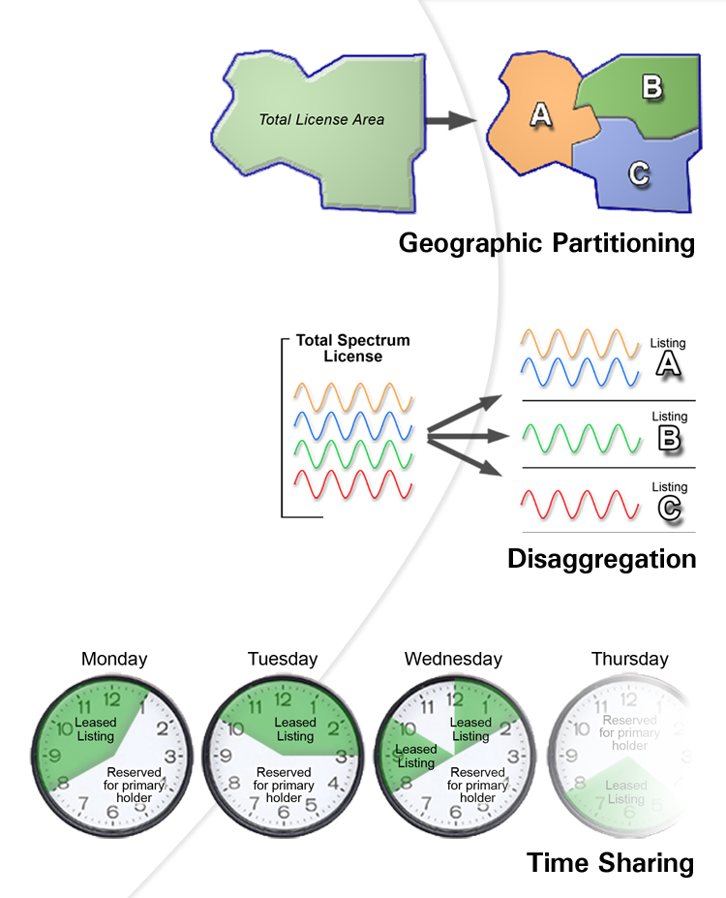
Secondary Market Opportunities “Licensed White Spaces”
FCC Rules Enable Creative Spectrum Use
Wholesale License transfers
Leasing
Short term
Long term
Partitioning
Repurposing of Spectrum
Waivers for legacy rules
Spectrum Sharing

Slide 11
SpecEx: The Online Marketplace for Spectrum

Slide 12
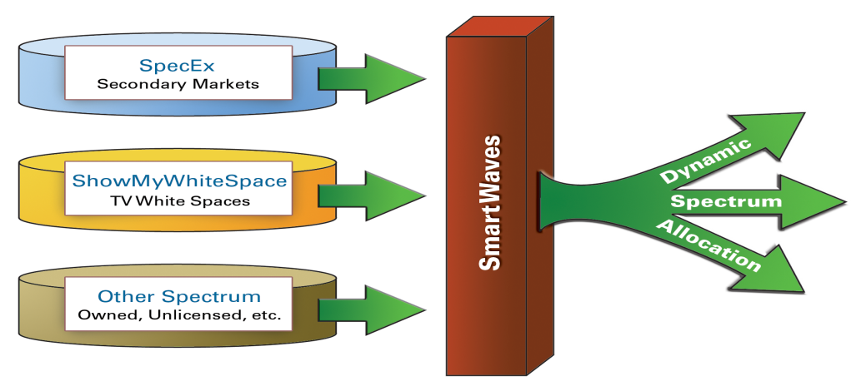
The Future: Universal Spectrum Access
Dynamic Allocation of:
“Owned Spectrum”
Unlicensed Spectrum (incl. TV and other White Spaces)
Spectrum on the Secondary Market (short term leases)
Database Driven (similar to TV White Spaces)
Spectrum is Put to its Highest Economic Use
Visit: www.SpectrumBridge.com for more on Universal Spectrum Access
Spectrum Scarcity

Slide 13
Thank You!
Rick Rotondo
CMO & Co-Founder
Spectrum Bridge Inc.
www.spectrumbridge.com
rick@spectrumbridge.com

