Slide 1
Utilizing White Spaces for broadband access Where do we go from here?
Fanny Mlinarsky
octoScope

Slide 2
Speakers
Fanny Mlinarsky – Moderator
President and CTO, octoScope
State of the industry and standards
Rick Rotondo
VP Marketing and CO-Founder, Spectrum Bridge
Flexible uses and novel licensing models in White Space
Chris Whiteley
Director of Business Development, xG Technologies
VoIP over White Space and other BWA applications

Slide 3
Introducing TV White Spaces
November 4, 2008 FCC approved Report & Order 08-260, allowing unlicensed use of TV band spectrum
Ofcom (UK) is in the process of making this Digital Dividend band available
EU has conducted a consultation on the band
China TV band regulations expected in 2015
TVBD = TV Band Device

Slide 4
Frequency Allocation of TV Channels
 | Channel # | Frequency Band
 | 2-4 | 54-72 MHz | VHF
 | 5-6 | 76-88 MHz
 | 7-13 | 174-216 MHz
 | 14-20 | 470-512 MHz** | UHF
 | 21-51* | 512-692 MHz
Fixed TVBDs only
*Channel 37 (608-614 MHz) is reserved for radio astronomy
**Shared with public safety
http://www.fcc.gov/mb/engineering/usallochrt.pdf
June 12, 2009 transition from analog to digital TV freed up channels 52-69 (above 692 MHz) thanks to spectral efficiency of digital TV

Slide 5
FCC Rules
TVBDs require geolocation capability and Internet access to a database of protected radio services. The TVBDs must first access the database before operating.
Fixed devices can operate on any channel between 2 and 51, except 3, 4 and 37
Channels 2 – 20 are restricted for use by fixed devices to protect wireless microphones
Fixed and personal portable devices must sense TV broadcasting and wireless microphone signals
May not happen!

Slide 6
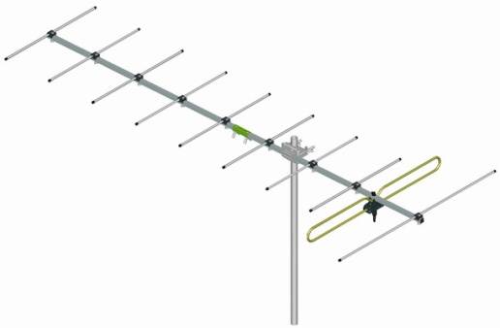
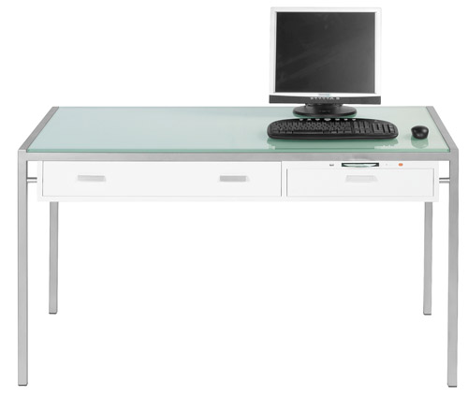
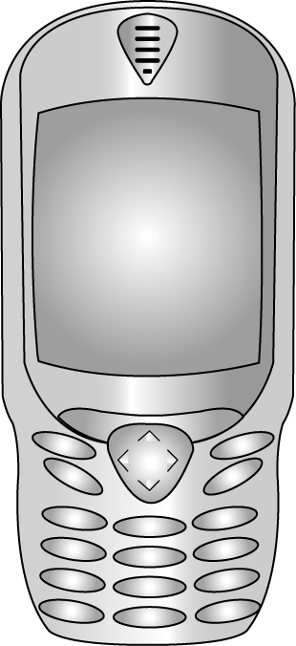
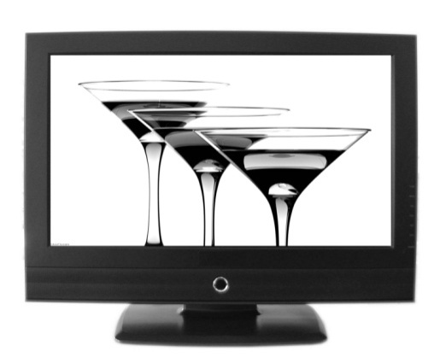
Hidden Node Scenario
TV signal attenuated by an obstruction (wall) is undetectable by a TVBD. TVBD transmits, interfering with TV broadcast, which is received unobstructed by a rooftop antenna.
TV broadcast received by an unobstructed rooftop TV antenna

Slide 7
Standards Organizations Involved
IEEE 802.11af – formed in January 2010 to adapt 802.11 to TV band operation
IEEE 802.16h – originally organized to adapt 802.16 to the 3650-3700 MHz contention band (see next slide), now also working on TV band operation of 802.16
IEEE 802.22 – cognitive radio approach
Regional Area Networks group that guided the FCC in the recent TV band regulations
Uses spectrum sensing and location information to determine whether given transmit frequencies and power levels will cause harmful interference to licensed services.

Slide 8
Lightly Regulated Band
March 2005 FCC offered 50 MHz 3650 to 3700 MHz for contention-based protocol
802.11y and 802.16h are expected to share this band
21st century regulation geared for digital communications
multiple services to share the band in an orderly way
300 Million licenses one for every person or company
$300 per license for 10 years
Registered stations (base stations): 1 W/MHz, ~15 km
Unregistered stations (handsets, laptops): 40 mW/MHz, 1-1.5 km

Slide 9
802.11af – TVBD Amendment
The goal is to keep new amendment as simple as possible – a few changes to make .11 work in TV bands; capitalize on work already done in 802.11y
About 15 pages / 2 years to approval
Use the OFDM PHYs with 5-, 10- and 20-MHz channel widths to specify the basis for a system that the regulators can approve for operation in the TV white spaces bands.
Focus engineering effort on well defined regulatory domains (Canada, US, EU,…)

Slide 10
802.11af Deployment Scenarios
Re-banding of the popular 802.11 systems
FCC EIRP: 4 W, 100 mW, 50 mW
Possible deployment scenarios
Indoor (< 100 m): like present WLAN
Outdoor (< 5 Km): comparable to the range of typical urban model
IEEE 802.11-10-0154-00-00af

Slide 11
SDR Forum Efforts
In Home Networking
WhiteFi (rural ISP service)
Wireless Control/Sensors (e.g. Smart Grid)
Secondary Broadcast
Microcell Broadcast
Military Equipment
Public Safety Equipment
WiFi on Steroids
Body Area Networks
Sensor Networks
TVBD to WiFi Gateway
Low Data Rate devices with intermittent use
SDR Forum is working with the FCC on test and measurement methodology for white spaces
Use case scenarios the SDR Forum is currently studying

Slide 12
Other Standards Organizations
ECMA International TC48-TG1 is developing PHY-MAC and coexistence protocols for wireless networks in the TV band http://www.ecma-international.org/memento/TC48-TG1.htm
Sponsor Organization: ECMA International (http://www.ecma-international.org ) and CogNeA (http://www.cognea.org )
Expected adoption by ISO/IEC: Oct. 2010

Slide 13
VHF/UHF Beach-front Property?
Lower frequencies experience lower attenuation in free space and through obstructions, e.g. buildings
However, when propagating through metal frames in modern buildings, Fresnel zone gets constricted and attenuation is introduced
Antenna – optimum length is a multiple of ¼ wavelength
3.3 feet for 70 MHz
4” for 700 MHz
1” for 2.4 GHz
Longer antennas required for UHF may be problematic for handheld devices

Slide 14
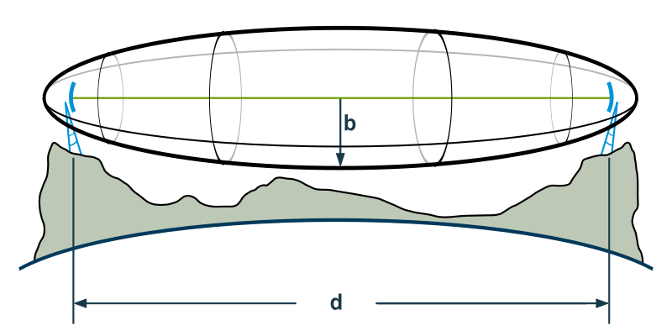
Antenna Fresnel Zone
r
D
r = radius in feet
D = distance in miles
f = frequency in GHz
Fresnel zone is the shape of electromagnetic signal and is a function of frequency
Constricting the Fresnel zone introduces attenuation and signal distortion
Example: D = 0.5 mile
r = 30 feet for 700 MHz
r = 16 feet for 2.4 GHz
r = 10 feet for 5.8 GHz

Slide 15
What’s to Come…
Products expected in about 2 years
Wi-Fi may be the first protocol to make use of white spaces

Slide 16
US TV Band Proposals to FCC
Comsearch
http://fjallfoss.fcc.gov/ecfs/document/view?id=7020355190
Key Bridge Global
http://fjallfoss.fcc.gov/ecfs/document/view?id=7020356596
WSdb
http://fjallfoss.fcc.gov/ecfs/document/view?id=7020355170
http://fjallfoss.fcc.gov/ecfs/document/view?id=7020355171
http://fjallfoss.fcc.gov/ecfs/document/view?id=7020355172
http://fjallfoss.fcc.gov/ecfs/document/view?id=7020355173
http://fjallfoss.fcc.gov/ecfs/document/view?id=7020355174
http://fjallfoss.fcc.gov/ecfs/document/view?id=7020355175
Spectrum Bridge
http://fjallfoss.fcc.gov/ecfs/document/view?id=7020355177
NeuStar
http://fjallfoss.fcc.gov/ecfs/document/view?id=7020355229
http://fjallfoss.fcc.gov/ecfs/document/view?id=7020355230
http://fjallfoss.fcc.gov/ecfs/document/view?id=7020355231
Key Bridge Enterprises
http://fjallfoss.fcc.gov/ecfs/document/view?id=7020355219
http://fjallfoss.fcc.gov/ecfs/document/view?id=7020355220
http://fjallfoss.fcc.gov/ecfs/document/view?id=7020355221
Telcordia
http://fjallfoss.fcc.gov/ecfs/document/view?id=7020355227
Google
http://fjallfoss.fcc.gov/ecfs/document/view?id=7020355207
Frequency Finder
http://fjallfoss.fcc.gov/ecfs/document/view?id=7020355224

Slide 17
Speakers
Fanny Mlinarsky – Moderator
President and CTO, octoScope
State of the industry and standards
Rick Rotondo
VP Marketing and CO-Founder, Spectrum Bridge
Flexible uses and novel licensing models in White Space
Chris Whiteley
Director of Business Development, xG Technologies
VoIP over White Space and other BWA applications

Slide 18
Speakers
Fanny Mlinarsky – Moderator
President and CTO, octoScope
State of the industry and standards
Rick Rotondo
VP Marketing and CO-Founder, Spectrum Bridge
Flexible uses and novel licensing models in White Space
Chris Whiteley
Director of Business Development, xG Technologies
VoIP over White Space and other BWA applications

Slide 19
Q & A
Fanny Mlinarsky
President and CTO, octoScope
Rick Rotondo
VP Marketing and CO-Founder, Spectrum Bridge
Chris Whiteley
Director of Business Development, xG Technologies
?

Slide 20
To Learn More…
Articles, white papers, test reports and presentations
http://www.octoscope.com/English/Resources/Articles.html
Contact Fanny Mlinarsky (fm@octoScope.com) Mobile: 978.376.5841 www.octoscope.com
Wireless CTO and product development services

