Slide 1
your friends, mobile
your mobile social hub

Slide 2
fring is your mobile social hub…
Where you meet, communicate and share experiences with all your online friends, using an intuitive and integrated internet experience, all directly from your mobile device.
Internet
friends
Social alerts
Friends locator
IM
Voice Calls
Music
Maps & Location
Video Calls
Features >>

Slide 3
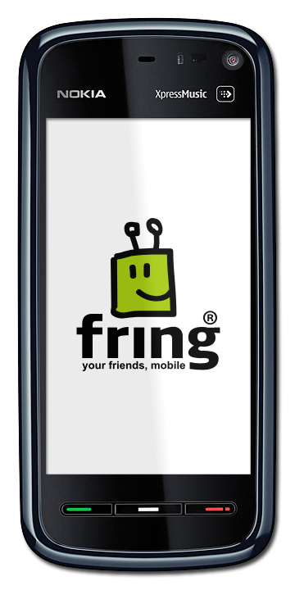
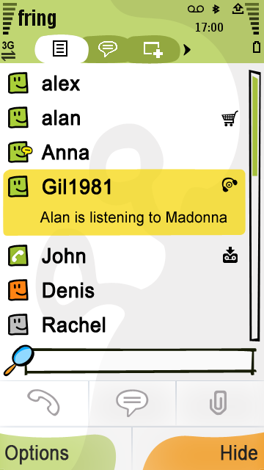
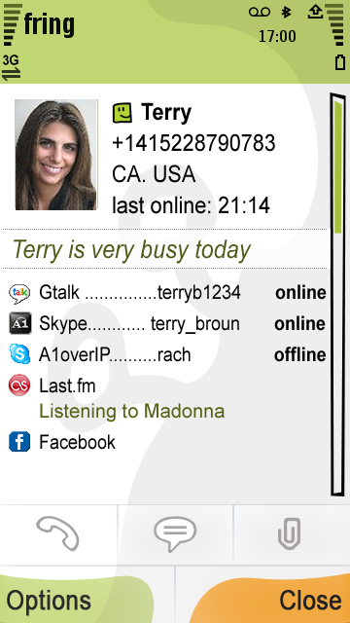
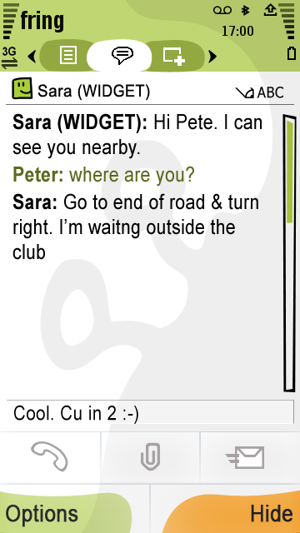
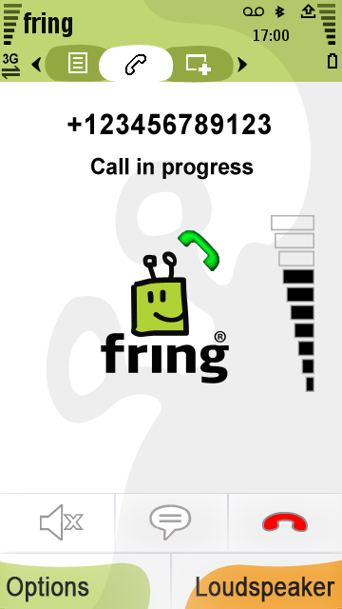
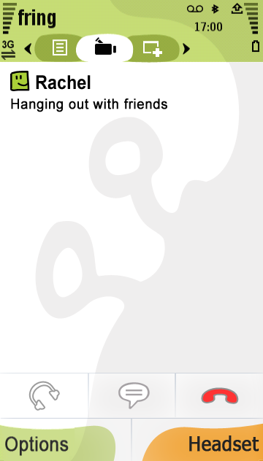
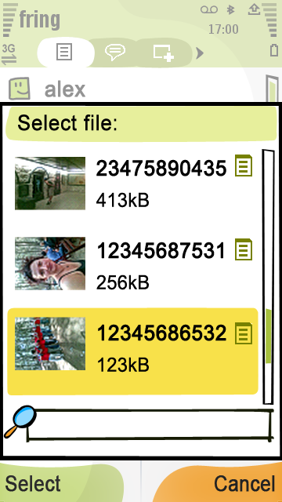
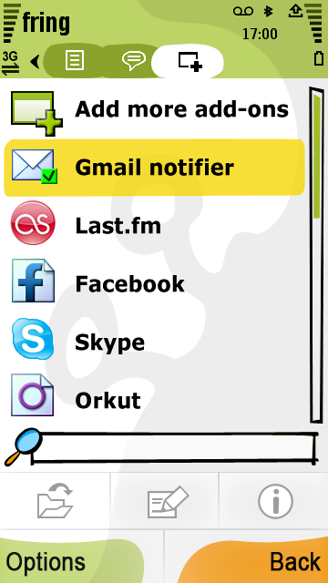
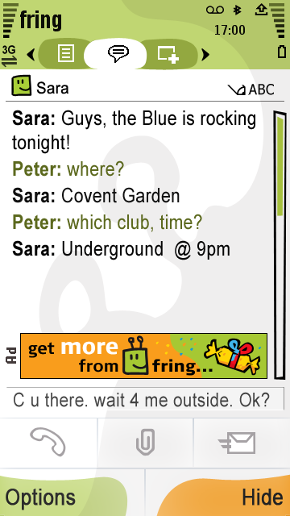
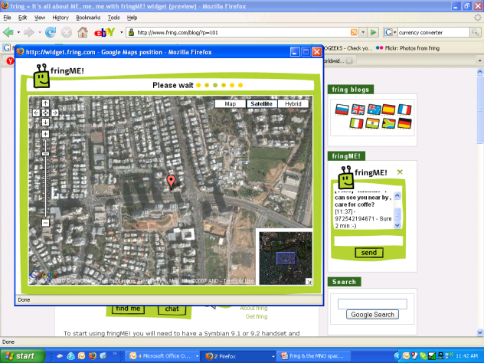
See who’s available and where…
Location
Dynamic Buddy list
The Experience Launchpad
Dynamic user profile
Friends + Experiences
Communication Options
Mobile Social Experience
Platform
send music & pictures to your friends
Call
Video calls
VoIP calls to other fringsters, online communities & GSM contacts
Chat
Live video calls between fringsters and social networks
Send files to fringsters & online community buddies
View fringster’s real-time location & communicate with them from any online device with fring web widget & Google Map
(GPS or Cell-ID)
Live rich IM chat between fringsters & online communities
Add-ons created by 3rd party developers, utilizing the platform’s “community glue”
Real-time presence
indication
Real-time User Generated Content


Real-time status for each service
Real-time Behavior/
Context
Real-time User generated content
Communities & services subscribed to by user
Real-time content generated by add-on

Slide 4
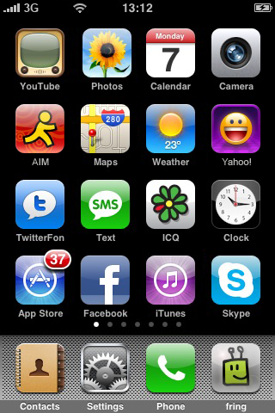
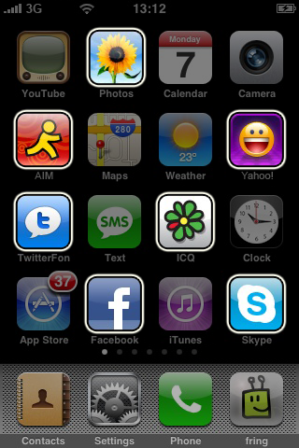
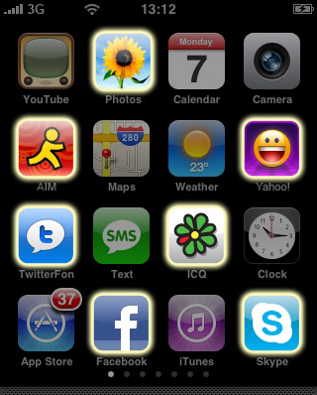
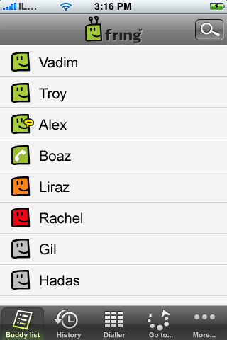
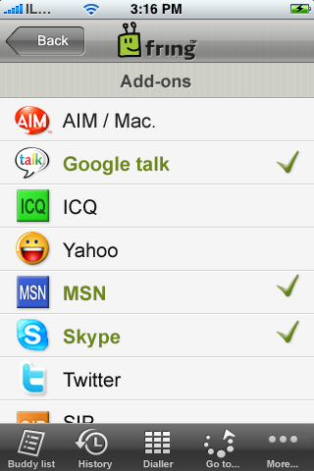
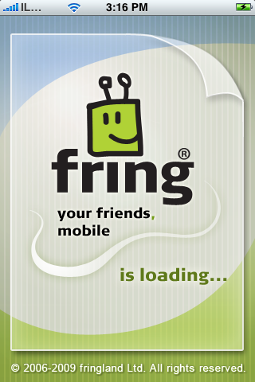
So why fring? Consumers
Why go in & out, in & out of each separate app looking for your friend…
When you can interact with ALL your friends wherever they are, from fring

Slide 5
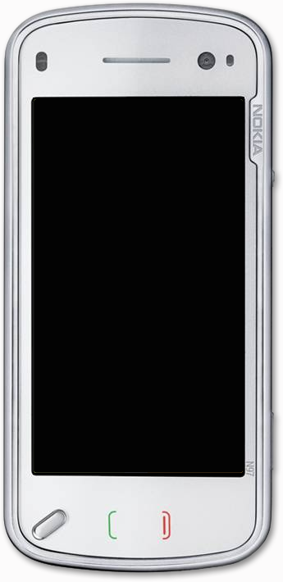
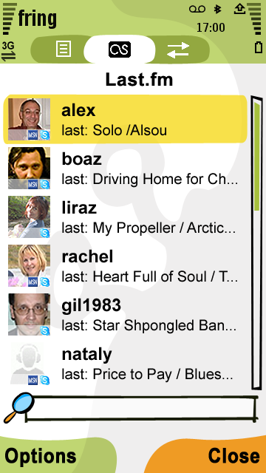
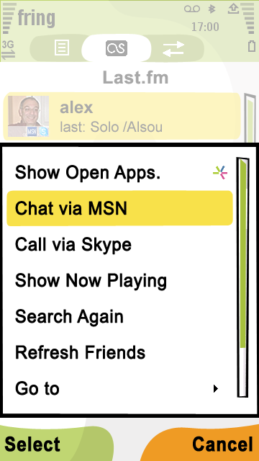
So why fring? Consumers
Mash- up the social communities together
Why fring? Partners >>

Slide 6
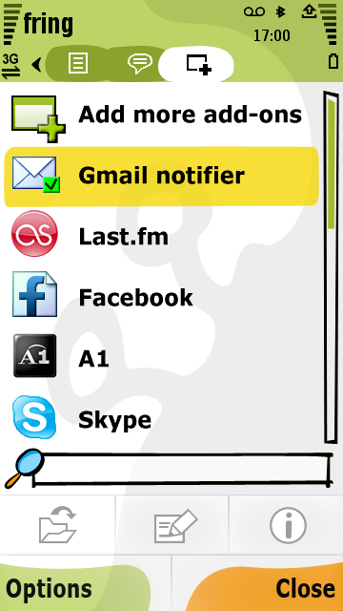
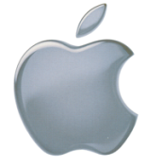
So why fring? Commercial Partners
Value-added services ARPU
Synergistic commercial opportunities from social mash-up of services e.g.
social networking + LBS
file sharing + presence
opted-in content based advertising
cross-social platform experience sharing
Unique 3rd-party add-ons offering
To their own user-base
Subscription-based, ad-funded/ free
Reduce churn
Keep users engaged
Expose subscribers to more rich services
Convert computer web interaction to mobile device air time
Technology >>

Slide 7
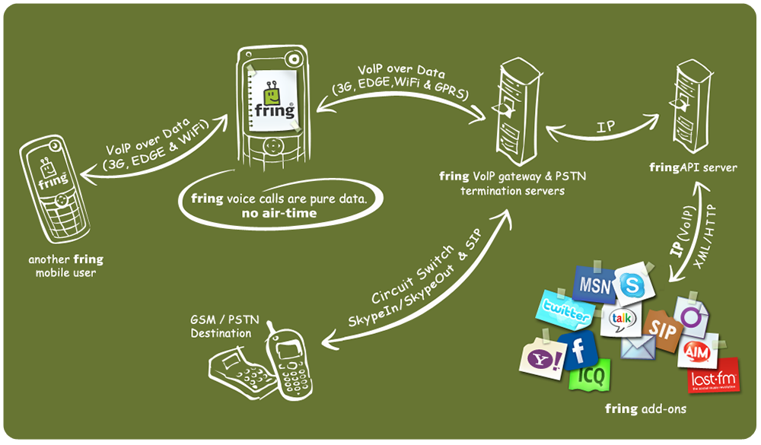
High level architecture

Slide 8
How does fring do it?
Thin client technology
Compatible with 7 mobile platforms
native narrow and wide band CODECS
native GUI integration
efficient battery use
minimal CPU and memory usage
3-sided P2P network architecture
Patented hybrid peer to peer client server mobile optimized architecture
VoIP over low-speed GPRS, optimized for 3G , roam over high-speed Wi-Fi networks
Mobile VoIP compatible with existing wireline VOIP systems
(i.e. Skype, Google Talk, MSN Messenger & SIP)
Add-ons… web services in the cloud
(i.e. Twitter, Last.fm, Facebook & WeFi )
The result >>

Slide 9
The result…
multi Platform
Symbian S60 (Jan. 07)‏ , Windows Mobile 5, 6 (June 07)‏, Symbian UIQ (July 07)‏, iPhone (April 08), J2ME (June 08) Linux (June 08)
multi Community
fring (Jan. 07)‏, Skype (Jan. 07)‏, Google Talk (Jan. 07)‏, Windows Live (Feb. 07)‏, SIP (March 07)‏, twitter (May 07)‏, ICQ (Aug 07)‏, Yahoo (Dec 07), AIM (Dec 07), Orkut (June 08), Facebook (June 08)
multi Bearer
GPRS/HDGE/3G (Jan. 07)‏, Wi-Fi (Jan. 07)‏, EVDO/CDMA (June 07)‏, WiMAX
Growth >>
Notes:
9

Slide 10
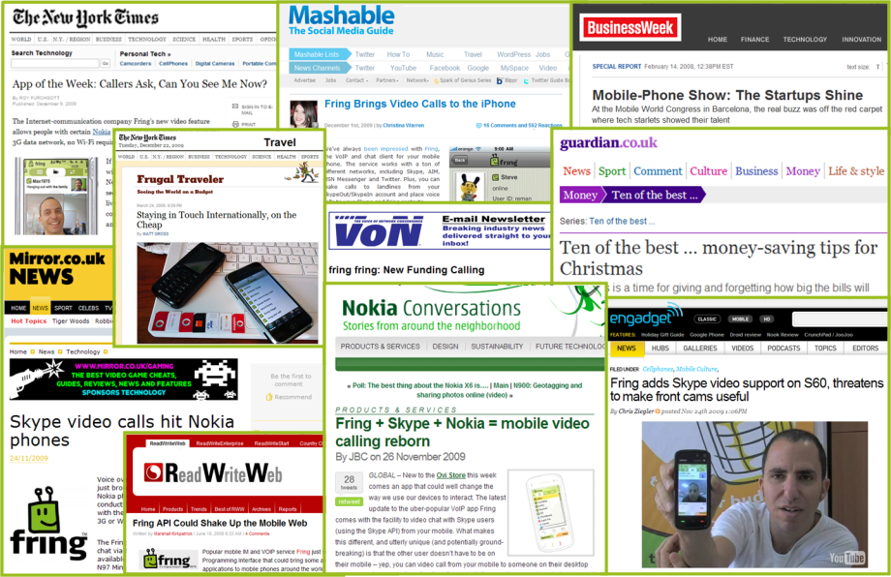
from the press…

Slide 11
your friends, mobile
Boaz Zilberman
CSA
boaz@fring.com

