Slide 1


Slide 2





Slide 3



Hattan Shobokshi
mvcdotnet.wordpress.com

Slide 4


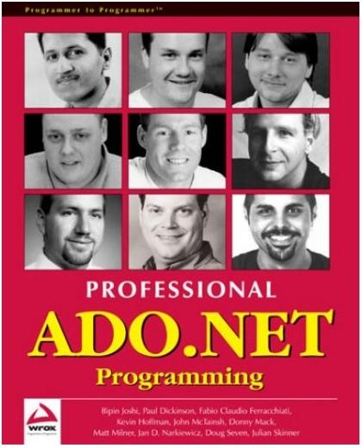
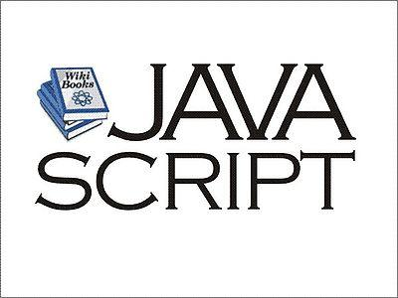
Web Development in the Past (Microsoft Stack)

Slide 5






















Web Development Today

Slide 6
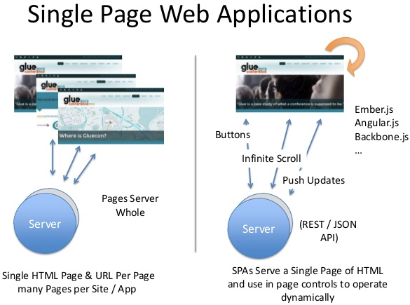
SPA

Slide 7

Angular JS
Works with any server side technologyASP.NET, Node, Php, Ruby on Rails ...
Declarative Data binding
Highly Testable
Does NOT depend on jQuery, BUT includes jQlite
Features: Client Side Routing, Services, Dependency Injection

Slide 8


Slide 9

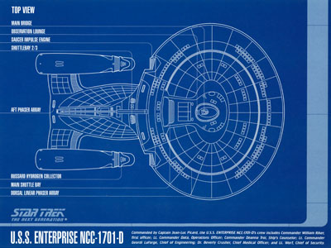
Library vs Framework

Slide 10
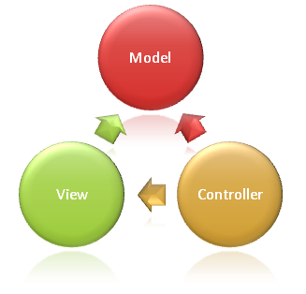
Model View Controller
Controller : Responds to User Interaction
Model : Data
View : Representation of Data

Slide 11
HTML was built for documents not web APPLICATIONS

Slide 12
Angular is what HTML would have been had it been designed for applications

Slide 13
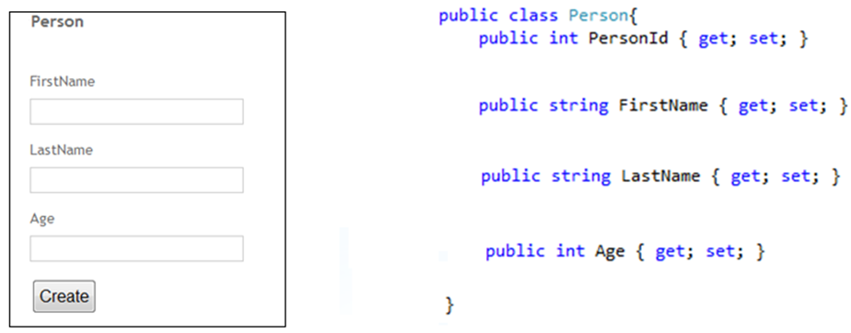
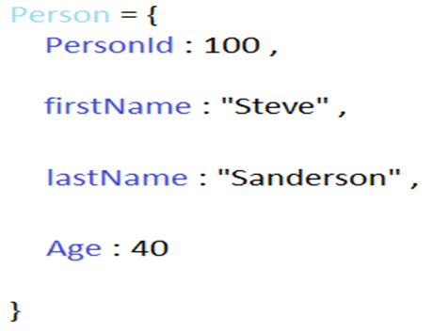

Data binding

Slide 14


DEMO

Slide 15
The future
Object.Observe
Shadow DOM

Slide 16
The end
QUESTIONS?

