Slide 1
dreamfactory billappleton@dreamfactory.com
DreamFactory
Services Platform

Slide 2
The Mobile Disruption
Cross-platform mobile dev tools $8.2 billion by 2016
87% of CIOs want data and apps on mobile
By 2015 wireless web use will surpass wired
HOT | NOT
Web app | Web site
Wireless | Ethernet
Smart client | Web browser
App store | Intranet
REST API | App server
JSON & XML | HTML

Slide 3
The Rise of Services
Mobile
Browsers
Desktop
Servers
SOA
XML-RPC SOAP REST JSON

Slide 4

HTML5 or Native
Consume REST API from
Browser or Smart Client
DreamFactory
Install open source software package or get free hosting on our website
External Services
Hosted SaaS or integration with your cloud / virtual machine
HTML5
Sencha
jQuery
Angular
Native
iOS
Android
Win 8
Other
Desktop
Server
Wearable
User Mgmt
OAuth, SSO
Permissions
Local Assets
File storage
SQL database
Email service
App Hosting
Multiple apps
Dynamic SDK
Security
Credential hiding
Session mgmt
Service palette
NoSQL
MongoDB
DynamoDB
Azure Tables
SQL
MySQL
Any Relational
Salesforce
File Storage
AWS S3
Azure BLOB
Openstack
External REST
REST API
with
JSON or XML
Documents
Secure Server Side Proxy

Slide 5
No Lock-In
Backend Service | DSP | Client Interface
Document Storage AWS S3, Azure BLOB CloudFiles, Open Stack Local file system |  | Document Storage REST API
SQL Services Local SQL Database MySQL, PostgreSQL DB2, ANSI SQL |  | SQL Services REST API
NoSQL Database MongoDB, MongoHQ SimpleDB, DynamoDB CouchDB, Azure Tables |  | NoSQL Database REST API
Swap out backend services without disrupting applications.

Slide 6



HTML5 Friendly
Write once run on any device.
PhoneGap packaging for device access.

Slide 7




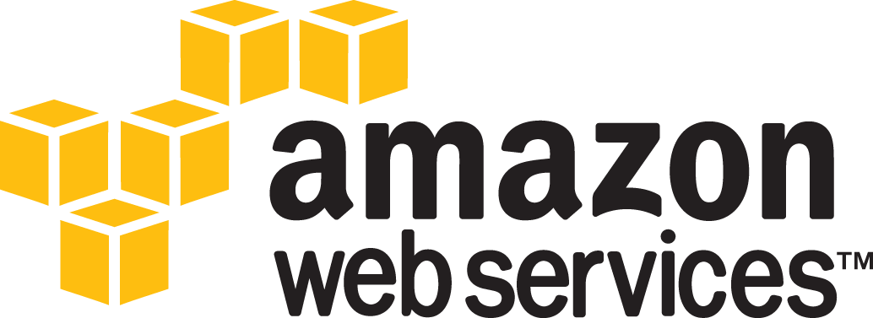



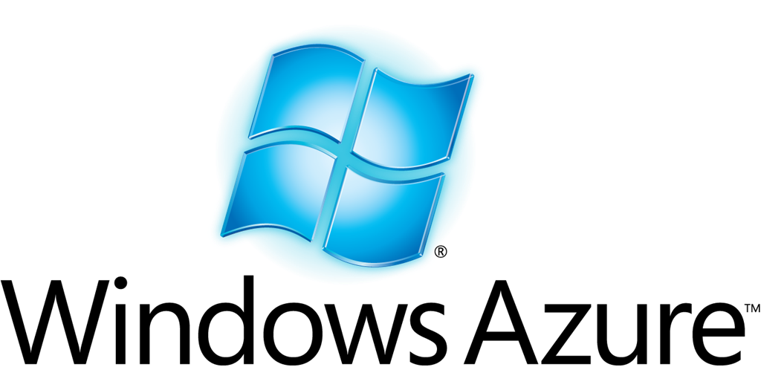
Deploy Anywhere
Free developer account or install open source software package. Move applications and data between platforms.

Slide 8
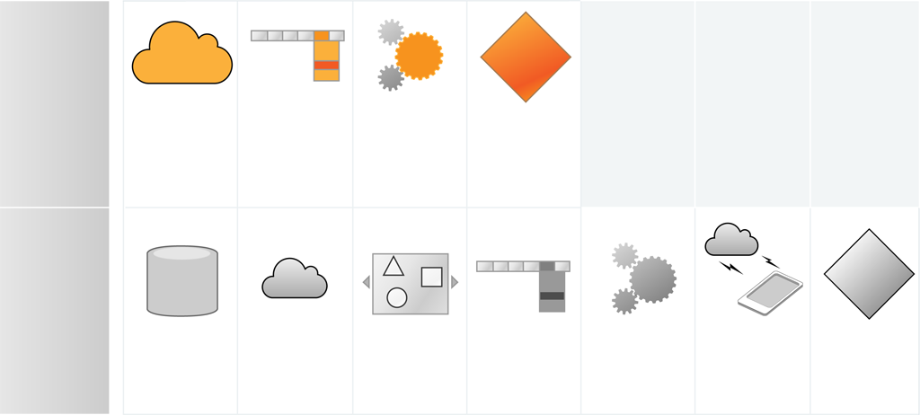
Faster, Better, Cheaper
One Engineer
New
Install
Services
Platform
Design
User
Interface
Create
Client
Application
Delivery
Old
Server Team
Configure
Server &
Software
Design
Backend
Services
Create
Services
Interface
Design
User
Interface
Create
Client
Application
Test
Services
Interface
Delivery
Now a single engineer can build a mobile enterprise application without any server-side software development.

Slide 9
Case Studies
Rich Client
Global retailer has 5000 users,17 countries, 9 clouds
DreamFactory improves communication between HQ and Retail
HTML5 Mobile
Development agency builds corporate Address Book in six weeks
Built in Sencha Ext JS for desktop, tablet, and phone
DreamFactory connects to the back end enterprise resources
iOS Native
Circa5 creates Heisenbug for enterprise IT
DreamFactory provides user management and database
C# Device
OpenNetCF builds industrial process control software
DreamFactory used for cloud storage, control, and monitoring
HTML Website
SoundCloud mobile-optimized website uses DSP for backend
DreamFactory delivers file storage, database, external integration

Slide 10
Appendix
Value Prop
Enterprise Security
Design Points
Screenshots

Slide 11
Value Prop
For software developers
No need for server-side software development
Smaller teams for front end only: lower costs
Better user experience on mobile devices
Support for occasional connection
More secure than “roll your own”
Faster time to value
For system administrators
Less network traffic, lower mobile data bills
Apache License for your cloud or data center
Manage platform with familiar tools for AWS or Azure
Move apps between development, testing, and production
Lower cloud hosting cost for compute, storage, and transactions
Service abstraction prevents lock-in

Slide 12
Enterprise Security
Server-side characteristics
Open source code base + security audits
Buffer overrun and SQL injection aware
Runs on your cloud infrastructure
Client-side controls
Comprehensive unified services palette
User management, single sign-on, open registration, guest accounts
Instant session updates for administrative changes
Programmable CORS support
User roles and permissions
Control application visibility
CRUD access for SQL data objects
CRUD access for Big Data sources
Expose BLOB storage systems by folder tree
REST access to services with credential hiding

Slide 13
Design Points
Standards-Based REST Service Architecture
GZIP compression for 95% bandwidth reduction
JSON object, array, and relationship support
Document exchange less than 250 milliseconds
Session ID as Cookie or URL parameter
Swagger support for documentation and testing
Programmable CORS services (run on website or desktop)
Server Software Package for LAMP Stack
VHD package for any Virtual Machine
Compatible with many different databases
Compatible with multiple processors, load balancers, etc.
Compatible with server side HTML page generation
Works out of the box but can also be customized
Service virtualization allows application migration

Slide 14
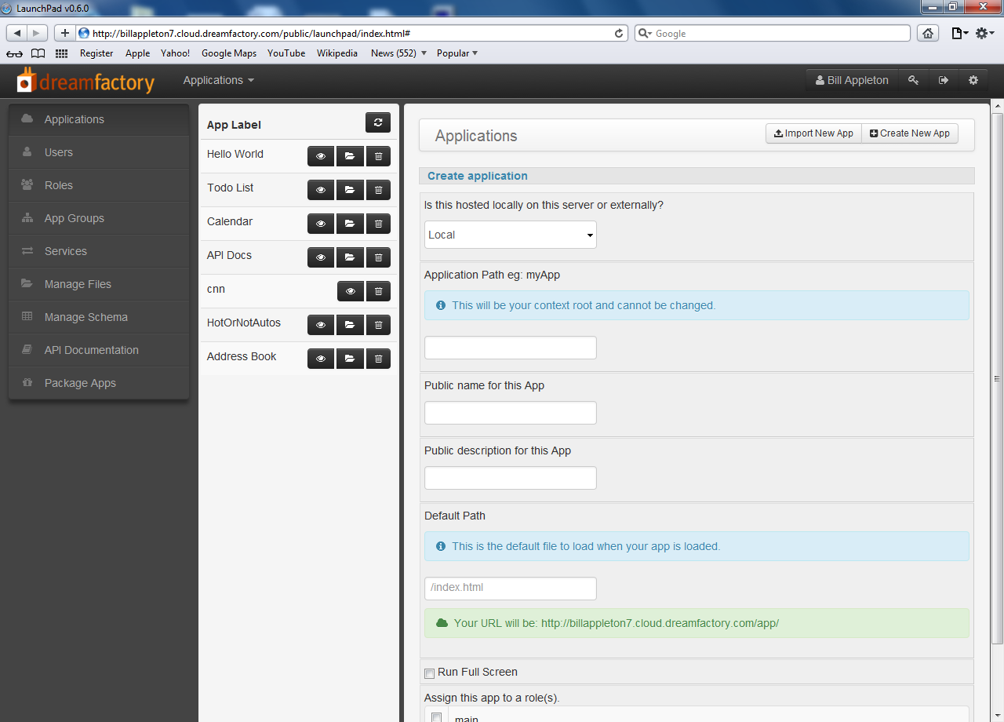
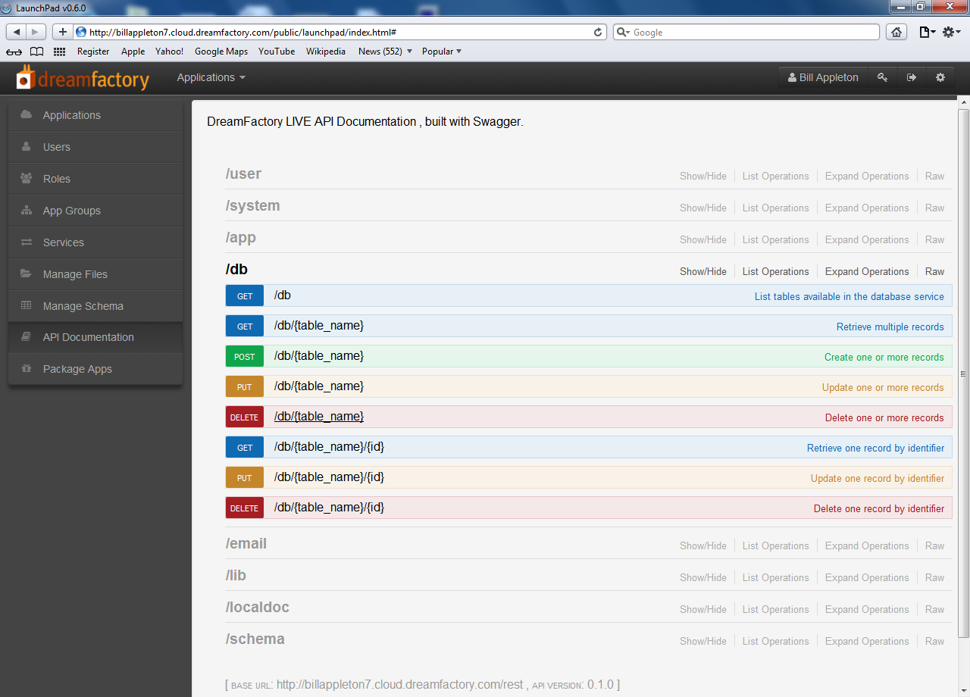
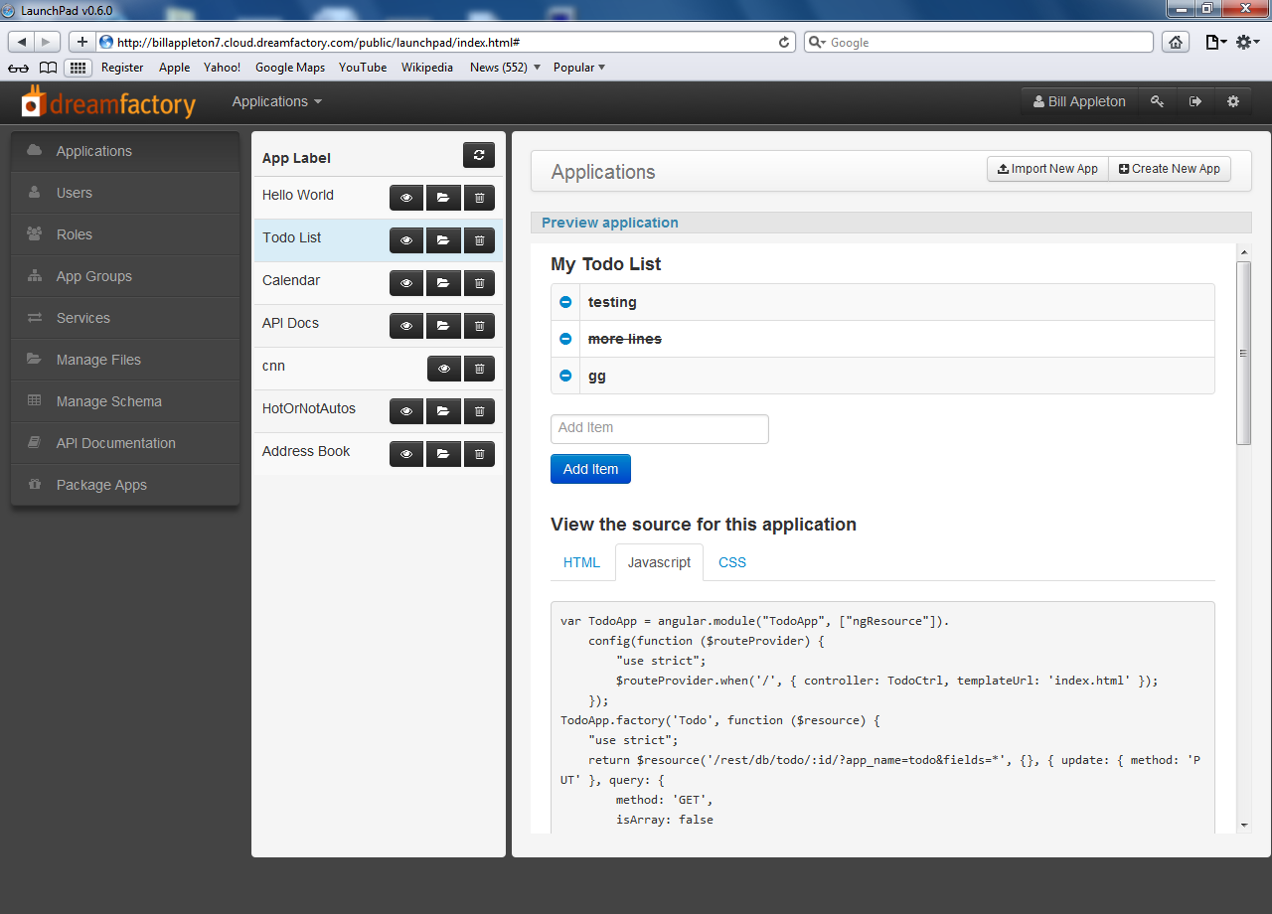
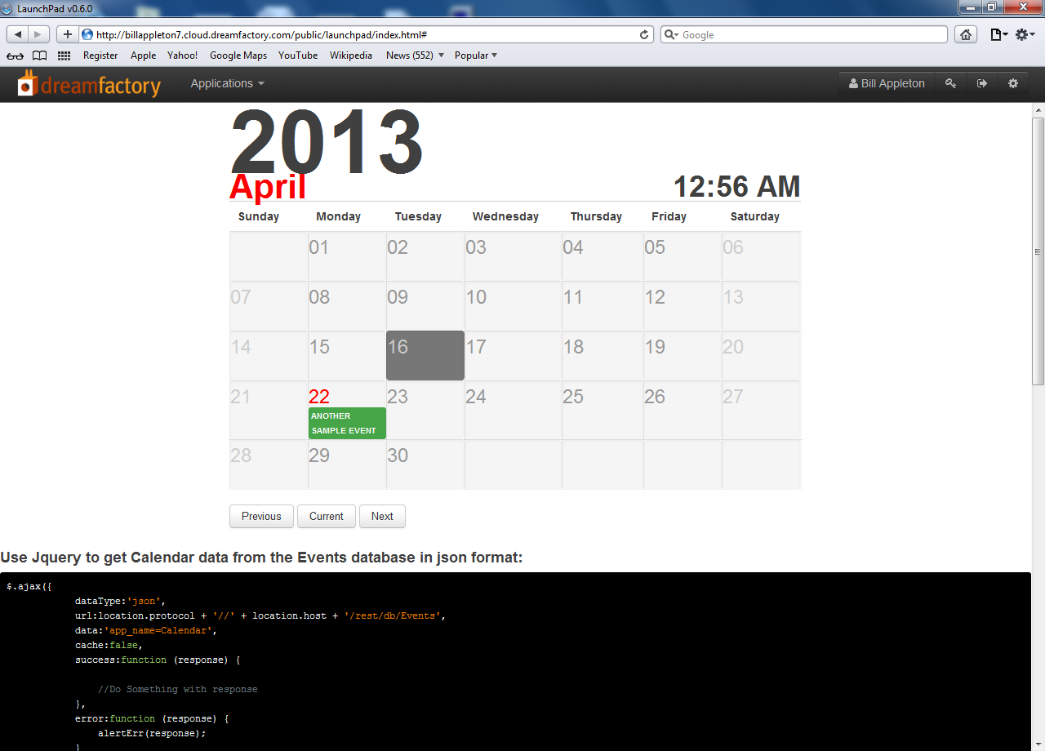
Screenshots
Admin Console
Live API
Tutorial App
Example App

Slide 15
Picture 1

Slide 16
Picture 2

Slide 17
Picture 3

Slide 18
Picture 4

