Slide 1

Your Product Launch Marketing Strategy
and Content Creation Team
www.contentboost.com/product-boost
203-295-0195
info@contentboost.com

Slide 2


Product Launch Challenges
According to market research, 30,000
new consumer products are launched
each year, but 95% of them fail.
The chief reasons new products never take off?
The product is not targeted to the right audience
The marketing strategy is siloed
The ad campaign generated insufficient levels of awareness
The proposed marketing strategy was not designed for real-world use
In today’s competitive marketplace, an effective product launch can
be the key to whether a new product or service succeeds or fails.
Notes:
*Source: http://hbswk.hbs.edu/item/6496.html?wknews=02142011

Slide 3
Product Boost is Here to Help
Product Boost is a one-stop shop for all needs relating to your next
product launch.
From creating compelling custom content to equipping you with industry-leading marketers who can become your personal brand advisors to identifying strategic distribution options, your Product Boost team will become another arm to your marketing division, tasked with building awareness and excitement surrounding your next unveil.
Each piece of the program is developed in line with your corporate identity,
value proposition and unique differentiators.

Slide 4

Maximize Your Product Launch
Your Product Boost team will develop a three-month custom content blitz campaign, characterized by a fail proof marketing and product strategy, SEO-driven marketing copy and revenue-generating sales prospecting documents.
Why us?
Access to a team of expert writers dedicated to
seeing your product launch excel
Bolster your product's online presence with
content supporting your solution
Grab the attention of your target audience with
a comprehensive marketing strategy

Slide 5

Product Boost Delivers
Assigned Team – A team consisting of a
content producer, operations manager,
designer, and social media specialist is
assigned to your company.
Research & Development – We will conduct
a thorough review of your product and website
to develop a content marketing strategy.
Strategy Development – We will develop
Your custom content marketing strategy and
editorial calendar based on the results of
our research, discussions with your company
and overall goals.

Slide 6


Program Deliverables:
Official press release/product announcement
Your official press release/product announcement will let the world know that your new product is available and valuable.
Drive traffic to your website and create buzz about your product unveiling by posting your press release on national newswires and on social media channels.

Slide 7
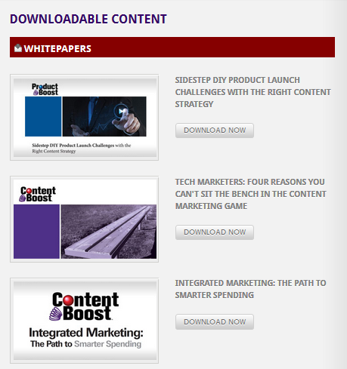
Program Deliverables:
White papers and case studies
This downloadable content hosted on your website will provide you with fresh and engaged leads for your sales team.
Distribute through email campaigns and on social media sites to increase your website traffic.

Slide 8
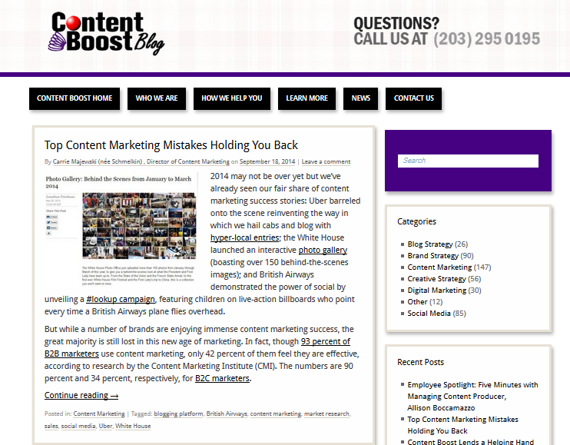
Program Deliverables:
Blog posts & news articles
Optimized for specific keywords related to your unveiling and target industry – these posts will increase your organic search rankings, online brand visibility, and drive more traffic to your site.

Slide 9
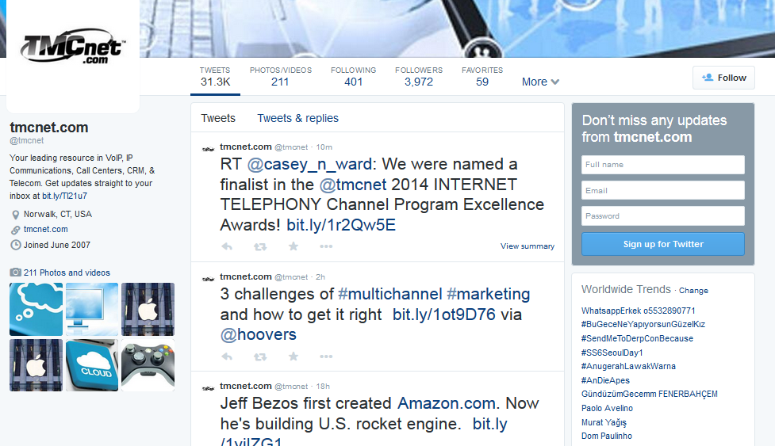
Program Deliverables:
Social media updates
Fill your social media accounts with valuable content for your audience to learn more about your new product and your company.
Generate buzz amongst your target audiences and industry influencers.

Slide 10

Set Your Product Up for Success
By partnering with Product Boost for your next product unveiling you will:
  Optimize your budget for maximum impact
  Build sales momentum as you get ready to
  go-to-market
  Get your product noticed and generating buzz
  Be prepared to nurture your leads with
  compelling, supporting content

Slide 11
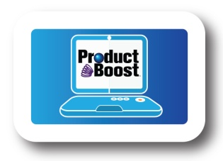


Contact Product Boost today!
www.contentboost.com/product-boost
203-295-0195
info@contentboost.com

