Slide 1
Contact Center Track: CC02 Session Sept 1, 2009 Outbound Call Centers: Driving Efficiency and Regulation Compliance
Frederic Dickey
Director Product Management
Sangoma Technologies

Slide 2
Agenda
What are Outbound Contact Centers?
What is Call Progress Analysis?
Attributes of Call Progress Analysis?
Benefits of IP Contact Centers
Sangoma Overview
Closing

Slide 3
What’s an Outbound Contact Center?
Operations that need to reach out proactively to large lists of customers/prospects/contacts
Emergency
Collection Agencies
Appointment / Reminders
Not just Telemarketers!

Slide 4
How do you reach out?
Start with a List of customers/prospects
Staff a Call Center with Agents
Dial manually…
OR
Automate the dialing process…

Slide 5
What’s an Automated Dialer?
Set-up and Manage Campaigns
CRM integration, list management
“Hammer” out high volumes of calls
Predictive, progressive, preview dialing
When a call connects, connect to an agent

Slide 6
Efficiency Lesson #1
Use Automated Dialers!

Slide 7
OK, I now have an Automated Dialer
But on my campaigns*:
20% of the calls are Live Answers only
70% of the calls are answered by Voice Mails / Answering Machines
10% are de-listed, busy or other
Could I only connect Agents to Live Calls?
Doing this is Called Call Progress Analysis or CPA
* Typical call distribution

Slide 8
What is Call Progress Analysis?
Algorithm implemented in S/W or F/W that :
Attempts to Classify the outbound call
Busy, Reorder, Vacant, etc.
Human, Answering Machine, Fax, etc.
Provides Classification result to Dialer for processing
Connect to an Agent on Human results only
Mark to retry later (on a Busy for instance)

Slide 9
What’s the point?*
Accuracy → | No CPA | 80 % | 95 %
Calls per day | 50 K | 50 K | 50 K
Cost per agent per hour | $ 10 | $ 10 | $ 10
Annual Agent Lost Time Cost | $ 650 K | $ 130 K | $ 33 K
Number of Agents | 105 | 84 | 80
* Based on in-house modeling

Slide 10
Efficiency Lesson #2
Turn on Call Progress Analysis!

Slide 11
How do you make a machine analyze and classify calls?
First things first: the human brain
Every time we place a call we instinctively perform call-progress analysis
We listen for dial tone before dialling, detect ring back, busy, answer, background noise, etc.
Nearly unfailing precision!
How to match this with a machine?
Algorithms!
Typical: CPA algorithms implement heuristics on specialized hardware

Slide 12
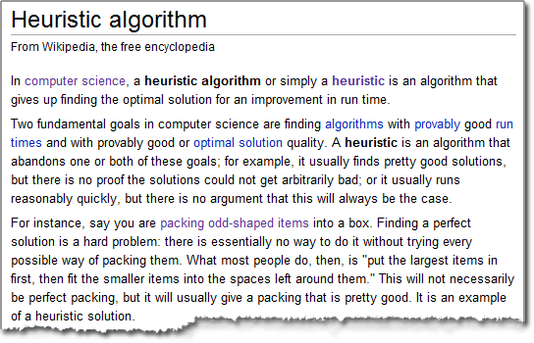
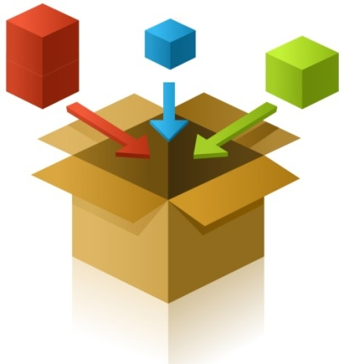
Heuristics…Huh?
Make a complex problem simpler with a set of “simple” rules at the expense of speed and / or accuracy

Slide 13
Heuristics for CPA
Signal to Noise Ratio
Ring Thresholds
Energy Levels
Energy Duration
Frequency ranges
Timeouts
Etc.
Several parameters requiring tuning and optimization
Optimization different for different types of outbound campaigns

Slide 14
Neural Networks: Another Approach for CPA
Instead of Heuristics, mimic the human brain
In S/W this is called Neural Networks
Statistical modelling based on Neural Networks
learning machine trained over large amounts of data
High out-of-the box accuracy and confidence measures
Robust to volume variations and network conditions
Quick connection (using pre-connect info)
Streamlined tuning

Slide 15
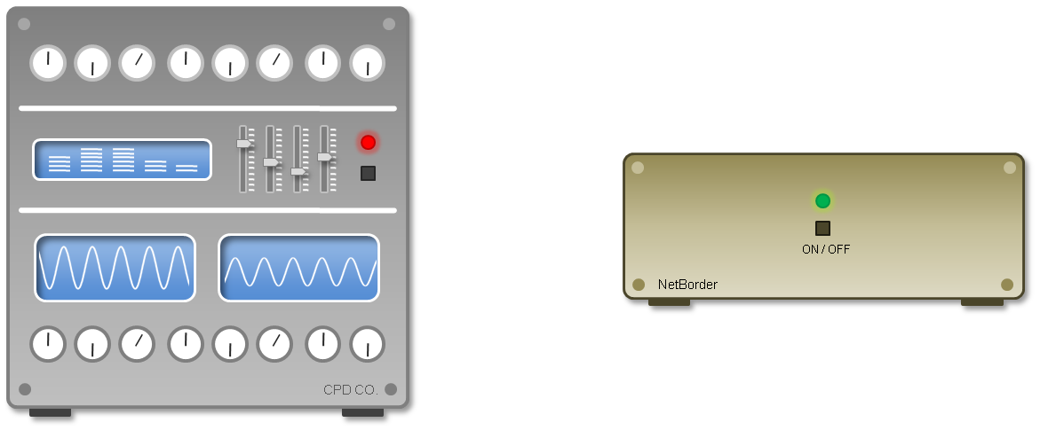
Heuristics vs. Neural Networks Analogy

Slide 16
Increased Regulatory Pressures
U.K. Ofcom (Sept. 2008)
Live agent within 2 seconds
< 3% call abandonment rates
(including false AMD detection)
Recommendations to turn off AMD
Canadian CRTC (July 2008)
Live agent within 2 seconds
Do not call registry
< 5% call abandonment rates
U.S.A. FTC
Live agent within 2 seconds
< 3% call abandonment rates

Slide 17
CPA Required Attributes
Accurate
Fast
Easily ‘Tuned’
Optimize Productivity
Meet Regulations
Reduce Nuisance Calls
Reduce Dropped Calls
Improve Customer Service
Meet Regulations
Reduce Nuisance Calls
Reduce Dropped Calls
Reduce “dead air” calls
Address Multiple Campaigns
Residential
Wireless
Businesses
Reduce operational costs
Hosting Services
Often Orthogonal Attributes

Slide 18
Efficiency Lesson #3
CPA must be:
Accurate
Fast
Easily Tunable

Slide 19
One more component to “fast”
Once the CPA has performed it’s tasks…
Call Center needs to connect the call to an available agent
Access internal routing policies
Invoke CTI Transfers at the PBX
May take some time
Often “blowing” the call transfer budget
Impossible to meet Regulations of Live Agent Connect

Slide 20
Telecom is moving to VoIP
Call Centers are PBX’s enhanced with Business Process integration
CTI, CRM Integration, Inbound Queuing, IVRs, reporting, Outbound dialing, etc.
PBXs are moving to VoIP/SIP
Very difficult now to buy legacy these days
Call Centers are also moving to VoIP/SIP

Slide 21
Benefits of VoIP/SIP Call Center
Remove dependency on proprietary CTI link integration – use SIP
Virtualization
Agent, Routing Databases, Servers can be anywhere
IT infrastructure friendly
Software running on standard servers and OS
Ease of Business Processes Integration
Voice is “just” another application in the datacenter

Slide 22
Call Transfers in SIP
How to perform Call Transfers in SIP?
Use SIP REFER or SIP re-INVITE messages
These happen very quickly in SIP
Why?
It’s the nature of SIP!
SIP provides for Fast Call Transfers

Slide 23
Efficiency Lesson #4
Migrate to VoIP Call Centers
CPA integration with VoIP

Slide 24
Closing Remarks
Outbound Dialing is not Evil!
Automated Outbound Dialing requires
Call Progress Analysis Technologies (CPA)
CPA Technologies need to be:
Accurate
Fast
Easily Optimized
Integrate well into VoIP architectures

Slide 25
Sangoma overview: Telephony H/W building blocks
What do we do all day at Sangoma?
Drivers and APIs
Base PCI or PCI Express card
Optional DSP module for echo cancellation
Personality Card: Quad port analog module
Open Source Platforms
Asterisk
Freeswitch
Yate
Application Developpers:
TDM APIs
MTP2 APIs
WAN APIs
OS:
Windows
Linux
Personality Card: Octal port T1/E1 module
Personality Card: Quad port T1/E1 module
Personality Card: Dual port T1/E1 module

Slide 26
Sangoma Overview: Software Building Blocks
NetBorder
Express: TDM to SIP software VoIP GW
Call Analyzer: SIP based B2BUA for call classification for Outbound Contact Centers
Agent Bridge: SIP Enable legacy phone lines for the IP Call Center
Sangoma SS7 Gateway
SS7 ISUP “plug in” for Asterisk and Freeswitch

Slide 27
Thank you!

