Slide 1
The Role of Content in a Marketing Automation Program
Jeff Dworkin
jeff.dworkin@marketingautomaton.partners
@mktgpartner

Slide 2
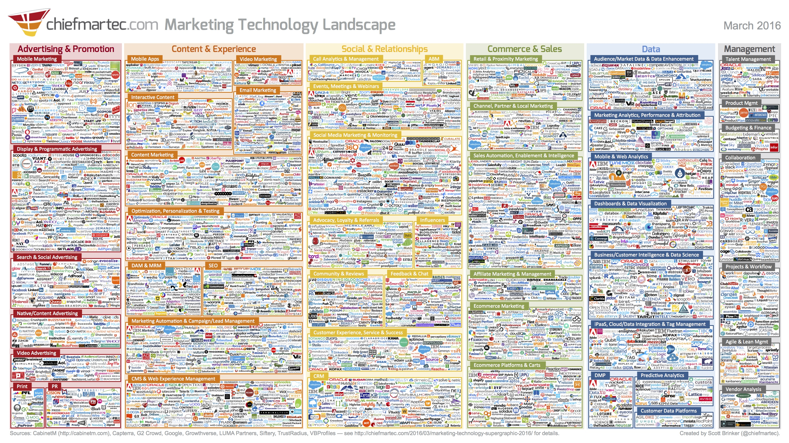
Notes:
Lead to Revenue Packages

Slide 3
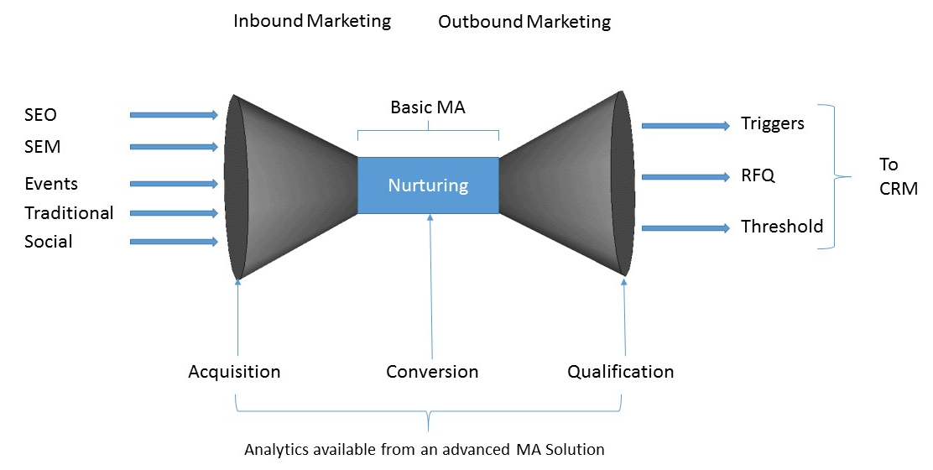
Horizontally Integrated Marketing

Slide 4
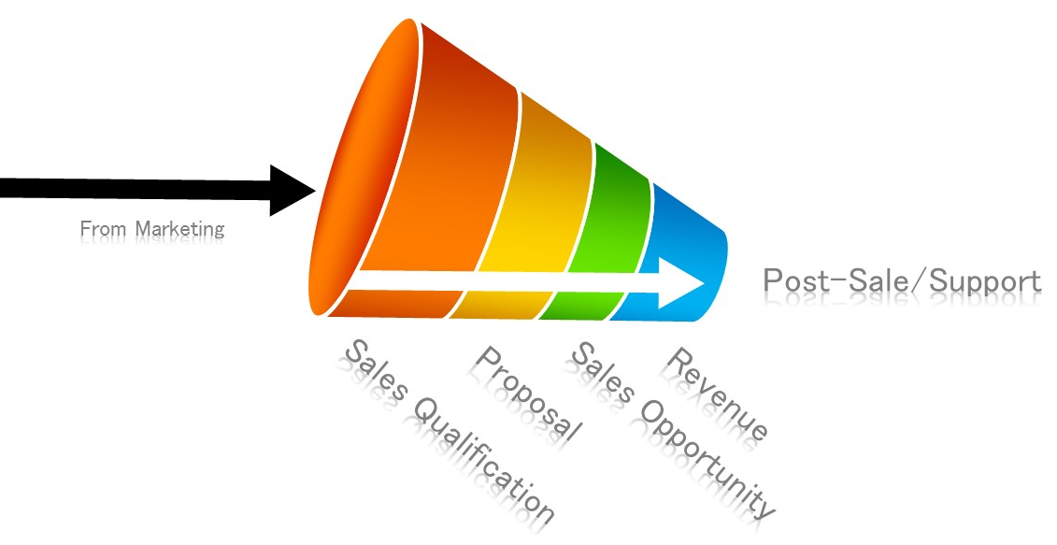

Slide 6
A
Attention
I
Interest
D
Decision
A
Action
Notes:
Awareness – Consideration – Decision
Attract-Convert-Close-Delight
Possible Solution-Interest-Research-Evaluation-Narrowing the Field- Social Vetting-Negotiation-Decision
Awareness – Evaluation – Consideration
Person or Committee
Sales Model
What marketing has [CLICK]

Slide 7
Notes:
Lead to Revenue Packages

Slide 8
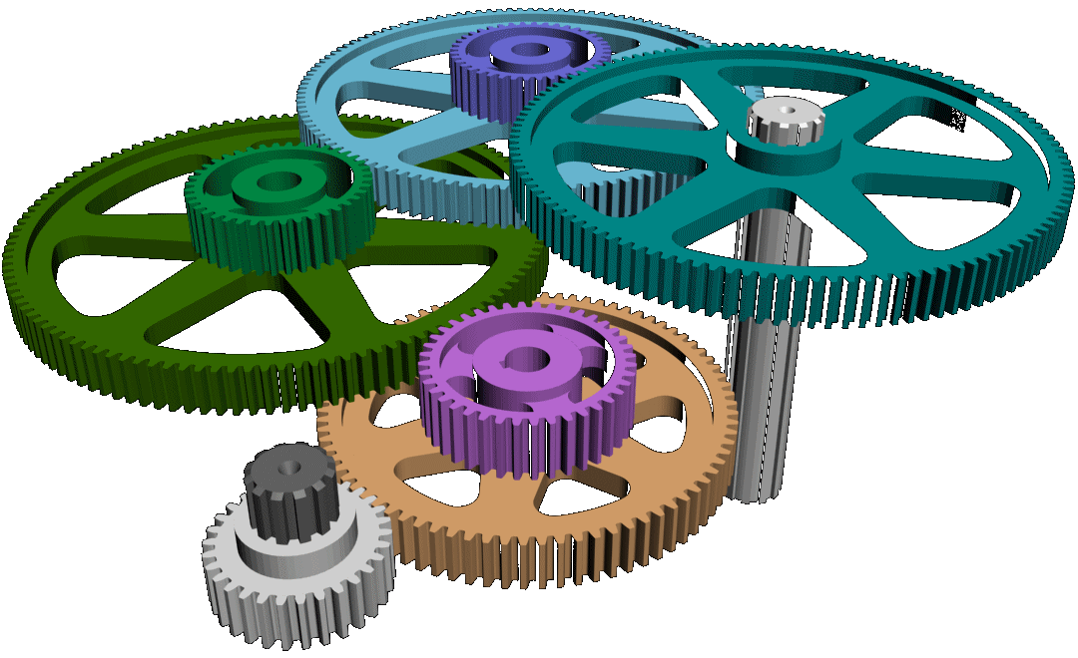
Feed the Machine
With Relevant Content

Slide 9
Relevant Content
Creating and delivering the right content based on the current goal

Slide 10
A
Attention
“Do I have your Attention?”

Slide 11
Content to Get Attention
Product Marketing
Solutions Marketing
Hammers to Carpenters
They are looking for you. Exactly what you have. Sell it to them.
Decks to Homeowners
They may not even know the solution to their problem
They may not have even thoroughly defined the problem
Educate them
Teach them the things they don’t know they don’t know
Build Trust

Slide 12
Getting Attention - Short Form Content
Viewers are early in the buying cycle
It’s a “bread crumb” to lead them to more relevant content
It may be a summary or excerpt from other content that is used later in the process.
Blog post that is summary of a long form whitepaper
One twelve page whitepaper vs four three page articles

Slide 13
Getting Attention with Content
The content should have a purpose
Visitors who view/download this content are interested in X
Visitors who view/download this content are at point Y in their journey
That puts them onto a list where interest X is nurtured

Slide 14
Getting Attention with Content
Key Words
SEO/SEM/Landing Pages
Pay-Per-Click
Specific to Retargeting

Slide 15
Getting Attention – Short Form Versions of
Video
Articles
Infographics
Curated Lists
Quizzes and Widgets
Whitepapers
Webinars
Notes:
From AIS

Slide 16
I
Interest
“Are You Interested?”

Slide 17
Content to Build Interest
We are the Experts
We can solve YOUR Problem
Building Trust
Thought Leadership
Education
We understand your problem
Other companies who have your problem are our customers
We have a solution for you
Notes:
Vitamins vs Painkillers

Slide 18
Building Interest- Long Form Content
Viewers are deeper into the buying cycle
Content that they may share with others on a buying committee
Demonstrating Expertise
More Detailed – More Specific
Building on the short form content
A speaking event becomes a webinar that leads to a detailed whitepaper

Slide 19
Content To Build Interest
Nurturing
Landing Pages

Slide 20
Content to Build Interest – Getting Specific
Solutions Papers
Ebooks and Guides
Newsletters
Interactive video
Feature guides
Demo videos
Testimonials
Analyst Reports
Calculators and tools
Notes:
Mention having a gallery of the next kind of content when presenting the proceeding kind
The buying cycle is long. It could be months between Attention and Interest

Slide 21
D
Decision
“Are You Ready?”

Slide 22
Decision Content – You are THE solution
Live Events
Case Studies
Trend Reports
Competitive Information
Ratings and Reviews

Slide 23
Predicting a Decision with Content
Downloading, Lingering or Multiple Views of Certain content may be an indicator that a Decision is Eminent
That is a Trigger Event to which sales should be immediately alerted

Slide 24
A
Action
“They’re out there, waiting to give you money.”

Slide 25
Talk to Sales
Give them what they need
The job of the salesperson is to close
Closing is an art
Give them what they ask for

Slide 26
Post-Sale Content
Newsletters
Event Notification
Customer Appreciation
Invite them to participate

Slide 27
Content is the fuel that feeds the machine
Inbound
Outbound
Closing
Post Sale

Slide 28
The Role of Content in a Marketing Automation Program
Jeff Dworkin
jeff.dworkin@marketingautomaton.partners
@mktgpartner

