Slide 1
Security the Smart Grid

Slide 2
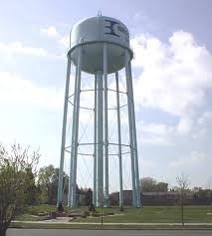
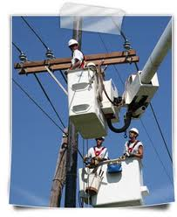
Smart Grid Security a Start of a Big Opportunity
Transportation
Utilities
Critical Infrastructure
City Services
Public Safety
Power Grid

Slide 3
ProjectSafety survey found local wireless network security needs
Need: Wireless end-to-end security
Need: Secure COTS Interoperability Standards
Need: Secured public/private network sharing
Need: Sustainable municipal wireless networks
Need: Secure intelligent transportation networks
Need: Multi-agency secure access
Need: Securety for power grids and utilities
Need: Off-net cloud networks

Slide 4
Survey need a serious security solution with a proven track record in security
The WirelessWall Core Technology was originally developed by U.S. Navy to provide secure,
Mobile shipboard networks
Designed to meet needs of multiple federal and military agencies
Over $50M investment for development
Multiple NIST certifications and FIPS 140-2
JSIC/JFCOM multi-year tested 2005-2009 recommended for interoperability DoD-wide and
use by Coalition Forces
Vendor supported: Cisco, Motorola, Aruba, Nortel, etc.
Mature and fielded since 2001 (DoD, DoE, municipal and commercial)

Slide 5
Private-public wireless networks: if we secure it, they will come
September 18, 2009 at 12:30 PM by Larry Karisny
There is a recurring network model that is coming out of the US broadband stimulus grant requests and recent FCC workshops. States across the nation have been trying to present sustainable models to support broadband service in rural areas while recent FCC workshops have been trying to tackle the issue of the US now being 18th in the world in offering broadband services. This is all coming to a head while critical network applications such as public safety, transportation, utilities and power grids all look for a network solution that will improve their service capabilities. The consistent direction to efficiently offering these sustainable networks are shared public/private models.

Slide 6
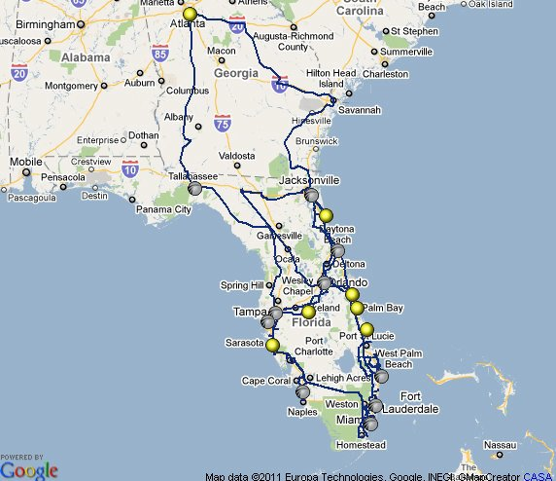
Sharing network assets

Slide 7
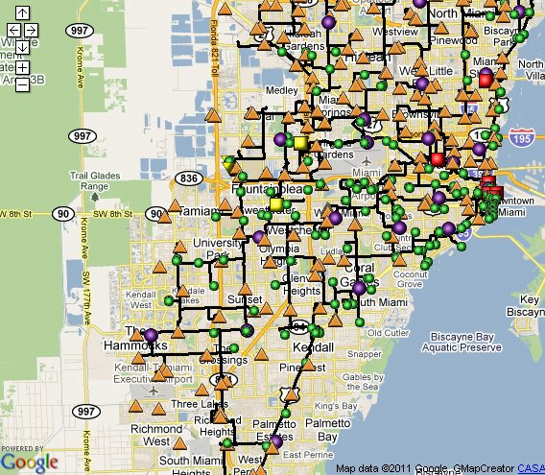
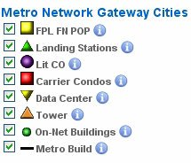
Power Companies have a lot of fiber backhaul

Slide 8
FDOT District 6 fiber upgrades

Slide 9
Outsourcing Municipal, County and State Networks

Slide 10
Private-public wireless networks: if we secure it, they will come
September 18, 2009 at 12:30 PM by Larry Karisny
In a recent FCC workshop, State and Local Governments: Toolkits and Best Practices, Charles Ghini, Director, Florida Department of Management Services, Division of Telecommunications, has a more holistic approach to multi-agency statewide networks. “If you don’t have a…statewide vision, you’re increasing your chances of failure, and that’s the way we’ve been going at it, the wrong way. We were too fragmented in Florida.” Other states began to realize the need to pool their communication assets as they tried to evaluate sustainable models to serve rural areas.

Slide 11
State outsourcing of IT assets begins.
North Carolina Gov. Bev Perdue Wants Privatized IT
North Carolina Gov. Bev Perdue
December 10, 2010 By Matt Williams
North Carolina Gov. Bev Perdue wants a vendor to consolidate the state government’s technology services and move them into a centralized location.

Slide 12
Washington Gov. Chris Gregoire
Wants to Create New IT Agency
January 7, 2011 By Lauren Katims
Washington state Gov. Chris Gregoire hopes to create a new technology agency to add to the state’s IT system as part of her overall plan to save the state $32 million over the next four years.
The Consolidated Technology Services Agency, if created, is estimated by the executive branch to save $10 million a year. The new agency would privatize and consolidate some of the state’s basic IT operations, such as help-desk support and data center operations.

Slide 13
October 29, 2010
Wireless Networks for Smart Grid - the Case for Mobile Carriers
By Jon Arnold (ICP)
Founder, Intelligent Communications Partners
One of the more interesting topics from last week’s GridWeek was the debate over public versus private networks. This has been a long-standing issue, as utilities have typically built and relied on private networks of their own. There are lots of practical reasons behind this, but with the rise of mobile broadband and ongoing evolution towards 4G and LTE (News - Alert), private may not always be the best way forward.

Slide 14
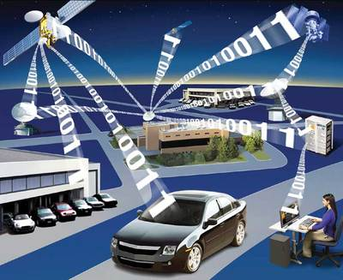
And more applications coming

Slide 15
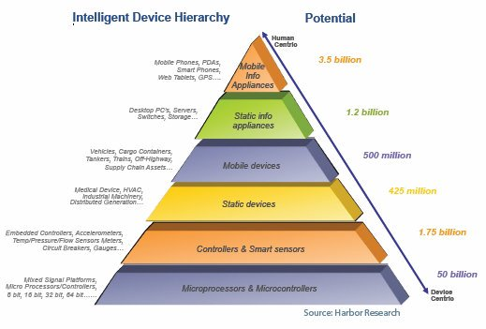
Moving from H2M to M2M

Slide 16
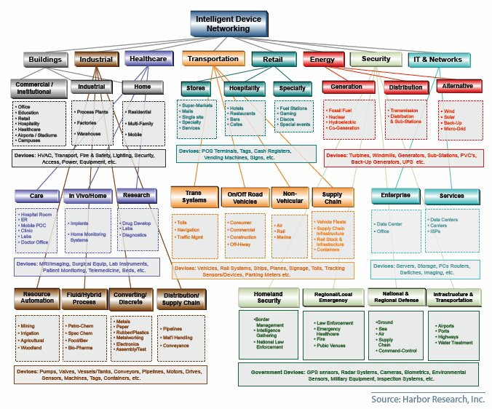
Will touch every venue in every market

Slide 17
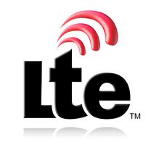
All lot of public and private networks to secure and different ways of doing it
Legacy

Slide 18
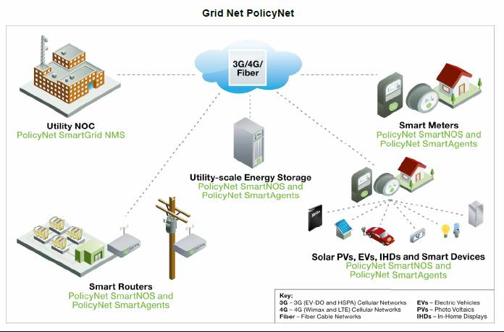
Grid Net Layered Security Platform

Slide 19
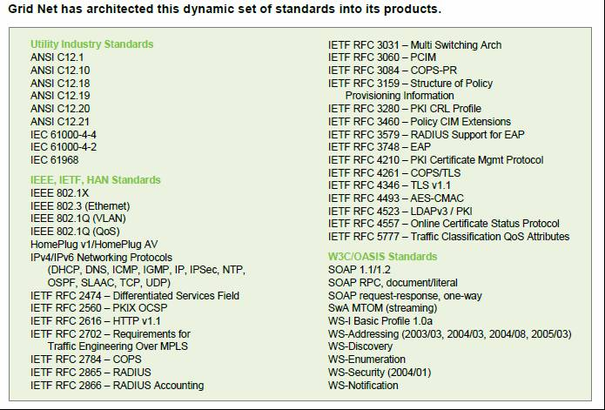
Following the Standards

Slide 20
GridNet Layered Security Model
Multi-level, multi-layer security: key features
1. Meter energizes, self-authenticates
* Device security via EAP/TLS, IPSec, IKE, unique digital signature, and hardware-enforced code signing
* WiMAX PKMv2 (EAP/TLS over RADIUS)
* X.509 Certificate, PKI system, and AAA Server
2. Meter authenticated, authorized by 4G broadband network
* EAP-based authentication
* AES-CCM-based authenticated encryption
* CMAC and HMAC based control message protection schemes
3. Meter authenticated, authorized by PolicyNet
* Identity and AAA Services (ITU, IETF)
* Certificate Authority w PKI
* AAA Server (RADIUS, EAP/TLS)
4. Secure Smart Grid system connection established
5. End-to-end data encryption and transmission
* Cipher Block Chaining Message Authentication Code Protocol (CCMP)
* IPSEC/GRE, TLS, GMPLS
* Traffic Engineering: DiffServ, RSVP

Slide 21
Military Tested Layer 2 End to End Network Agnostic Encrypted Security Cloaking the Net
Legacy
Network Vulnerabilities
Layer 2 Network Cloaking

Slide 22
Military Grade Layer 2 Encryption
Securing wireless Local Area Network interconnections with Layer 2 encryption
By
Juan Asenjo
Thales e-Security
Enabling military and civilian government operations to dynamically interconnect Local Area Networks (LANs), wireless technologies are a lifesaver in environments where wired connections are cost-prohibitive or just not practical. However, transmitting sensitive information over the airwaves presents security challenges including passive attacks and active attacks. Enter Layer 2 encryption, which can effectively thwart these security challenges. (U.S. Air Force photo by Senior Airman Julianne Showalter)

Slide 23
The Advantages of Layer 2 Encryption
Layer 2 encryption is the industry’s first Wireless Firewall.
Like a firewall, it supports policy filters to control what services users can access on a
network and provide an audit trail.
It protects data in-transit for WiFi, WiMax, Mesh, 3G, 4G, Zigbee or LANs
Like a VPN, it provides encrypted network access for users via a client
Better than a firewall or a VPN because it is Layer-2, with performance and simplicity
advantages over IPsec or SSL
FIPS 140-2 certified strong AES encryption
Offers best-of-breed wireless security: strong encryption, authentication and access
Control comparable to WPA2-Enterprise, even on legacy WiFi with no security
or weak security like WEP
Makes the network unsniffable.
Improves any network topology by adding blanket end-to-end encryption

Slide 24
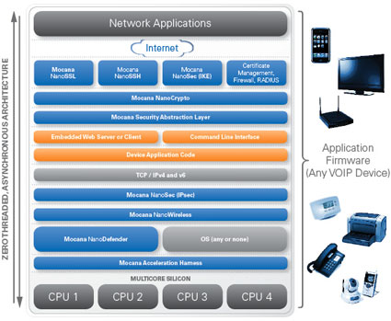
Embedded Security

Slide 25
Embedded Security, Securing Internet Things
Embedded device security is designed to secure all aspects of any connected device, computer or service. They are built on a common architecture and share a common cryptographic code base.
* Minimal latency
* Low power consumption
* Low memory
* Minimal code size
* Suitable for both hardware and software
* Authenticated Encryption
* Single key for both encryption and authentication
* Word based (16-bit)

Slide 26
Question and Comments
Larry Karisny
lkarisny@projectsafety.org

