Slide 1
High Speed Air Interfaces
Mike Ueland
Telit Wireless Solutions
Notes:
Position and Telit background
High-speed air interfaces
Most apps are not bandwidth intensive. Video over 2.5G is acceptable, so why do we need the seriously high data rates of HSPD and LTE? Developing and certifying these next-gen modules is going to be expensive. This session will examine another NGN issue. They’re all-IP in the core so operators want all-IP air interfaces. M2M apps have long life cycles and in time 2G/2.5G and even 3G networks will have been retired. This challenge has to be faced, even when the good times are rolling.

Slide 2
M2M is Hot!
Berg Insight reports that M2M modules and other devices grew by 48% to 37M in 2010.
Berg expects a 25% CAGR through 2015
Growth drivers:
Lower cost modules/devices
Tier One carriers engaged
Lower cost service plans
Source: The Global Wireless M2M Market, Dec 2010, Berg Insight
Notes:
Berg Insight predicts the number of cellular connections used for machine-to-machine communication to grow at a compound annual growth rate (CAGR) of 25.6 percent to reach 187.1 million worldwide by 2014. In the same timeframe, m2m's share of the global cellular network will rise from today's 1.4% to reach 3.1%.[1]
Morgan Keegan & Co. estimates that TAM is >75 billion. ^ Billion people worldwide.
Analysys Mason’s Steve Hilton estimates that there were 62M M2M connections globally in 2010 and it is expected to grow by a 36% CAGR to 2.1B by 2020.

Slide 3
Historically M2M=2G
Coverage and service level consistency has been more important than bandwidth
2G modules 1/3 the cost of 3G modules
AT&T in particular is encouraging many of their customers to use 3G for new M2M projects

Slide 4
What Happened to EDGE?
The recent rapid move towards 3G has potentially dealt EDGE a fatal blow
Performance/value ratio never served any application well
Notes:
Because 3G is faster than EDGE in every area, it is usually preferred unless it is not available or the signal is too weak. EDGE has the upper hand in low signal areas, as it requires less signal strength to operate than 3G. However, 3G often drops out in areas where there is a less-than optimum cellular signal. Moreover, 3G is fairly expensive, requiring data plans of $30 or more per month. Because EDGE is an older technology, some carriers, such as T-Mobile, offer it as a less expensive alternative to 3G.
Read more: 3G Speed Vs. Edge | eHow.com http://www.ehow.com/about_5375179_speed-vs-edge.html#ixzz1CLBGpA6n
http://www.ehow.com/about_5375179_speed-vs-edge.html

Slide 5
3G Networks Gaining Popularity
Source: Qualcomm
Notes:
In the U.S. and Canada, 3GPP technologies added a net 2 million new subscribers in the first quarter of 2010 and included in this number were 5 million new mobile broadband (UMTS-HSPA) connections.
Today, there are there are 8 commercially deployed UMTS-HSPA networks in the U.S. and Canada.
With recent deployments of HSPA and the rollout of HSPA+, T-Mobile USA experienced the highest percentage of growth amongst its peers in mobile data service revenues for the quarter. In its 1Q 2010 earnings statement, T-Mobile reported 5.2 million customers were using 3G-capable converged devices on the T-Mobile USA network, an increase of 33 percent from 3.9 million customers as of the fourth quarter of 2009 and a significant increase from 1.5 million customers as of the first quarter of 2009.
AT&T experienced 29.8 percent growth in wireless data revenues in 1Q 2010, up $947 million, versus the year-earlier quarter to $4.1 billion. AT&T had a 3.3 million net increase in 3G postpaid integrated wireless devices on the network to reach 26.8 million, more than double the company's year-earlier total.
Rogers' data revenue growth of 40 percent in the 1Q 2010 comprised 26 percent of wireless network revenue and was supported by the activation and upgrade of approximately 348,000 additional smartphone devices, of which approximately 35 percent were for new wireless subscribers. This resulted in subscribers with smartphones representing 33 percent of the overall postpaid subscriber base at end of 1Q 2010, up from 23 percent at the end of 1Q 2009 and generating ARPU nearly twice that of voice-only subscribers.
Worldwide, 346 commercial networks in 148 countries offer UMTS-HSPA.
http://www.cellular-news.com/story/43532.php

Slide 6
3G Benefit to Carriers
Better spectral efficiency
Support high bandwidth applications
Longer voice talk time
Mapping of all services onto HSPA
Faster call set up time/lower latency
Smooth migration to LTE
Source: Nokia Siemens

Slide 7
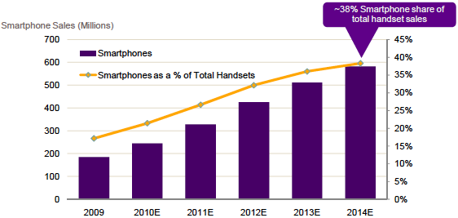
Smart Phones Driving 3G Rollout
Source: Qualcomm & Informa Telecoms & Media (Q1 2010)
Notes:
Smartphone sales expected to reach more than 500M by 2014
Growing at a 33% from 2009-10
26% CAGR forecasted for 2009-14
T-Mo reports 50% of all new phone sales are smartphones.

Slide 8
Mobile Data Traffic Increases
According to Allot Communications' Mobile Trends report, global mobile data traffic increased by 72% in 2009; YouTube accounted for 10% and VOIP 4%.
Cisco reports Global mobile data traffic will grow 26 times between 2010 and 2015, to 6.3 exabytes--a billion gigabytes--per month!
According to CTIA, SMS traffic increased from 7B text messages/month in 2005 to 173B text messages/month in 2010.

Slide 9
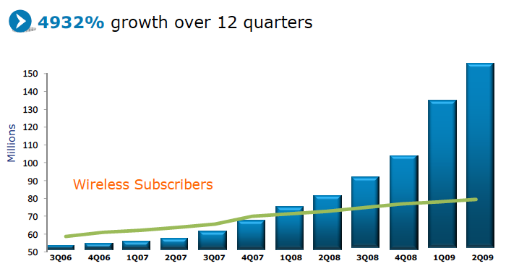
AT&T Mobile Data Growth
Source: AT&T
Notes:
Growth was

Slide 10
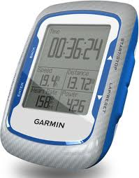
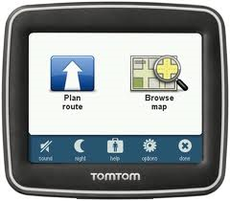
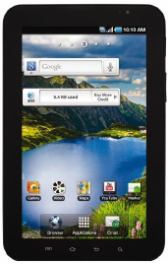
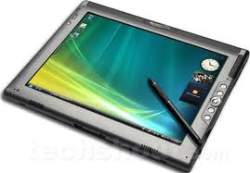
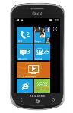
Connected Devices
Notes:
According to a new research report from Berg Insight, the worldwide number of shipped consumer electronics devices with cellular connectivity grew to 22 million in 2010 compared to 11 million in the previous year. Notebooks is still the most common device category to equip with cellular connectivity but tablets, e-readers and PNDs are fast growing categories as well. In the next five years, shipments of connected consumer electronics devices are forecasted to grow at a compound annual growth rate (CAGR) of 65.2 percent to reach 271 million in 2015. “The sheer availability of affordable devices with embedded connectivity has exploded during the last year with substantial price reductions on connected personal navigation devices and popular e-readers such as the Amazon Kindle and Barnes & Noble's Nook”, says Johan Svanberg, Senior Analyst, Berg Insight. He adds that the Apple iPad caused the market for Internet tablets to take off and there were 17.1 million tablets sold worldwide in 2010 out of which 3.9 million have cellular connectivity. Heightened consumer awareness, decreasing prices of modules and chipsets together with massive global deployments of high speed cellular networks such as LTE will have a great positive impact on the market. “However, there is a lot of work to be done when it comes to wireless data subscriptions and a great deal of business innovation is needed in order to make embedded cellular connectivity a common feature in consumer devices”, added Mr. Svanberg.

Slide 11
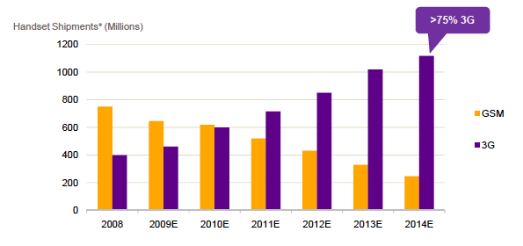
Migration from 2G to 3G
Source: Qualcomm

Slide 12
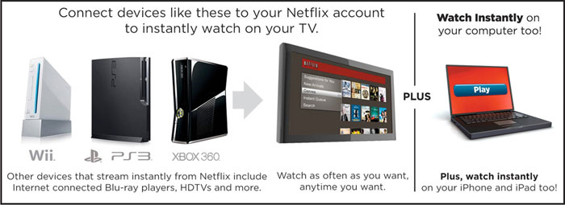
3G/4G Data Rates
The potential impact of increasing bandwidth is revolutionary
WCDMA (384kbps)
21 hrs
HSPA (14Mbps)
2 hrs
LTE (100Mbps)
4.8 min
Source: GSMA
Notes:
Read more: Breaking down 4G vs. 3G cellular networks - The Denver Post http://www.denverpost.com/business/ci_16969414#ixzz1CLf8vlgi

Slide 13
Effective Rates
Source: ITU, Verizon, T-Mobile and Sprint

Slide 14
North America Taking 3G/4G Lead
US has 6% of global subs, 21% of all 3G subs
Verizon is aggressively marketing LTE
AT&T recently announced plans to speed up LTE deployment
Notes:
AT&T to begin LTE deployment in second half 2011 and expects to be done by end of 2013.

Slide 15
Carrier 3G/4G Strategies
AT&T
Continue with HSPA+ deployments; begin LTE deployment 2H 2011.
Verizon
Available in 38 markets and over 60 major airports, and will cover nationwide 3G footprint with 4G LTE by the end of 2013.
T-Mobile
200M POPs of HSPA+ 21; moving to HSPA+ 42
Sprint
Using Clearwire’s WiMax network

Slide 16
Which Applications Will Benefit
Security
Mobile computing
Automotive
Remote monitoring
Digital signage

Slide 17
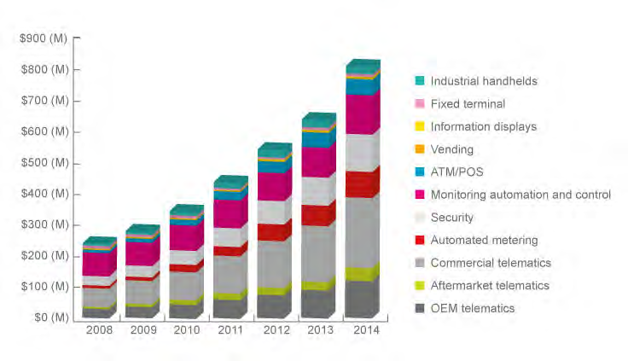
NA Cellular M2M Module Revenue
Source: ABI Research, M2M Market Forecasts, 2Q 2009

Slide 18
What is the Impact on M2M Developers?
Developers will need to make trade-offs in the short term on connectivity choices
3G devices require more power
3G modules are bigger in size

Slide 19
What’s the status of the 2G network?
T-Mobile: Have indicated it will be available beyond 2020
Verizon: 1xRTT being used to support voice in 3G
AT&T: Have not formally announced plans but for certain applications, requiring 3G

Slide 20
M2M Total Cost of Ownership
Notes:
-Even with 3G, service is still 45%+ of TCO for a 5 year contract; more for longer deployments.

Slide 21
3G/4G Forecast
Second generation 3G modules will drive down costs in 2011
4G modules for M2M will become feasible in 2013
3G device costs won’t achieve parity with 2G devices for a number of years
There will be carriers that support 2G for a long time to come

Slide 22
Thank You!

