Slide 2
Business to Business: A Growing Target for the LBS Market
Presented by:
Rick Burtner
Senior Vice President, GM of Distributed Products Group
Numerex Session Date: Wednesday, 2/02/11 - 3:10-3:45pm

Slide 3
Breaking down LBS-based M2M
M2M is using a device … … … …
wireless, wired, sensors, etc.
to capture an event … … … … … … …
location, status, condition, etc.
that is relayed through a network …
satellite, cellular or hybrid
to an application … … … … … … …
off-the-shelf or customized software
which translates the captured data into meaningful information … … …
“stolen vehicle is located” “driver is speeding” “trailer temperature is above normal” “secure container has been opened” “panic alert received”
Helping corporate enterprise make effective strategic decisions

Slide 4
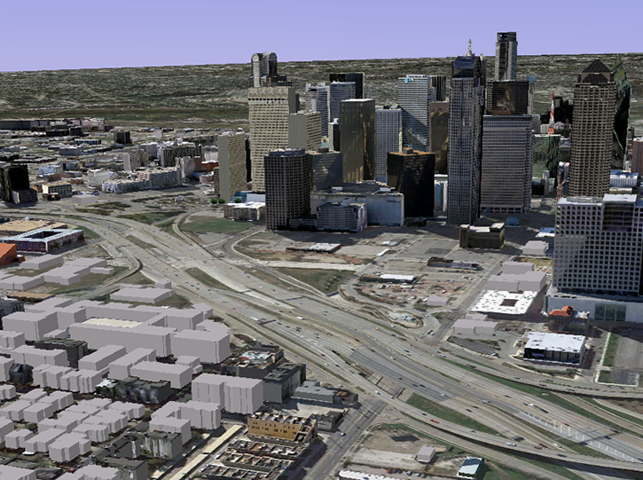
LBS & M2M are ... Everywhere
Tank Monitoring
Personal tracking
Home Security
In-Vehicle Emergency Call System
Home Appliance Monitoring
Remote Patient Monitoring
In-Building Wireless Solutions
Equipment and Tool Tracking
Billboard Control
Real-Time Business Intelligence
Vehicle and Cargo Tracking
Inventory Monitoring
Automated Meter Reading
Supervisory Control and Data Acquisition
Personal Emergency Response System
ATM Surveillance
Pipeline Monitoring
Location-Based Services
Vending Machine Monitoring
Real-Time Locating Systems
Waste Management
Fleet Management
Alarm Monitoring

Slide 5
A Promising Outlook for LBS
Enterprise Impact
Cost Savings
Increase in Revenue
Increase in Productivity
Improved Customer Relations
Operational Efficiencies
Industry
Trends
Data Security
Standards
Device Management
Cloud Computing
Enterprise Integration
“Having visibility into the temperature and humidity levels of facilities, the location of raw materials, and the status of a production line is interesting. But being able to piece the events together to help make faster, smarter decisions – that’s magic.” - Deloitte – Depth Perception; 2010 Technology Trends White Paper

Slide 6
Low Hanging Fruit = Immediate Savings Example
Making MAGIC through Measurable ROI
According to customers, LBS solutions may provide measurable results within 3-6 months of deployment. Operational efficiencies such as fuel costs and workforce productivity may be seen right away using simple plug-n-play devices, while long term ROI benefits are realized through analysis tools and advanced optimization applications.
Advanced Optimization = Long Term Savings Example
Route Optimization
Theft Reduction
Labor Costs
Paperwork Reduction
Significant cost savings are realized through better inventory, route and process management
=
Reduced Overtime
Fuel Costs
Increases visibility into operational inefficiencies for immediate action
=

Slide 7
Enterprise Customers Need Total
End-to-End Services from One Partner
Form factor or custom devices
Feature rich
Certification services
Order Management services
Building Block #1
Enabling Devices
International cellular service
Network & SIM Management Services
Customizable intelligence reporting
applications designed for LBS markets
Cloud-based application platforms allow
customers to build off of a core software
package and scale easily for growth
Network & Application Expertise
Building Block #2
Logistics and fulfillment services including
drop-shipping and the capacity to scale on a
global basis
24/7 customer & technical support
Firmware upgrade support
RMA & Warranty management
Logistics , Fulfillment & Customer Support
Building Block #3
Expert business consultation services
Gateway process development for unique
device protocol requirements
Integration of data into existing database for
data storage
Administrative reporting features for simple
data analysis and management
Project Mgmt & Systems Integration
Building Block #4

Slide 8
LBS Markets at the Forefront
Government Agencies & Public Sector
Fleet Management & Industrial Applications
DOD
DHS
Law Enforcement
Driver Behavior & Analysis
Logistics
Fleet Scorecard
Emergency Management
Government Education
Border Security
Commercial Enterprise
Consumer Applications
Oil Field Service & Security
Transportation (Location/Sensors)
High Dollar Assets & Equipment
Intelligent Reporting
Vehicle Recovery

Slide 9
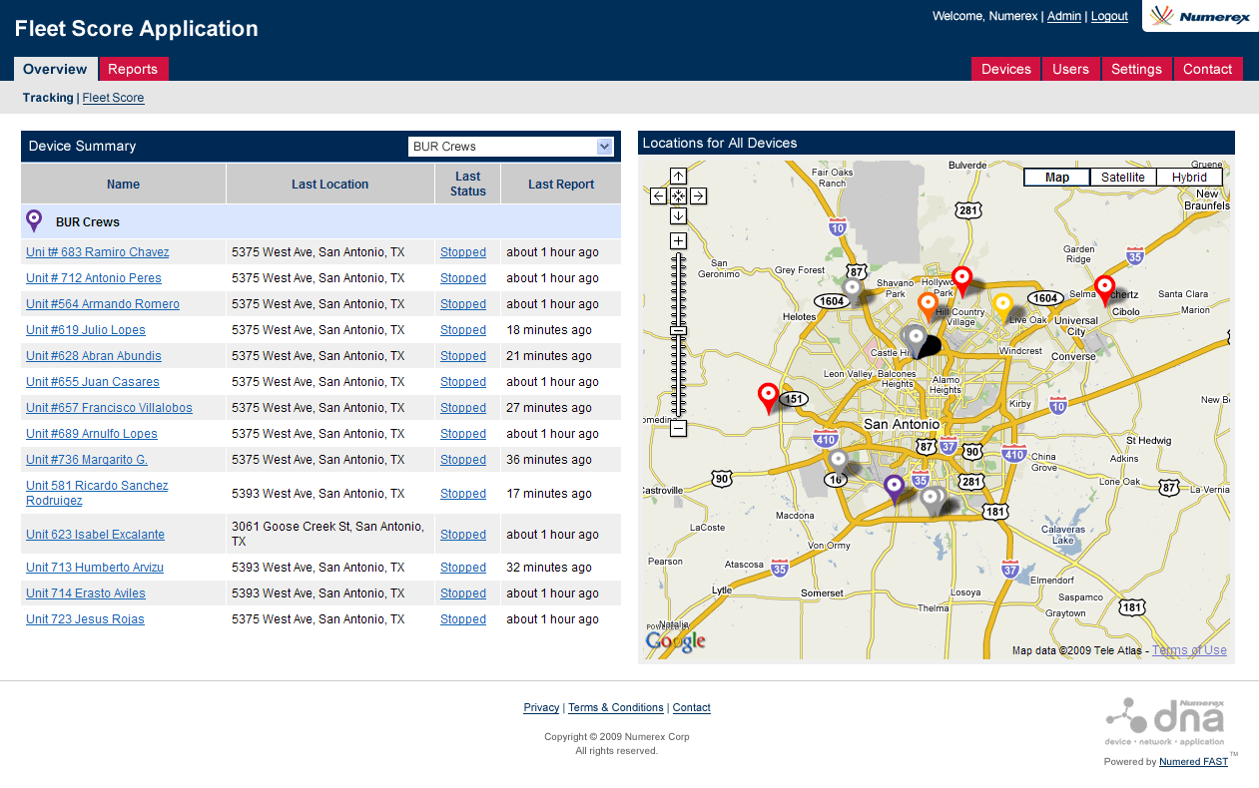
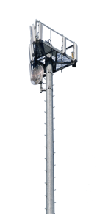
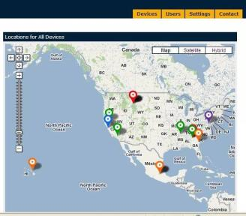
Supply Chain Logistics - Fleet Management
Key Features:
Track location and integrate sensor features
Maintain total asset visibility plus monitor utilization and capacity
Remotely monitor vehicle conditions of
commercial and utility service fleets
Set up mileage or date-based maintenance
tasks for vehicles
+
+
Satellite or cellular solutions equipped with location and sensor technology

Slide 10
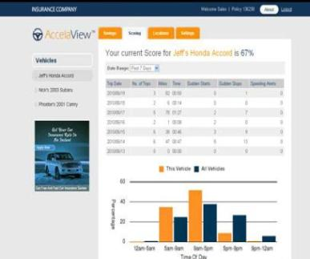
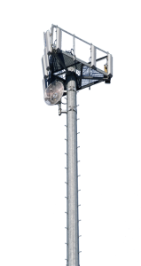
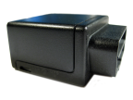
Insurance Industry - Vehicle Telematics
Key Features:
Intelligent vehicle reporting based on factors such as
excessive speed, acceleration, nighttime driving,
geofence alerts, etc.
GPS-enabled tracking capabilities
Customizable real-time notification settings
+
+
Simple plug-n-play device with diverse software feature requirements

Slide 11
Key Takeaways
The LBS M2M Market should hit the inflection point in 2011:
Companies are increasingly seeing
tangible ROI benefits from M2M Solutions
The right outsourced partner simplifies a complex set
of variables...
As a result, you can sleep at night!
By enabling customers to innovate and customize their business capabilities, organizations adopting a best-of-breed enterprise application strategy are finding opportunities for true business transformation.
- Source: Deloitte – Depth Perception; 2010 Technology Trends White Paper

Slide 12
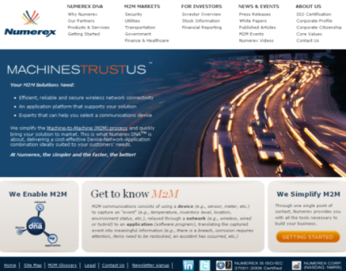
Thank You!
Rick Burtner
Senior Vice President, GM of Distributed Products Group
Numerex Corp
rburtner@numerex.com
Visit numerex.com
or call us at
1888- NMRX M2M

