Slide 1
Industry Perspective - The wireless marketplace and winning through diversification of services.
Dr. Mo Shakouri
Corp Vice President

Slide 2

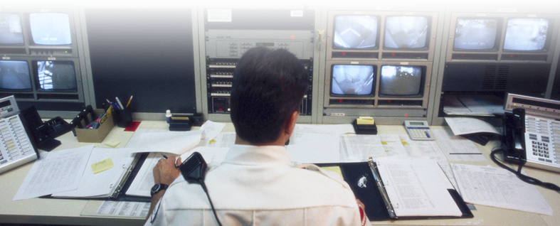
4G Wireless Broadband Markets
Carrier Customers
Enterprise Customers
(private networks)
Fixed, portable and mobile applications for broadband operators
Voice, video and data access
Backhaul
WISPs
Public safety (video surveillance)
Smart cities (municipalities, government)
Business and Industry
Smart Grids
Complete offering of end-to-end and turnkey open network solutions
Notes:
Alvarion has the largest footprint of 4G deployments globally
More than half of the WW WiMAX deployments are using Alvarion equipment
Alvarion is a financially sound company with positive cash flow and a strong balance sheet

Slide 3

Key Market Growth Factors
Consumer demand: “Always connected lifestyle”
Growth of wireless ecosystem:
availability and affordability of
applications and end user devices
Evolution of wireless broadband for a
variety of vertical markets such as:
Smart grids
Enterprises
Smart cities/municipalities
Public safety

Slide 4
Wireless Broadband Demand Growth
Global Mobile vs. Desktop Internet User Projection, 2007-2015E
Mobile Internet Devices
Desktop Internet Users
More than just phones:
iPad
Smartphone
Kindle
Tablet
MP3
Cellphone/PDA
Car Electronics, GPS, ABS, AV
Mobile Video
Home Entertainment
Games
Wireless Home Applications
Internet Users (MM)
Notes:
4
4

Slide 5
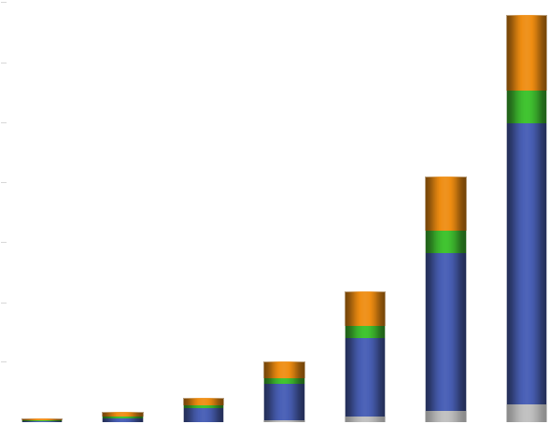
Wireless Broadband Demand Growth
Global Mobile Data Traffic, by Type (2008-2014)
2009-2014 CAGR
18%
Total
108%
8%
83%
78%
131%
103%
Total Mobile Data Traffic (Terabyte per Month)
39x Increase, 09-14E
69%
5%
Notes:
5
5

Slide 6




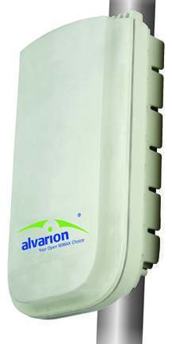




Wireless Broadband Market Segments
Enterprise
Public Safety / Surveillance
Underserved Areas
Consumer Access
Utilities
Municipalities / Governments
Entertainment / CE
City-wide Broadband
Notes:
6
6

Slide 7




Key 4G Requirements
Key Attributes
Platform options
Carrier-class WiMAX 802.16e certified platform
Wide range of frequencies (2.X GHz, 3.X GHz…)
Data, Voice and Video – Fixed & Mobile
Security: AES128, NERC-CIP
Deployment options
Macro and all-outdoor Micro BST
Outdoor remote RF heads
Scalable platform with up to 6 sectors
Coverage & Capacity
Optimized air link coverage and capacity
2nd/4th order diversity, MIMO and Beamforming
Performance
<100MSec roundtrip configuration
QoS levels for different applications
Notes:
BreezeMAX Radio Base Stations
successfully proven field experience and advanced core wireless and networking technologies
leveraging the company industry leadership
Years of experience with OFDM/OFDMA technology.
7

Slide 8
Protecting Customer Investment
Evolutionary approach guarantees CAPEX efficiency
  Supports both TDD network evolutions: investment protection and flexibility
  Reuse large part of existing infrastructure: lower rollout costs
  Rollout designed for phased approach based on market demand
WiMAX1
802.16e
enhanced
TDD
WiMAX1
802.16e
Upgrade Backward Compatibility
WiMAX2
802.16m
WiMAX/3G
integration
TD-LTE
Rev8
TD-LTE
Rev9/10
Notes:
Alvarion is the leader of the 4G wireless broadband market, with:
Comprehensive set of products and solutions
End-to-end and turnkey capabilities
Largest number of 4G wireless broadband deployments (WiMAX 16e)
Our 4Motion solution includes the most deployed 4G platform in the world today
We have shipped over half a billion dollars worth of WiMAX equipment

Slide 9





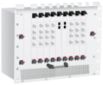
Network Overview Example
4G
RRH
(ODU)
ASN-GW
IP Backbone
Core
End User
Baseband
End User Devices | RAN (BS Site) | Core
Banzai biscuit | 4Motion Macro Outdoor & Indoor 2.5GHz ,5MHz MIMO B 2x2 DL / UL ratio = 29:18 | ASN-GW AAA
* Peak Sector Throughput: DL: 17 Mbps / UL: 4Mbps per sector

Slide 10
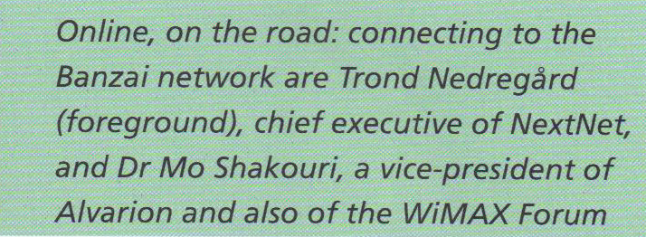
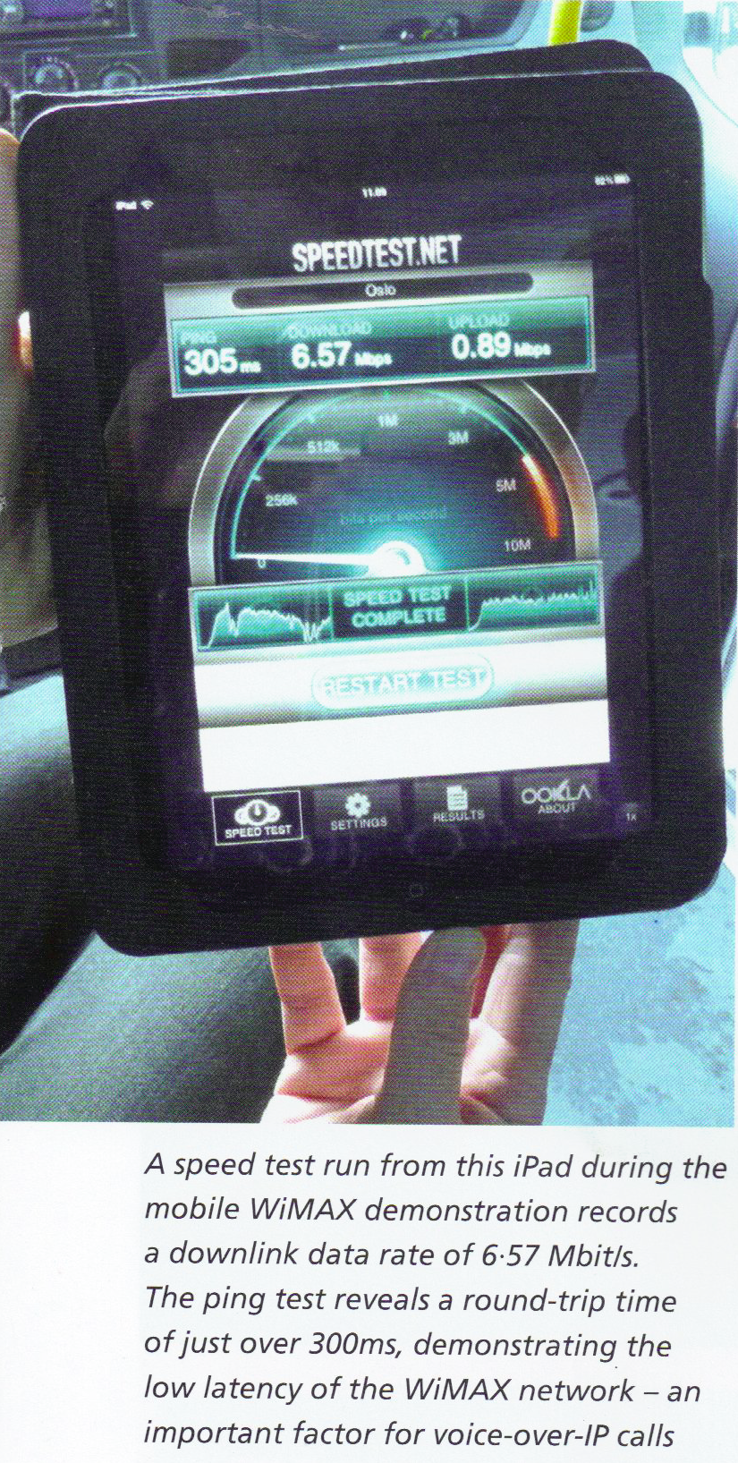
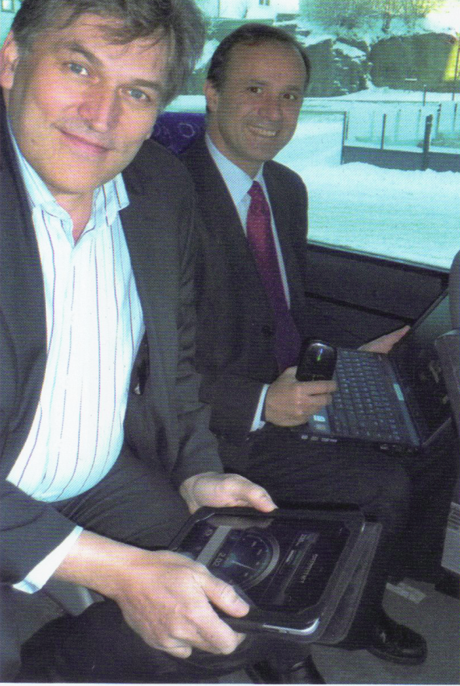
4G NextNet Banzai Network
Story in Land Mobile Magazine

Slide 11
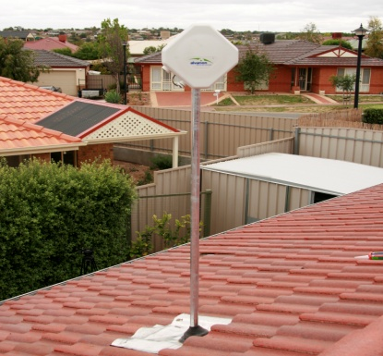
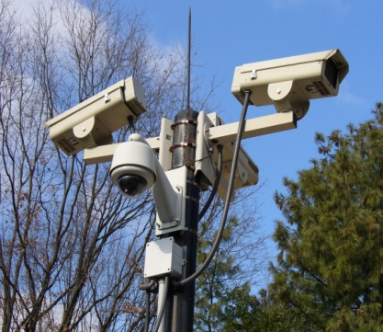
Wireless Broadband Applications Today
Port Security:
Port Botany Expansion Project, Sydney (Australia) Ports
  A CCTV system was deployed 200 meters from Sydney Airport runway, overcoming heavy RF congestion, harsh climatic conditions and obstacles on-the-fly.
Video Surveillance:
Acqui Terme, Italy
  Connecting 130 IP hi-res cameras throughout the city to police HQ, also allowing citizens to have a camera installed to monitor their homes. In return for paying for the camera and expenses, it is integrated into the city’s video surveillance system.
  to provide HQ with real time access to information in the field.

Slide 12

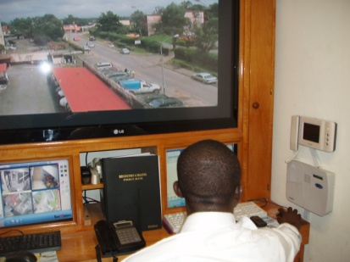
Wireless Broadband Applications Today
Digital Divide:
Aston Pride Network, Birmingham England
  As part of a nationwide government initiative to bring broadband to the most deprived communities, the Aston Pride network was set up in an inner city area in Birmingham where only 15% of local homes own a computer. More than half the homes are expected to be connected by next year, in return for paying a community license and small computing and connectivity fee.
Public Safety:
Communaute de Communes Roissy, Porte de France(CCRPF), France
  CCRPF, has a communal police force overseeing local police in each village. They have deployed a network allowing police to access files in real time and maintain close control and monitoring in each village. This includes a police vehicle with an SU installed to provide HQ with real time access to information in the field.

Slide 13


Wireless Broadband Applications Today
Mining:
Collahuasi Mine, Chile
  Providing WBB for a number of applications in a desolate, remote region of Chile. Examples include: dispatch vehicles, GPS positioning, gathering geological data in real time, video surveillance, monitoring the stability of structures, supporting a remote office and connectivity for people in the field.
Connectivity:
Caldonian MacBayne Hebridian and Clyde Ferries, Scotland
  Network provides WBB voice and data access for ferry terminals and vessels. It also supports ferry-to-shore communications such as: email and Internet communication including info on ticketing, passenger and vehicle details; remote access to real time information about the ferry system, including status of the engine, steering and electrical components; and future WiFi access at terminals for the public.

Slide 14

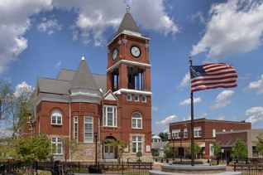




Our 4G Customers Provide Differentiating Services
Bringing affordable high speed internet access and digital phone service to un-served and underserved markets in the southeast US
Broadband wireless services to consumers, businesses, educational, healthcare, and public safety in 15 underserved markets across the USA
Wireless broadband services for residential and business customers across 12 states in midwest and western US
4G services to un-served and underserved customers across 17 states in rural America. Stimulate local development for over 546 rural communities.
Notes:
Nortel Corporate Presentation
© 2007 Nortel
14

Slide 15
Thank You

