Slide 1
Building
an Infrastructure
for
At-Home Agents
Presented by :
www.3clogic.com
Mohita Chawla
Director- Business Development
mchawla@3clogic.com
1-877-462-6021

Slide 2
Agenda
DRIVERS for home- based agents
Identifying the RIGHT MODEL for your needs
DESIGN and IMPLEMENTATION
REPORTING Management and Analytics
CASE STUDY

Slide 3
DRIVERS
for
Home-Based Agents

Slide 4
Story Of “Jack And Jill” With Bill
Hi I am Jill
$ 8- $10 per hour.
Incentives based on performance.
Hey I am Jack
Hi I am Bill
$ 25- $ 35 per hour.
Incentives based on agents performance.
Bill is all about sales and customer satisfaction.
Notes:
Bill -Sales and Customer Care Head

Slide 5
Drivers
Work-Home Balance
Manageability
Improved Productivity
Expanded labor pool
Lower operating costs
Seasonal Campaigns
@ HOME Agents
Personal Computer
Broadband Connect ion
USB HEADSET
Training
Call Center Software
Sitting at home taking/making calls (PRICELEES)
Retention
Flexi Hours
No IT Infrastructure
Profit
Flexibility Scheduling
Lower Telco costs
Notes:
Expanded labor pool – It is easier to recruit and retain skilled agents by providing flexible employment options to those who do not want to commute or relocate.
Lower operating costs - Having agents working from home means a much smaller contact and message center facility is required.
Employee flexibility - Access to a pool of qualified remote workers enables a center to easily add extra agents during a promotion or disaster recovery situation that causes an unexpected call spike. Also, remote workers are typically receptive to non-traditional
hours such as part-time work or split shifts.
Lower telecommunications costs - Routing calls over the IP network can dramatically reduce costs for both inbound and outbound calls.
Improved productivity - Remote workers are generally more productive than on-site workers. A study showed that telecommuting increased employee productivity by 10% with employees typically gaining a full hour a day or even greater productivity gains.
Better agent retention - Work-at-home options help to improve agent retention, reducing training costs (a major expense) and other overhead.

Slide 6
Identifying the
RIGHT MODEL

Slide 7
Premise Model
Signaling
Remote Agent
Data Center
Remote Agent
Media
To/From PSTN
Media
VoIP Network
SIP Server
CRM Portal
and Billing Server
STUN Server
Media Gateways
Telephony Servers
Media
Signaling
COMPLEXITY
COST
SCALABILITY
REMOTE
Contact Center Premises
Multiple servers on Call Center Location
Agents are connected using LAN/Limited connectivity

Slide 8
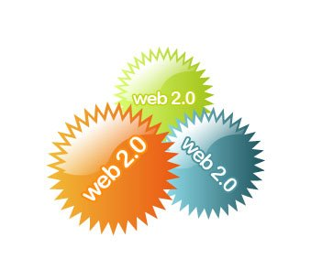
Hosted Model
Headset
PC
Broadband Internet
Distributed services and end points.
Shared applications/services.
Hosted anywhere on network
Standards based interfaces
No Servers on premise
No Media Gateways on premise
Agents can be anywhere including working from home
Supervisors can be anywhere
It Doesn’t Get Any Simpler Than This
Confidential

Slide 9
Implementation Requirement for Hosted Model
Jill
1. PC
2. USB Headset
3. Broadband Connection
Jack
1. PC
2. USB Headset
3. Broadband Connection
4.Web Browser
Bill
1. Web Browser
Time to Implement < 1 day

Slide 10
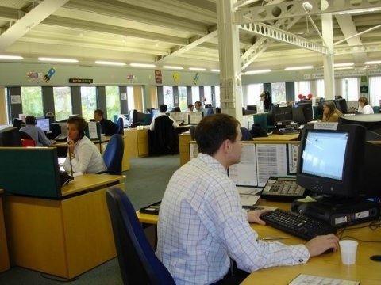
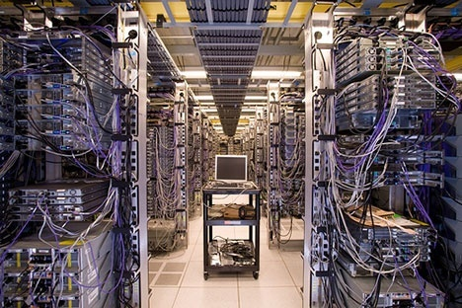
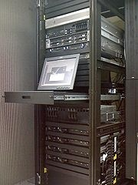
Simplicity in SaaS
Solution moves Telephony Hardware and Switches in call centers to a software as a service (SaaS) model
Contact centers are set up is easy at a fraction of the cost of traditional solutions
Result = Eliminate Call Center Complexity

Slide 11
DESIGN
and
IMPLEMENTATION
For Home-Based Agents

Slide 12
Essentials for Remote Agent Implementation
Network Connectivity
Telecom
Traditional Options – PSTN
Newer Options – SIP Lines
Think outside the box – Skype, Google Voice
Broadband connection
2. Security
Traditional – Firewall
New Option – Protocols, IP Sec VPN Tunneling
3. Call-Handling
Traditional options –PBX, Hard Phone
New Options – Soft phone
Think outside the box – Virtual PBX
4. Reporting Applications
Traditional options –Supervisors at single location
New Options – Supervisors geographically distributed

Slide 13
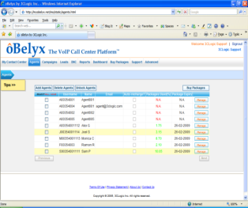
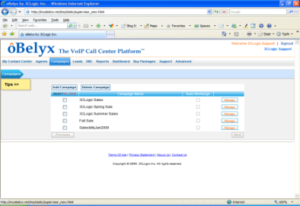
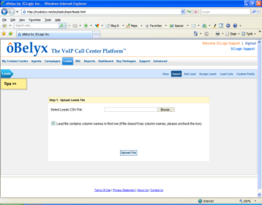
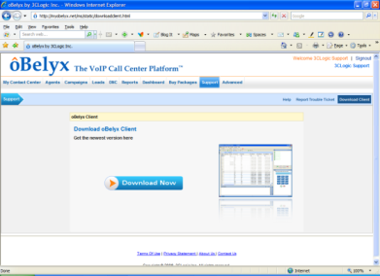
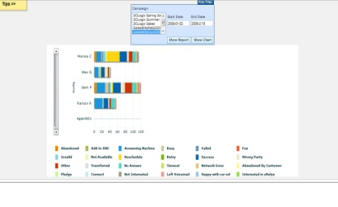
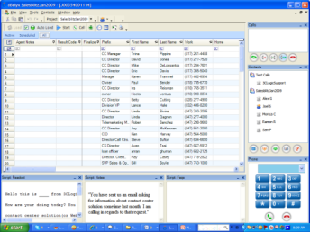
Project Implementation
Initiation and Planning
Defining your resources - Team, Task, Kick off date, VoIP
Managing
Access and Authorization
Coaching
Training
Real time reports
Closeout
Lessons learnt
Duplicate project
AGENT
FUNCTIONS
Add Agents
Define Campaigns or Skills Groups
Upload Leads
Interface with CRM
Download
Client
SUPERVISOR
FUNCTIONS
Start Dialing or Receiving Calls
Management & Reporting

Slide 14
REPORTING
Management And Analytics

Slide 15
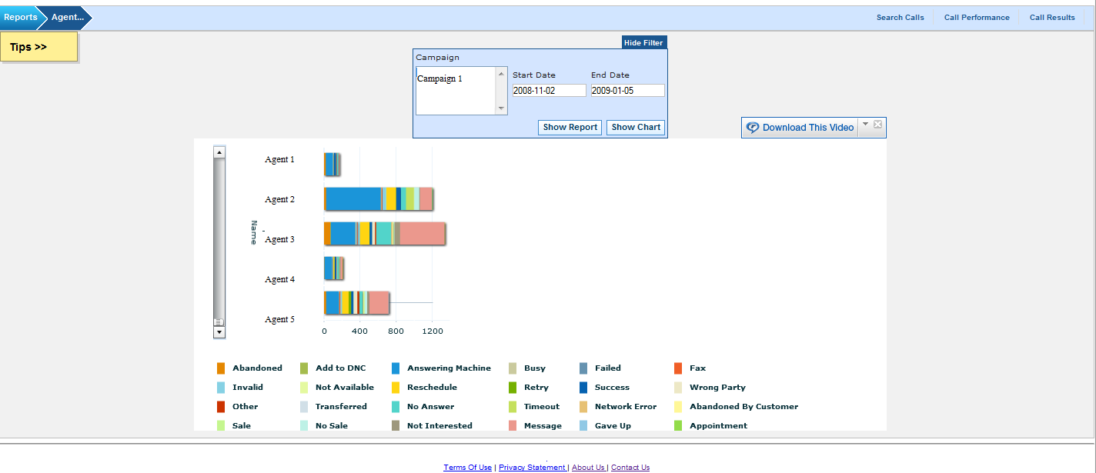
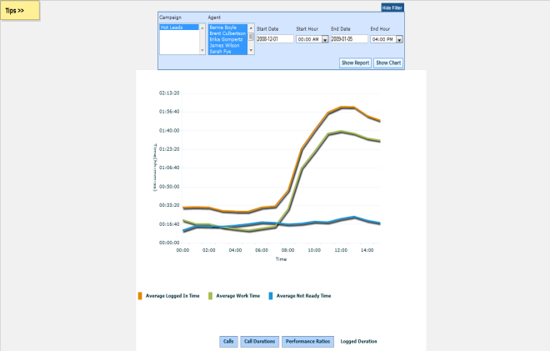
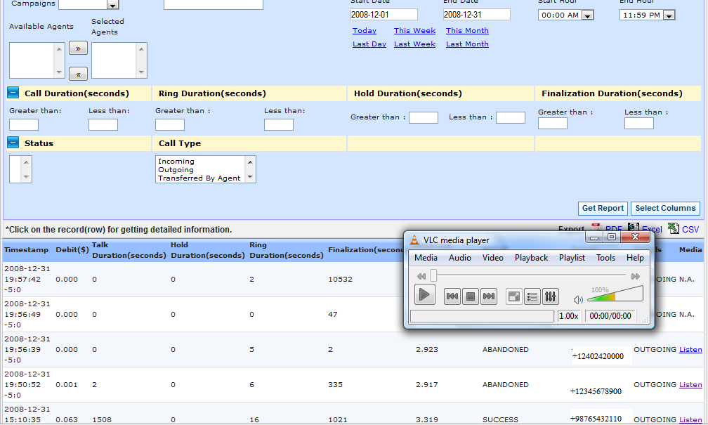
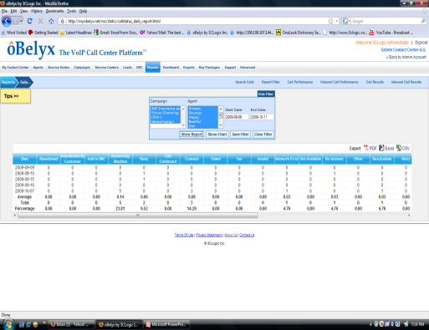
Reporting
REAL TIME ANALYTICS -CALLS,CAMPAIGNS AND AGENTS
HISTORICAL ANALYTICS- RECORDING, EXPORTABLE FILES ON CAMPAIGNS, AGENTS, CDR’s

Slide 16
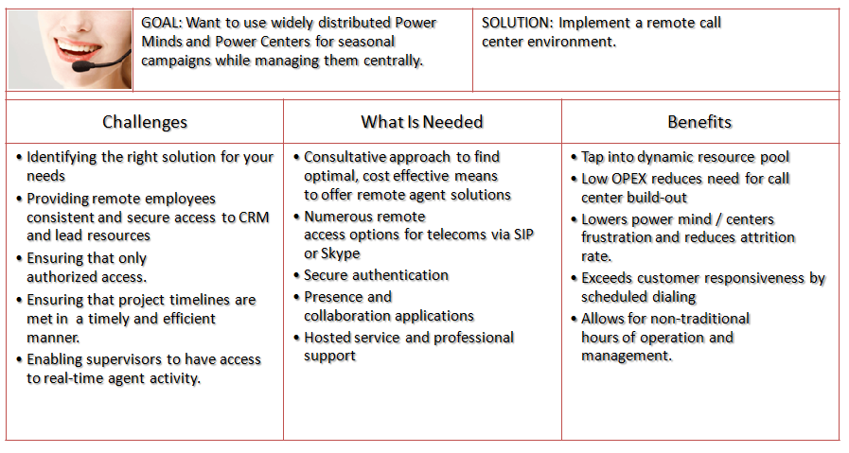
Case Study MRJunction

