Slide 1
The Value Behind Hosted Communications Applications
Tom Dalrymple
Director, Global Voice Services Product Management Verizon Communications

Slide 2
Communications in Today’s Workplace Some Key Challenges
Avoiding communication overload:
Services that work together whether speaking or messaging are a must
Integrating disparate and complex networks:
Achieving compatibility across the enterprise
Controlling communication costs:
Leveraging existing enterprise infrastructure
Managing a mobile customer base and workforce:
Users now demand the control to choose where and how they remain in touch-- as if at their office desk
Keeping the focus on your core business:
Access to key people and information to make quick and effective decisions
Becoming more environmentally conscious:
Balancing corporate social responsibility with energy efficient operations

Slide 3
Its not just about IP Telephony…
With the move of Business Telephony to IP, and common standards (SIP), integrated Communications Applications are seeing a wide adoption.
UC&C is the common term for this, but its not a new concept…demand for integrated telecommunications means has always existed.
Presence/IM/Video/Content Management have grown to become valuable additions to real-time Communications Applications.
The next step is to integrate Communications Applications with Business Applications (governing Business Processes).

Slide 4
Enterprise Drivers To UC&C
Distributed workforce collaboration
Better tools to work across geographically spread teams
Seamless experience for mobile/home workers
Integrated communications tools reduce human latency
More efficient Business Processes
Improved responsiveness to suppliers and customers / Quicker process turn-around time
Employee Satisfaction
Integrated communications tools prevent daily annoyances
Flexibility to work from anywhere
Attractiveness to younger-generation workforce
Tactical Wins
Reduced travel expenditure
Centralization of profile management/provisioning
Cost avoidance for mobile/fixed PSTN minutes

Slide 5
Accepted Cloud Tenets
Tenet | Goal
Financial | 40% lower TCO than buying own solution Low to no upfront investment
Flexibility | Easy to enter / exit arrangement
Functionality | Same or better than traditional solutions
Speed | Able to rapidly increase / decrease usage

Slide 6
The Drivers for a Network Based Hosted Solution.
HQ
Customers
Manufacturing
Data Centers
Call Centers
Suppliers
Partners
Complex Business Networks Evolve
Cloud Enabled Ecosystems
Accessing Information Anytime Anywhere
Reduces capital expenditure and customer risk
Shifts the technology risk to the service provider
Mergers / acquisitions / rightsizing flexibility
Focuses resources on managing the business versus the technology
Favorable TCO compared to dedicated/premised based

Slide 7
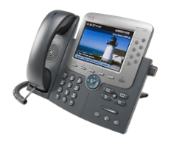
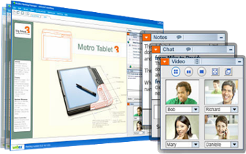
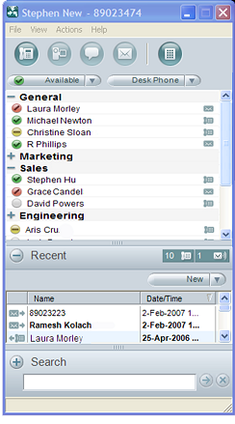
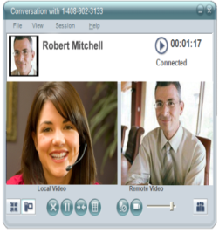
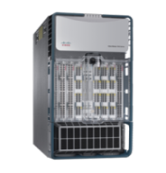
Advantages and Expertise of a Network Service Provider
Standard Global IP Network to facilitate integration and guarantee Quality
Enable collaboration between wireless and wireline based tools for remote workforce
Wireless
IP Telephony and Video
Conferencing
Global
IP Network Cloud
Provide Global Reach to on-line conferencing tools to reduces travel between sites
Partner certification to guarantee interoperability
Telepresence
Virtual workspace & Presence management via unified face integrated into hybrid environments
Professional Services expertise to enable integration
Global Expertise
Unified PC Clients
Ease Integration of Various Collaboration Tools Into a Unified Architecture
Any Device, Any Application, Anywhere

Slide 8
Communications Applications Portfolio … Interoperability
IP Integrated Access
IP Trunking
IP PBX connectivity
PBX or Key system connectivity
Ideal for small/medium locations
Use with IP PBX
True converged on-net and off-net voice access over a single IP connection
Hosted IP Centrex
IP Communications
Hosted IP PBX
Network-based IP PBX features
OPEX based financial model
Reduced up front investments and control costs
Flexible end-user scalability
Fully managed hosted IP PBX/UC
Focus resources on dedicated strategic business initiatives
Full Life Cycle Management:
Plan Operate
Install Maintain
Large Enterprises Require Flexibility and Full Solution Integration to Suite all Sites Configurations & Migrate at Their Own Pace

Slide 9
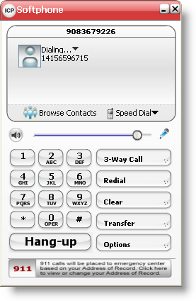
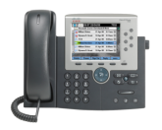
Hosted IP Centrex From Business Telephony….
Features and Functionality
Full featured Network Based IPPBX
Feature rich IP phones
Leverage Verizon Business VoIP network
Flat rate local and LD w/Metered International
Supports SIP and legacy phones
Remote Office/Find Me Follow Me
Telework and Mobility Packages
Collaboration Features
Address Book and Calendaring
Message Center
VM Delivery to Email
Key Centrex Migration Features
Coordinated Dialing w/TDM Centrex
Integration with premise based VM
Enhanced IP Features
PC Client
Call Blast
Remote Office
Outlook® Integration
9

Slide 10
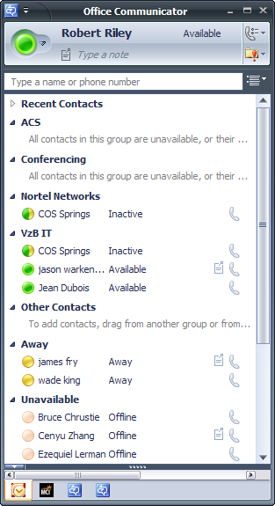
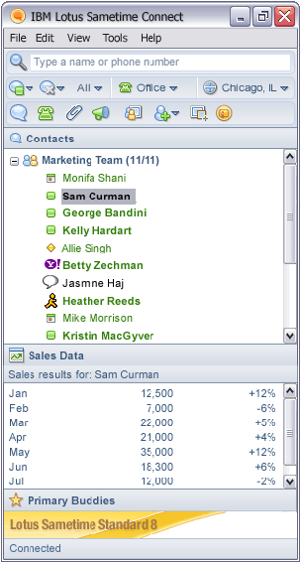
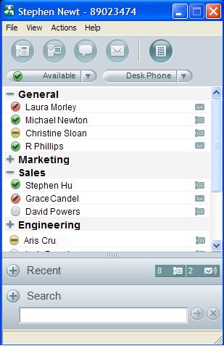
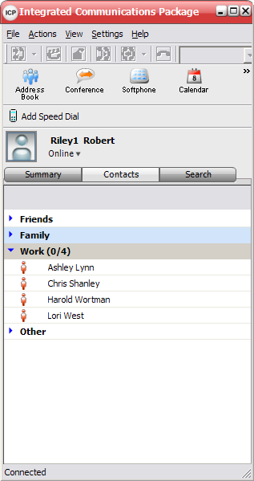
…to Hosted UC Integrating Hosted IP Centrex with Third Party Desktop Interfaces
Microsoft | IBM | IPPBX vendors | Verizon Business
 |  |  | Or choose Verizon’s own desktop UC client for a wholly cloud based Communication Application model
Office Communicator | Lotus Sametime |  | Integrated Communications Package
10

Slide 11
IP Trunking Drives Operational Efficiencies and Helps Control Costs
Operational Efficiencies | Control Costs
Manage all local services from a central site Focus in-house resources on key business issues vs. vendor management Assign local telephone numbers to any “virtual location” Reduce need for separate PSTN connections at remote sites Simplify administration with network-based private dial plan | Leverage VoIP technology to create operational efficiencies Migrate at your own pace Consolidate services and contracts for remote sites Avoid new outlays in costly equipment and capitalize on initial investments Network based resiliency and call failover at all times, to anywhere.
An efficient and cost-effective IP interface from your IP PBX to the PSTN

Slide 12
Converged VoIP Drives Cost Savings Burstable Enterprise Shared Trunks - BEST
Allows you to share local and long distance trunk capacity across your enterprise
Often reduces the total number of lines required at each site and across the enterprise
Gives enterprises with a decentralized network design the look/feel and efficiency benefits of a centralized model
Allows you to share trunk capacity country boundaries and across services:
A Hosted IP Centrex site in U.K.
IP Integrated Access site in Germany
IP Trunking site in France
Can all contribute to the BEST concurrent call pool
Leverage excess capacity across the enterprise
Powers your business with VoIP around the globe
Notes:
12
Verizon Business recently introduced a new feature – Burstable Enterprise Shared Trunks (BEST). With this enhancement, customers share voice call capacity across their enterprise rather than purchase a fixed capacity at each location. Some of the benefits to your business include
Leverage idle capacity at other locations and benefit from time of day differences to fully utilize spare capacity.
Compared to a standard TDM environment, BEST helps reduce the number of lines required at each site to meet peak hour requirements.
With BEST, a location can quickly increase capacity provided that Enterprise VoIP capacity and sufficient bandwidth are available. This enables you to centralize your Local and LD traffic requirements.
Additionally, BEST helps you leverage trunk utilization across the enterprise which is not feasible in the TDM environment due to its physically defined connections

Slide 13
Hosted Communications Applications
Any Device
Multi-media
Users access and personalize the same service from all their devices – one experience
The End User Experience
HD Voice, Video, Voice, Feature Control, File Share, Messaging, Presence, Click to Call
Mobility
One Number, Seamless FMC, Access to all Business Applications and content
.

Slide 14
Bringing It All Together
Prescriptive Solutions
Strategic Consulting
Translates business needs and requirements to solutions Profile users, business process enhancements and re-engineering Audit, assess and functional testing Technology upgrade strategies
Financial analysis
Business benefit analysis – ROI and TCO Capacity assessments to minimize capital expense
Operational Integration
Design and platform integration Implementation and migration Manage and project implementation timeframes, commitments, and costs Analytics and reporting
Your Questions
What is the right solution for me?
Where should I start?
What foundation should I implement?
How can I cost justify it?
How do I leverage my investment?
Notes:
14

Slide 15
Verizon’s Hosted Communications Applications
IP Contact Center
Advanced Voice
Hosted Unified Communications
Conferencing
IP Toll Free
IP Centrex
IP Trunking
IP Conferencing
SIP
Services
VILO
Hosted IPPBX
IP Integrated Access
IP IVR
Microsoft OCS
15
Networking/Access Solutions
Public IP (IDA)
Private (Private IP)
Global IP Networks
Global IP Network

Slide 16
Verizon Business Extensive Experience
2001  Verizon Business (MCI) starts hosted VoIP trials
2007 Best in class on overall VoIP strategy “…leads … on VoIP reliability, scalability, and sales capabilities” - Forrester WaveTM: U.S. Enterprise-Class VoIP Services, Q1 2007
2002  Introduced first commercial hosted VoIP
 Product of the Year (Internet Telephony Magazine)
2003  Product of the Year from Network Magazine
2005  Network capacity (1.5B minute)
 Innovation Award for Most Influential Technology in Data Services (VoIP over Private IP) Network Magazine
Verizon IP Trunking - 2007 Product of the Year For excellence in the advancement of VoIP communications - Technology Marketing Corporation
Hosted Interactive Voice Response and North American Hosted Contact Center Market Leader
2006 Network capacity (5B minute)
North American Enterprise VoIP Services Customer Value Enhancement Award
Editor’s Choice Excellence Award for Exceptional VoIP and IP Solutions
2009 Tops Infonetics Research’s Business VoIP Services Leadership Matrix
Notes:
VoIP Migration and the implementation of an IP Communications strategy is a process that few companies can do alone while still running their business. Working with an industry leader can help speed the migration process by providing an experienced team of professionals and access to a comprehensive set of solutions.
Verizon Business brings a vendor agnostic approach to convergence,
We’ve implemented converged voice and data solutions for a variety of customers, including financial services, retail, and government customers.
We’ve been recognized by a number of third parties for its ability to deliver and support voice and data solutions, including Internet Telephony and Frost and Sullivan.
And importantly, Verizon Business is a full service provider of IP Communications solutions, with dedicated teams that start at the design and assessment phase and work all the way thru ongoing support.

